Slide 1
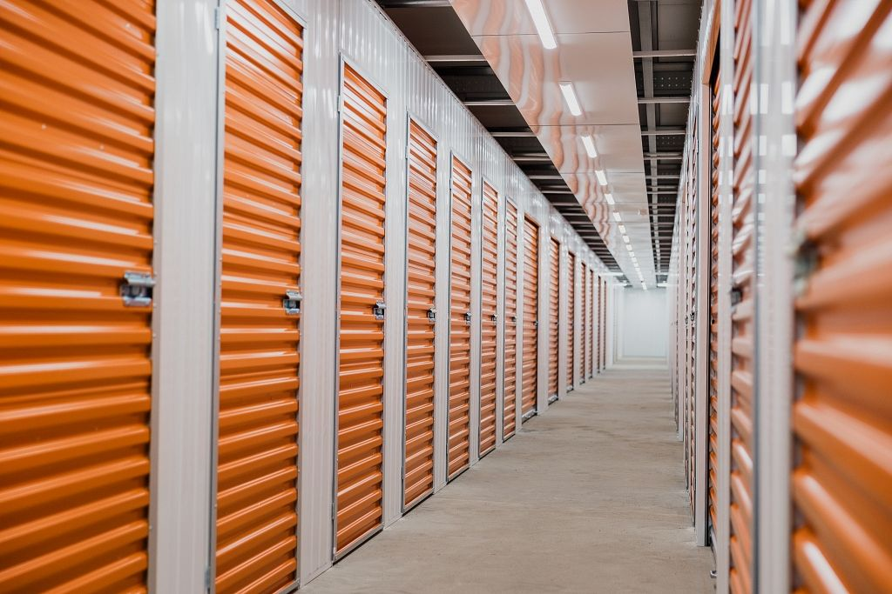



Building self storage for the future
Ollie Saunders – Savills Self Storage
Prepared for
10 June 2025
OPERATIONAL CAPITAL MARKETS

Slide 2
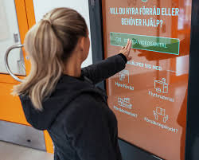
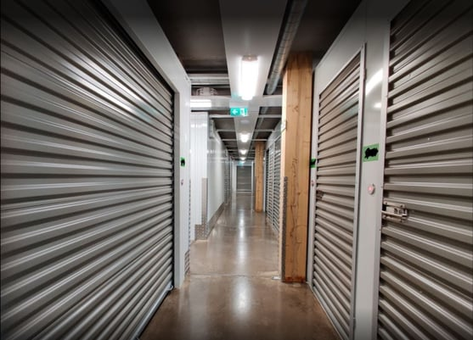
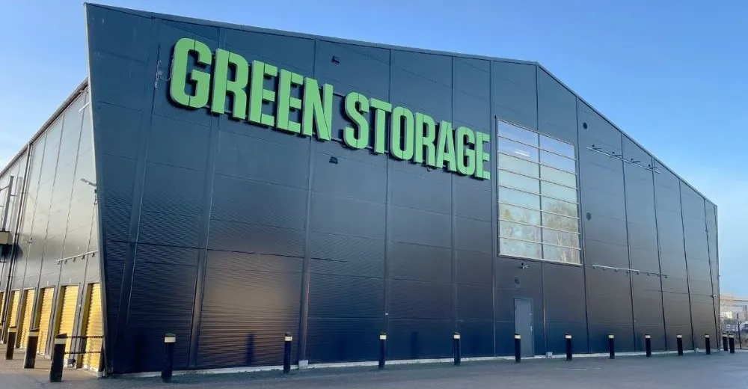
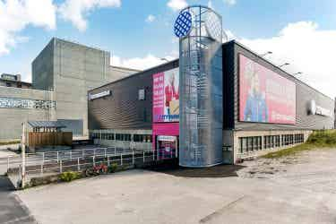
The impact of the Nordics

Slide 3
Dividers
1
The size of the industry and its growth
6

Slide 4
European Growth over the last 12 years
A market which has grown by 5.5 times or 15% CAGR

Slide 5
Nordic Growth over the last 12 years
A market that consistently represents c 10% of the European market and has grown 4.5 times

Slide 6
Dividers
2
The drivers of future growth
6

Slide 7
An urbanised population
The Nordics has some of the highest lived density in Europe

Slide 8
Population Development

Slide 9
Residential Rents are rising in the Nordics
Following similar patterns across Europe

Slide 10
Residential Rents are rising
The rental growth was significant during 2023 and 2024 compared to the average of past years.

Slide 11
Residential Construction is struggling
Construction initiations of multi-unit buildings in 2024 was down 20% compared to the 2023 and down 30% to 2022.
Q3 2024 initiations were at the lowest level of any quarter since Q3 2003.
As both financing and construction costs have increased, investors are struggling to pay more than the replacement costs for newly built residential projects, leading to delayed construction starts, and consequentially, distressed developers.
Bankruptcies among construction companies in 2024 increased by 61% compared to 2022.

Slide 12
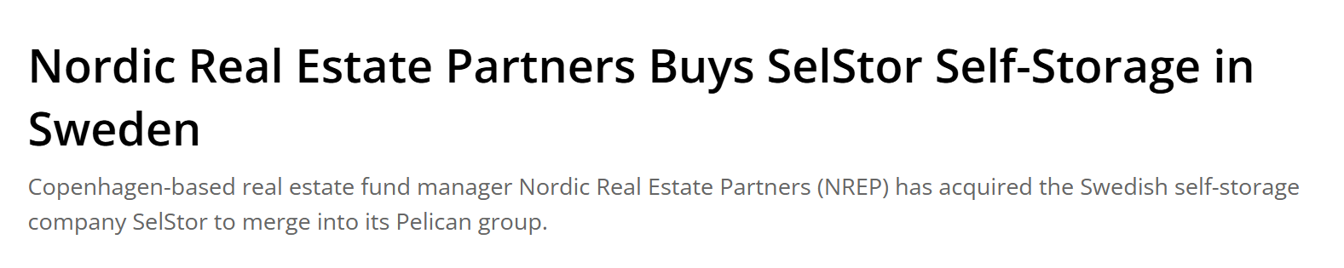

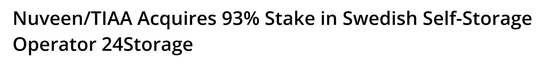
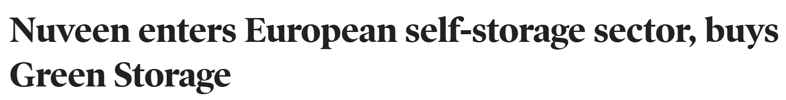
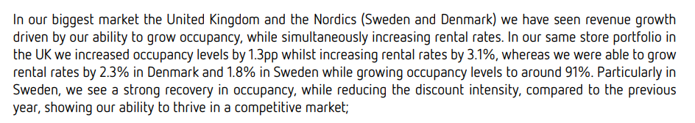
A market with scaled portfolios, market liquidity and a history of institutional investment

Slide 13
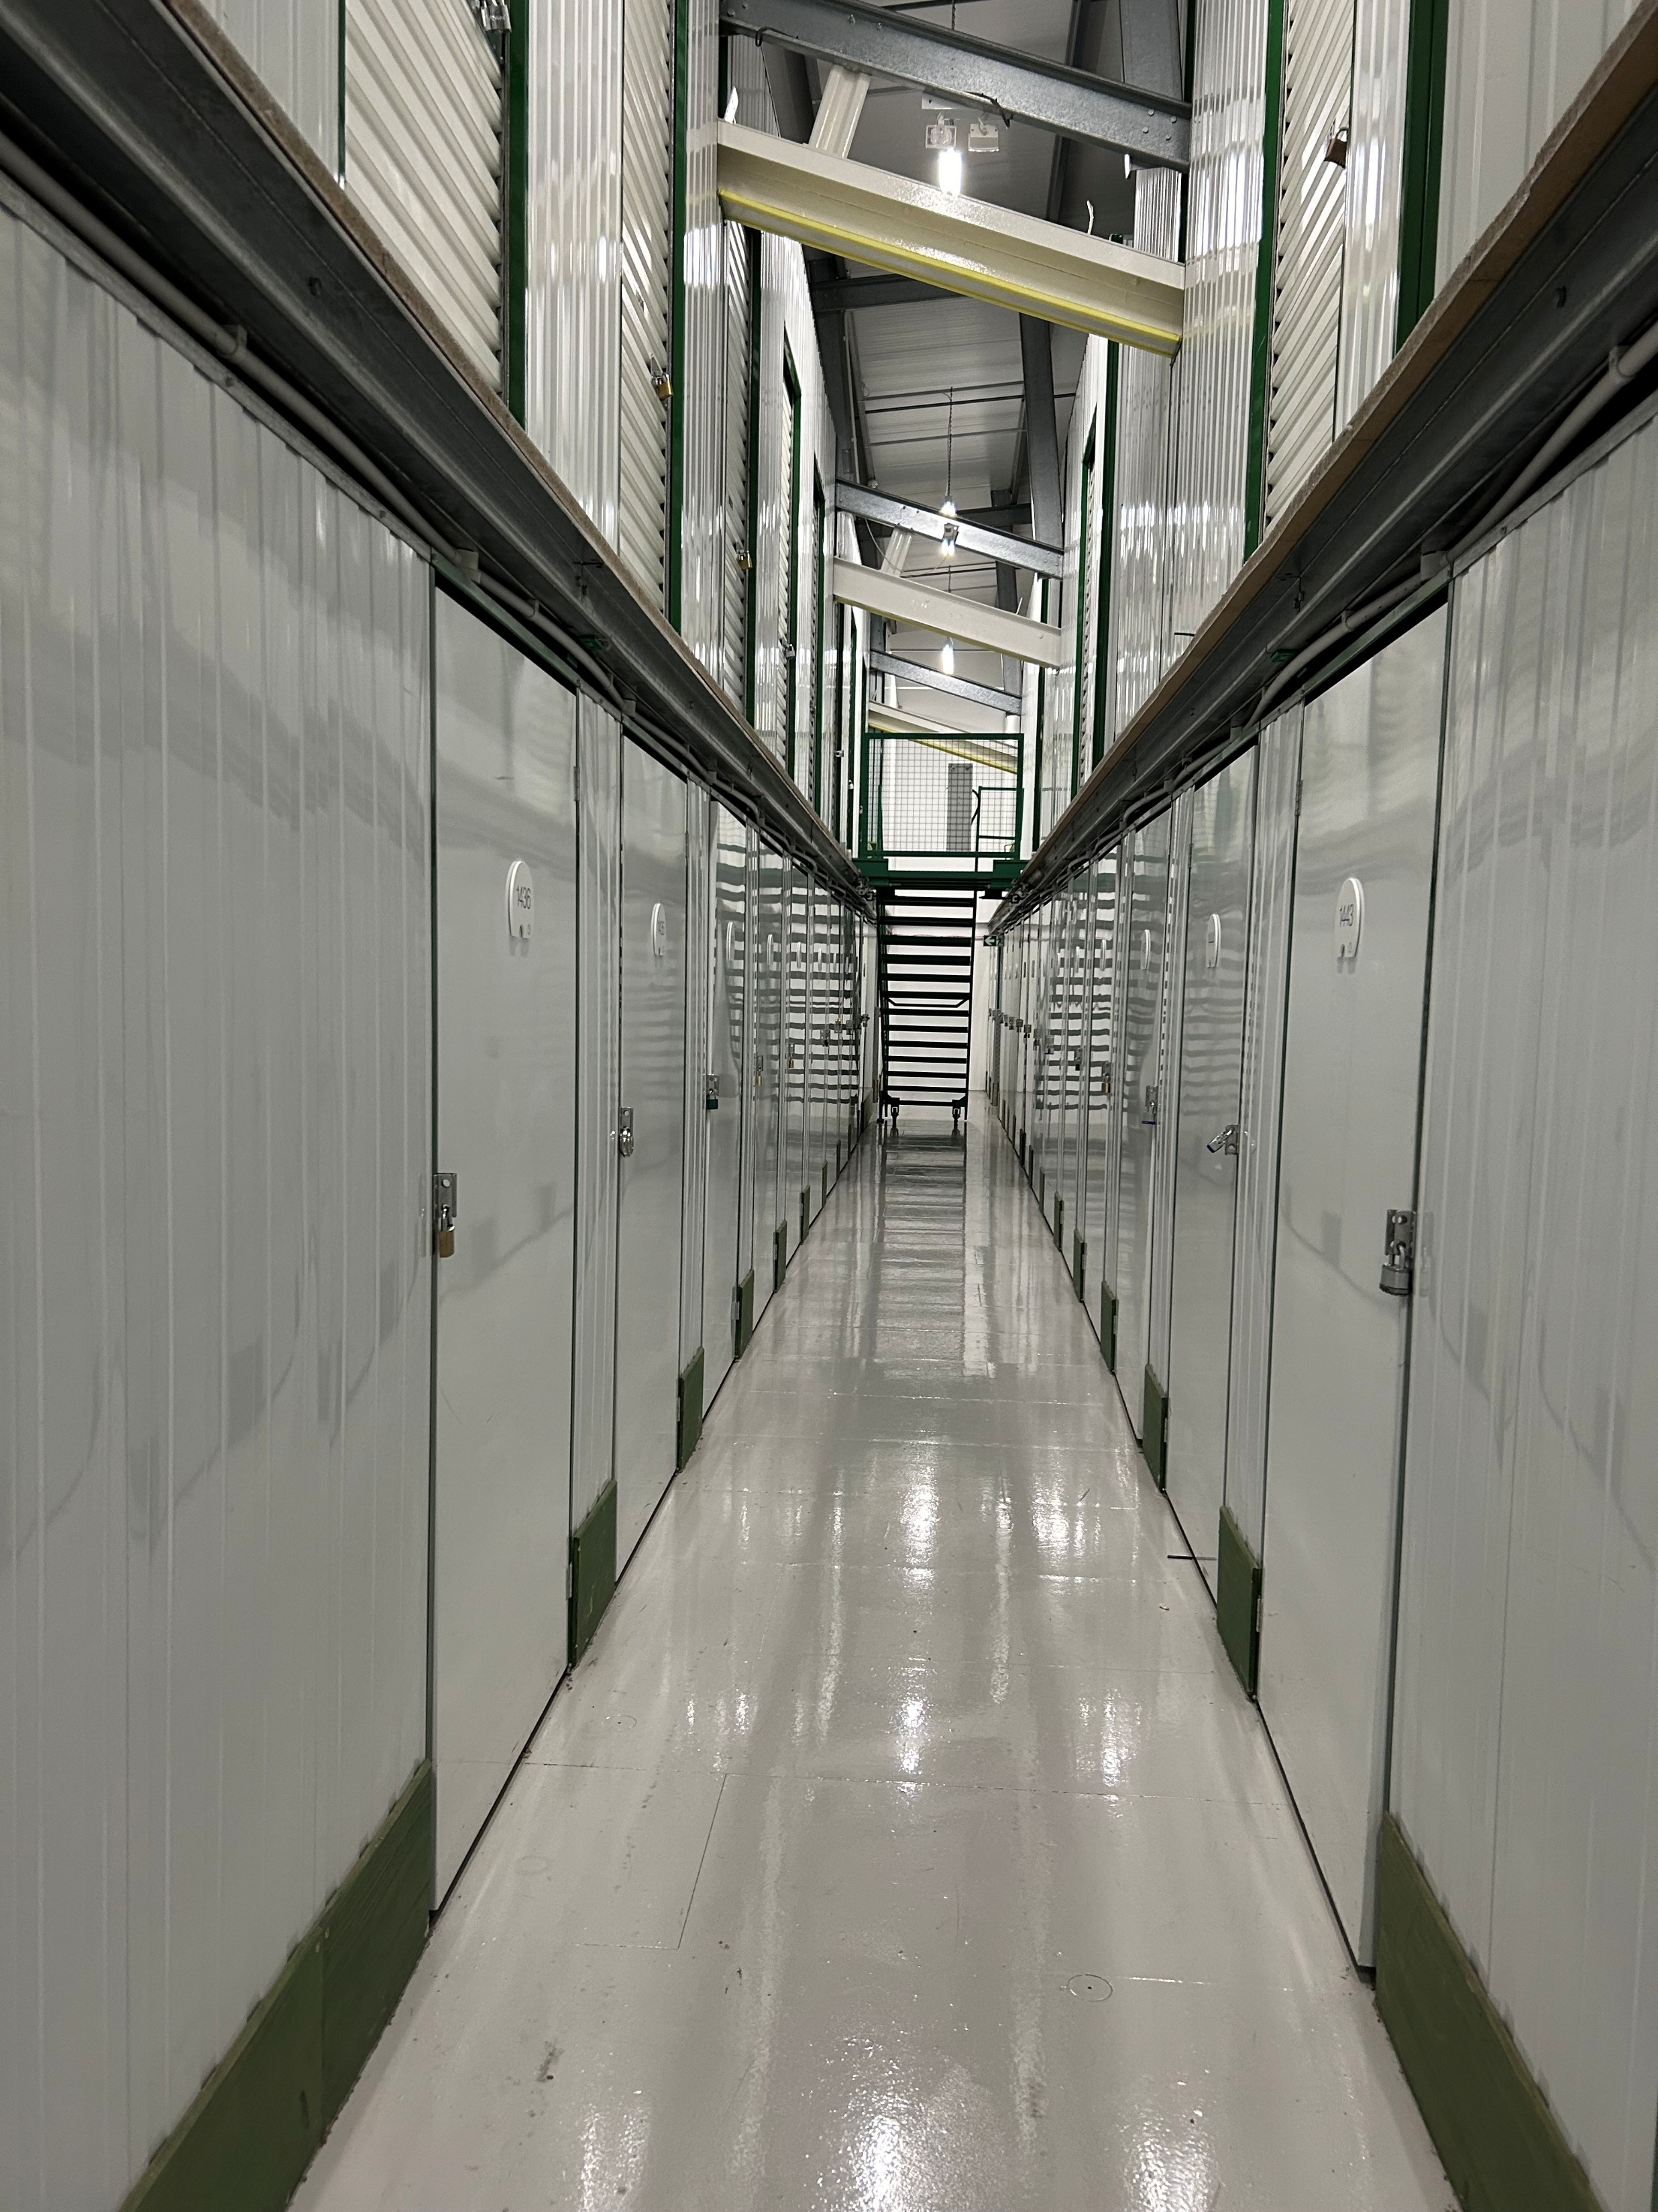
Savills Self Storage Score : From National Macro to Micro Location
A systematic approach to assessing the market demand for a given level of supply in a local market
  GDP
  Income Levels
  Residential Rents
  Proportion of People Living in Small Accommodation
  Population density
  Demographic Profile
  Number of small businesses with inventory
  Industrial Availability and Rents
  Proportion of Population who move house (both rental and sale)
  Relative to accurate floor area statistics

Slide 14
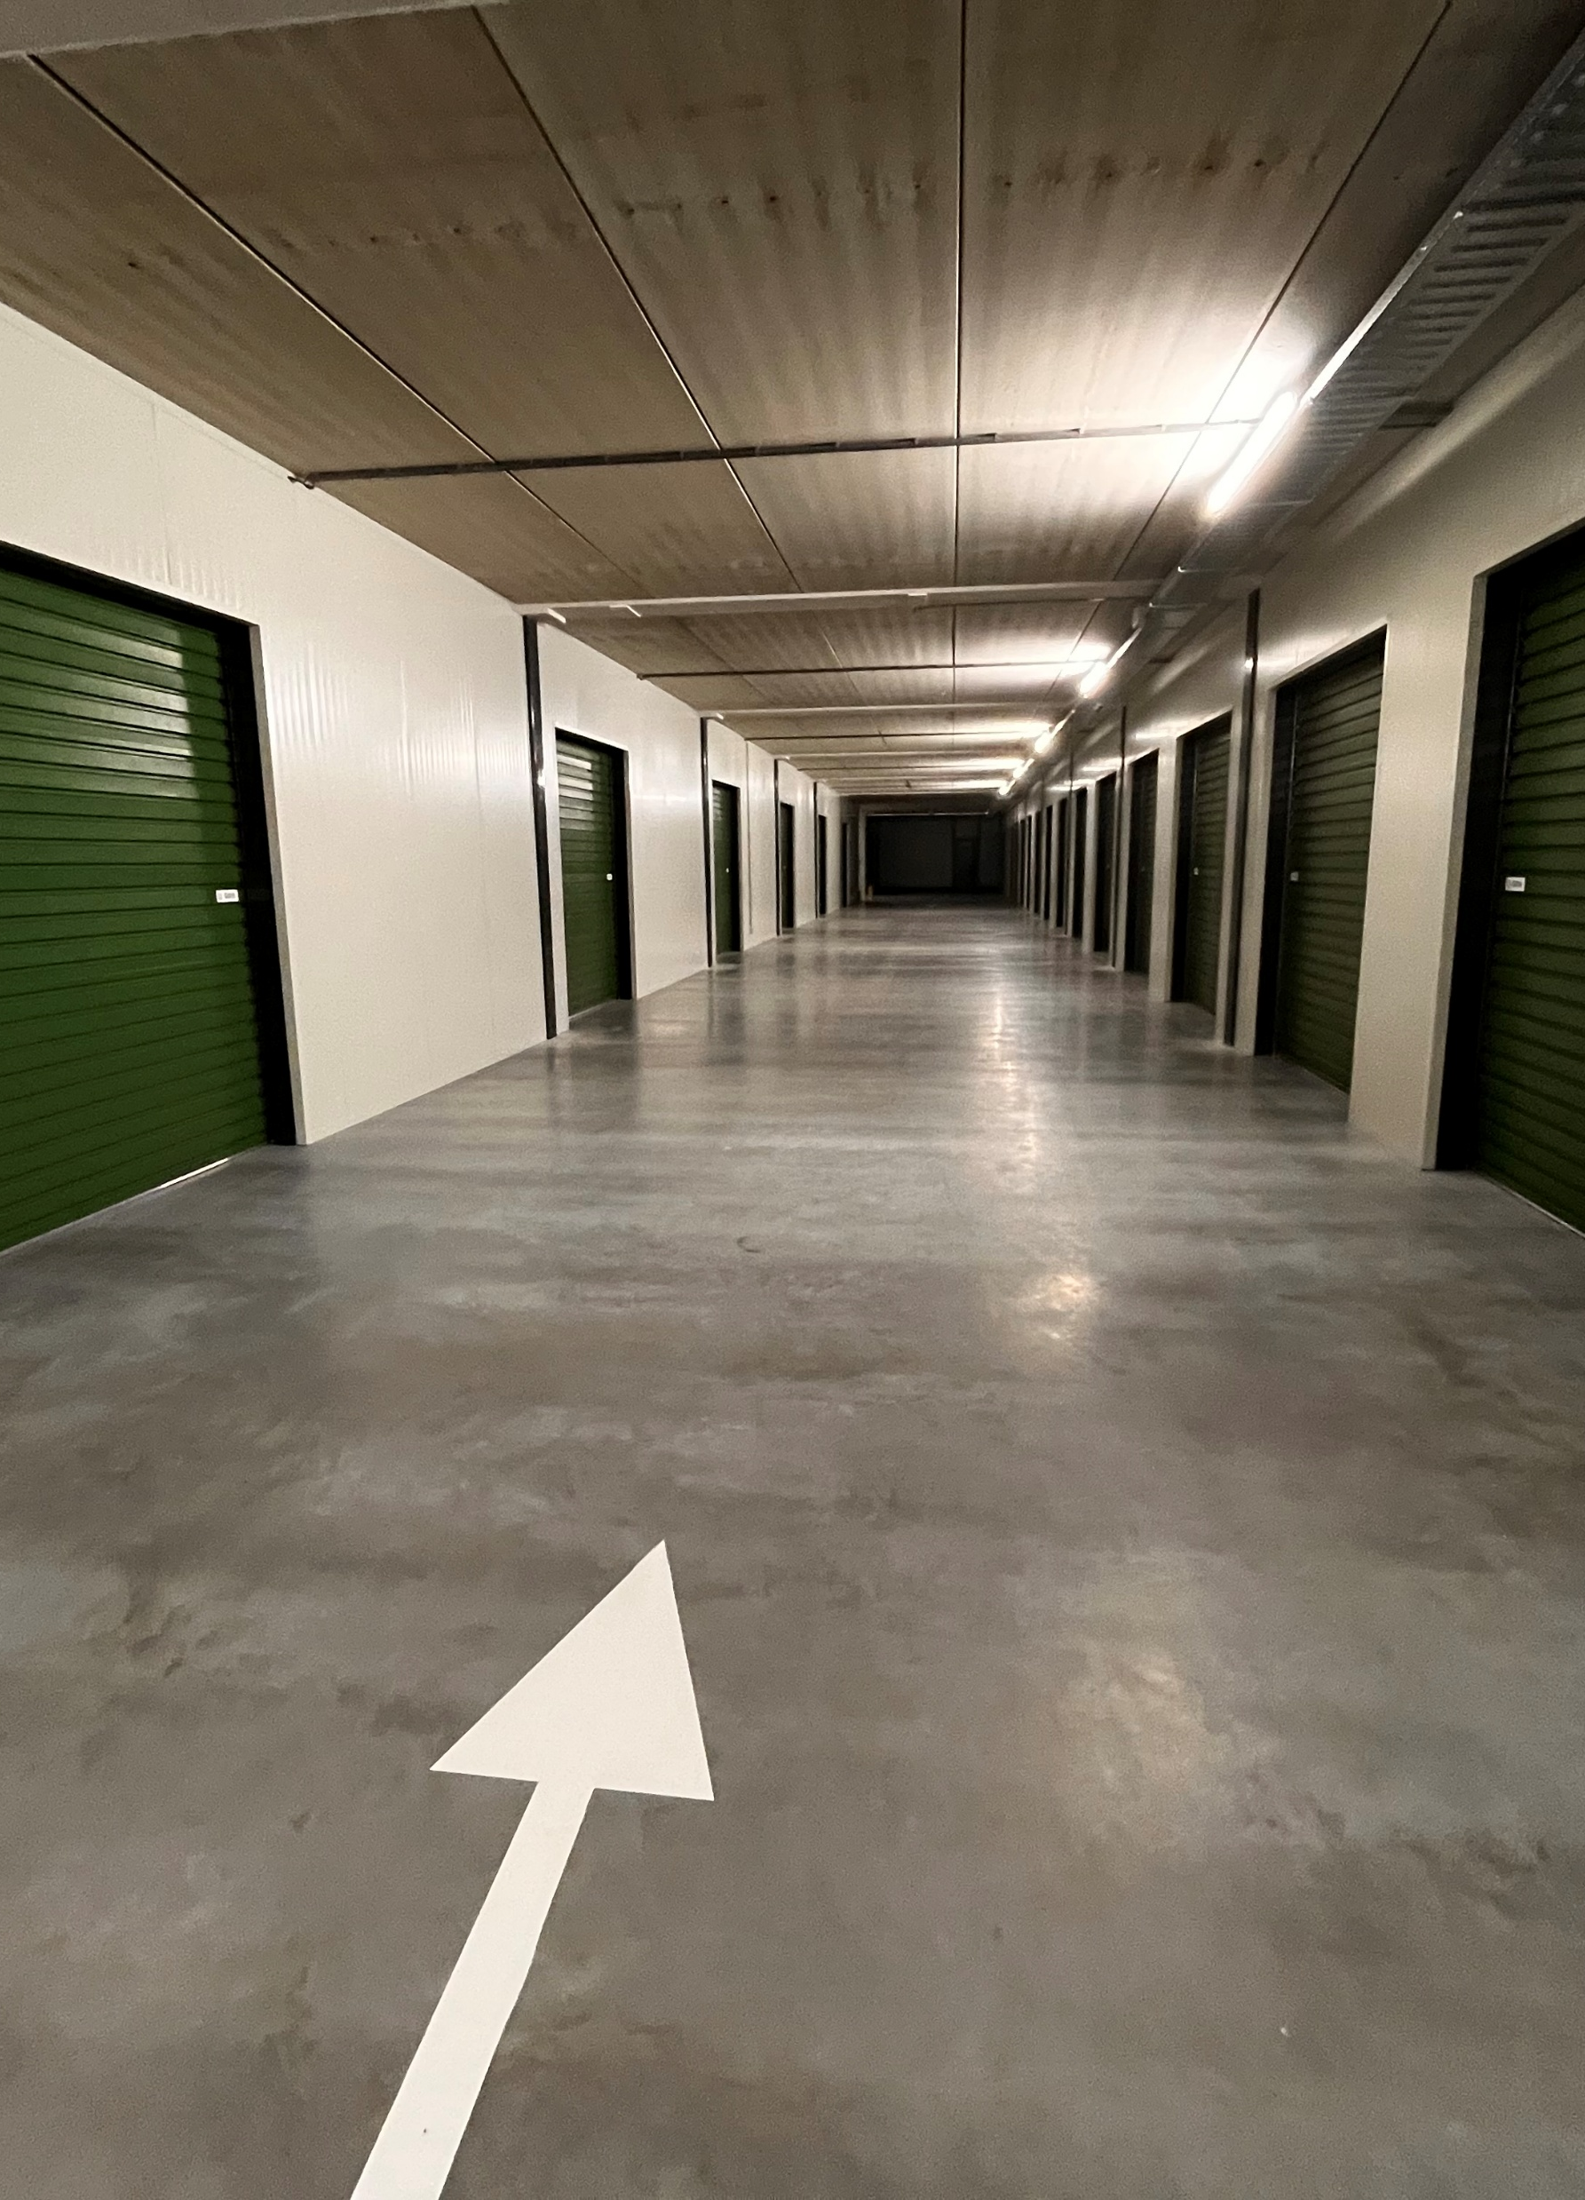
Dividers
3
Differentiation in a maturing sector as a key to value creation
6

Slide 15
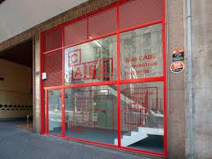
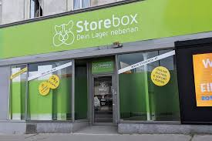
Metro Self Storage
Centrally managed serving their immediate catchment area – typically within a 5 minute walk time in areas of high urban density with stores of between 1,000 sq ft to 5,000 sq ft

Slide 16
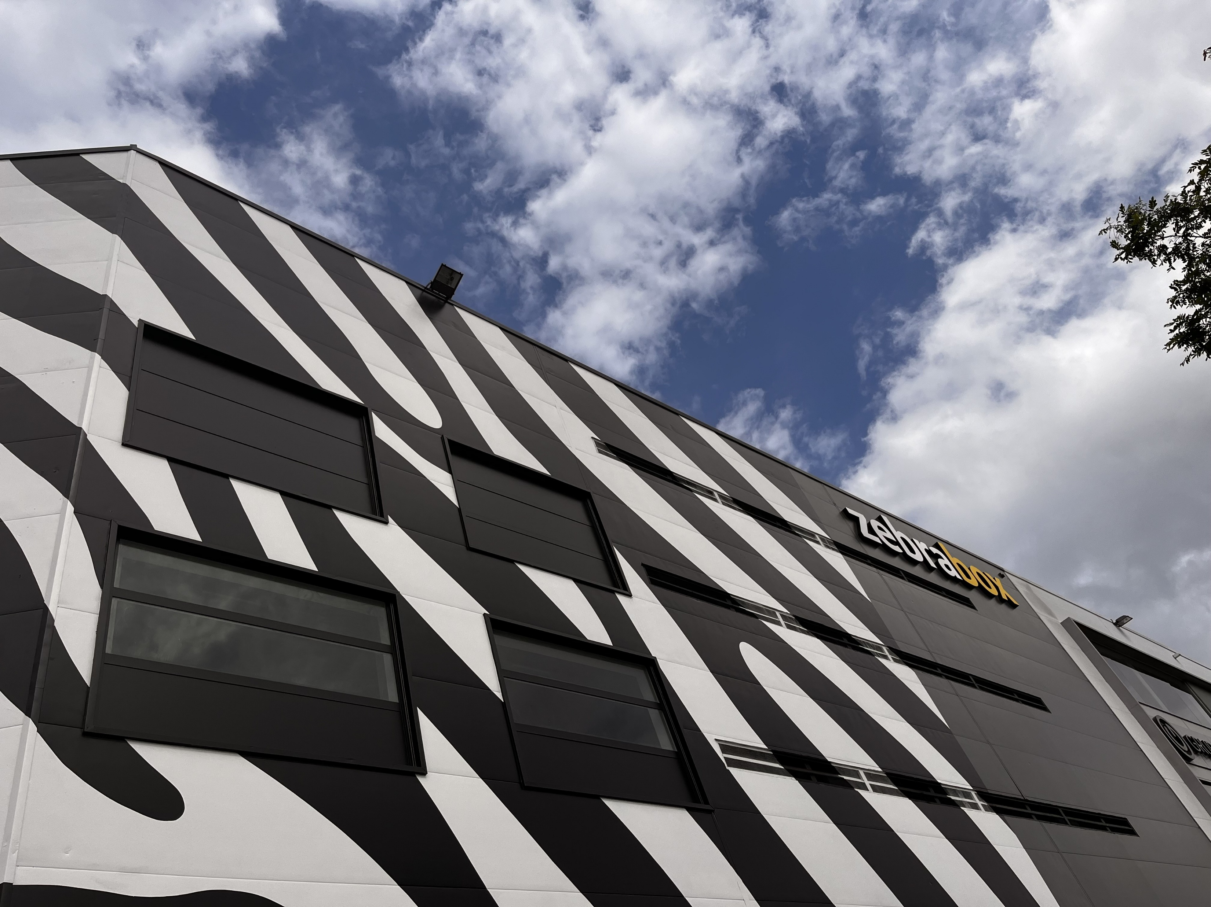
Urban Self Storage
Smaller self storage facilities of under 20,000 sq ft with low levels of staffing – sometimes acting as a hub to metro spokes – and inflling major stores – or in smaller market towns

Slide 17

Moving towards bringing self storage expertise to the B2B market

Slide 18
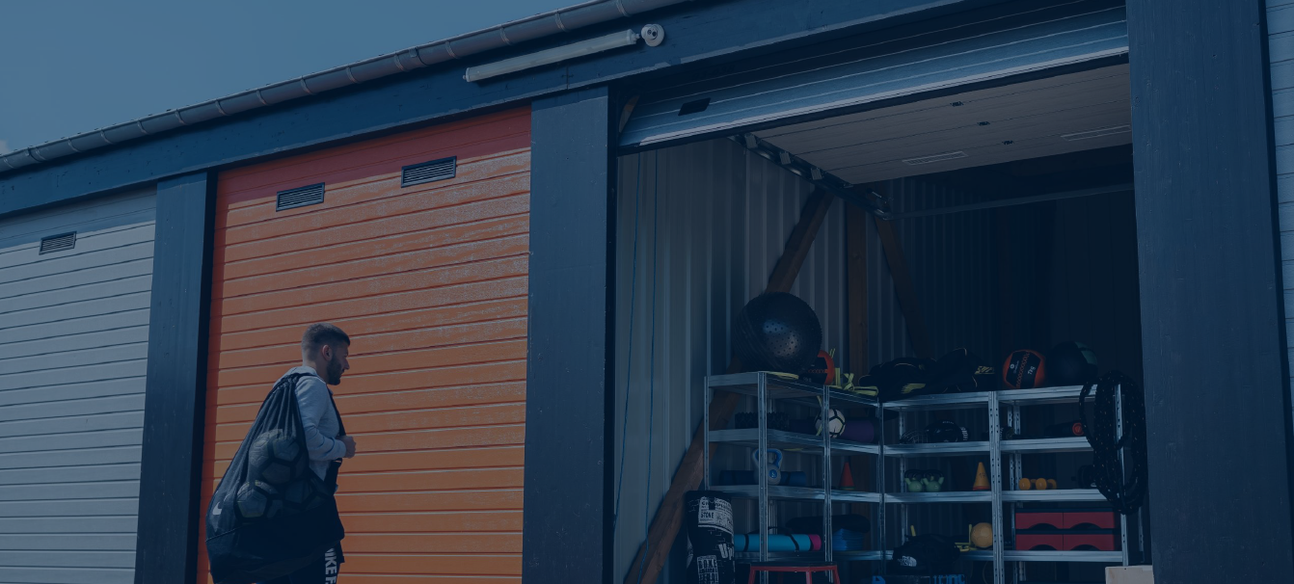
Drive Up Self Storage
Modern drive up facilities with a high quality user experience

Slide 19
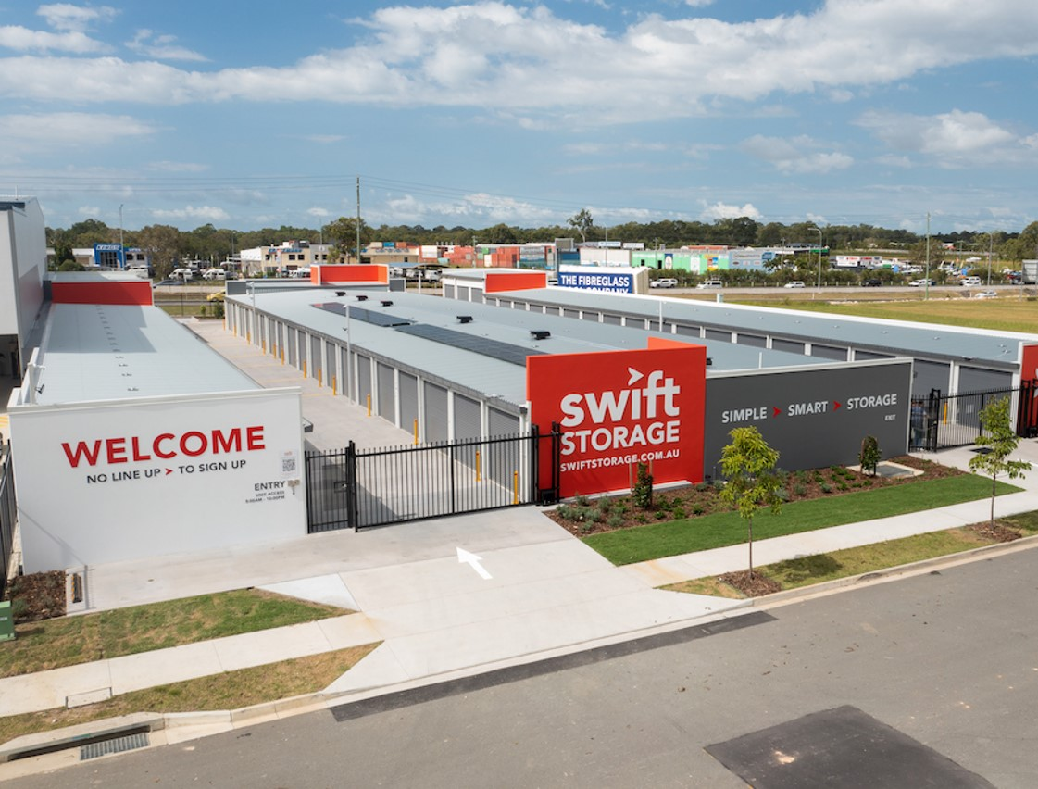
Drive Up Self Storage
Modern drive up facilities with a high-quality user experience

Slide 20
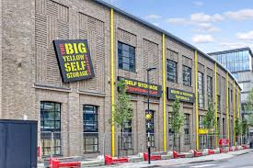

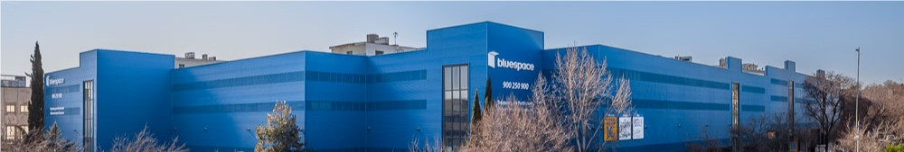
The mega store
Long term creators of value with stores of > 100k sq ft but the micro-location factors are essential for such significant deployment of capital.

Slide 21
Dividers
4
Building investments
6

Slide 22
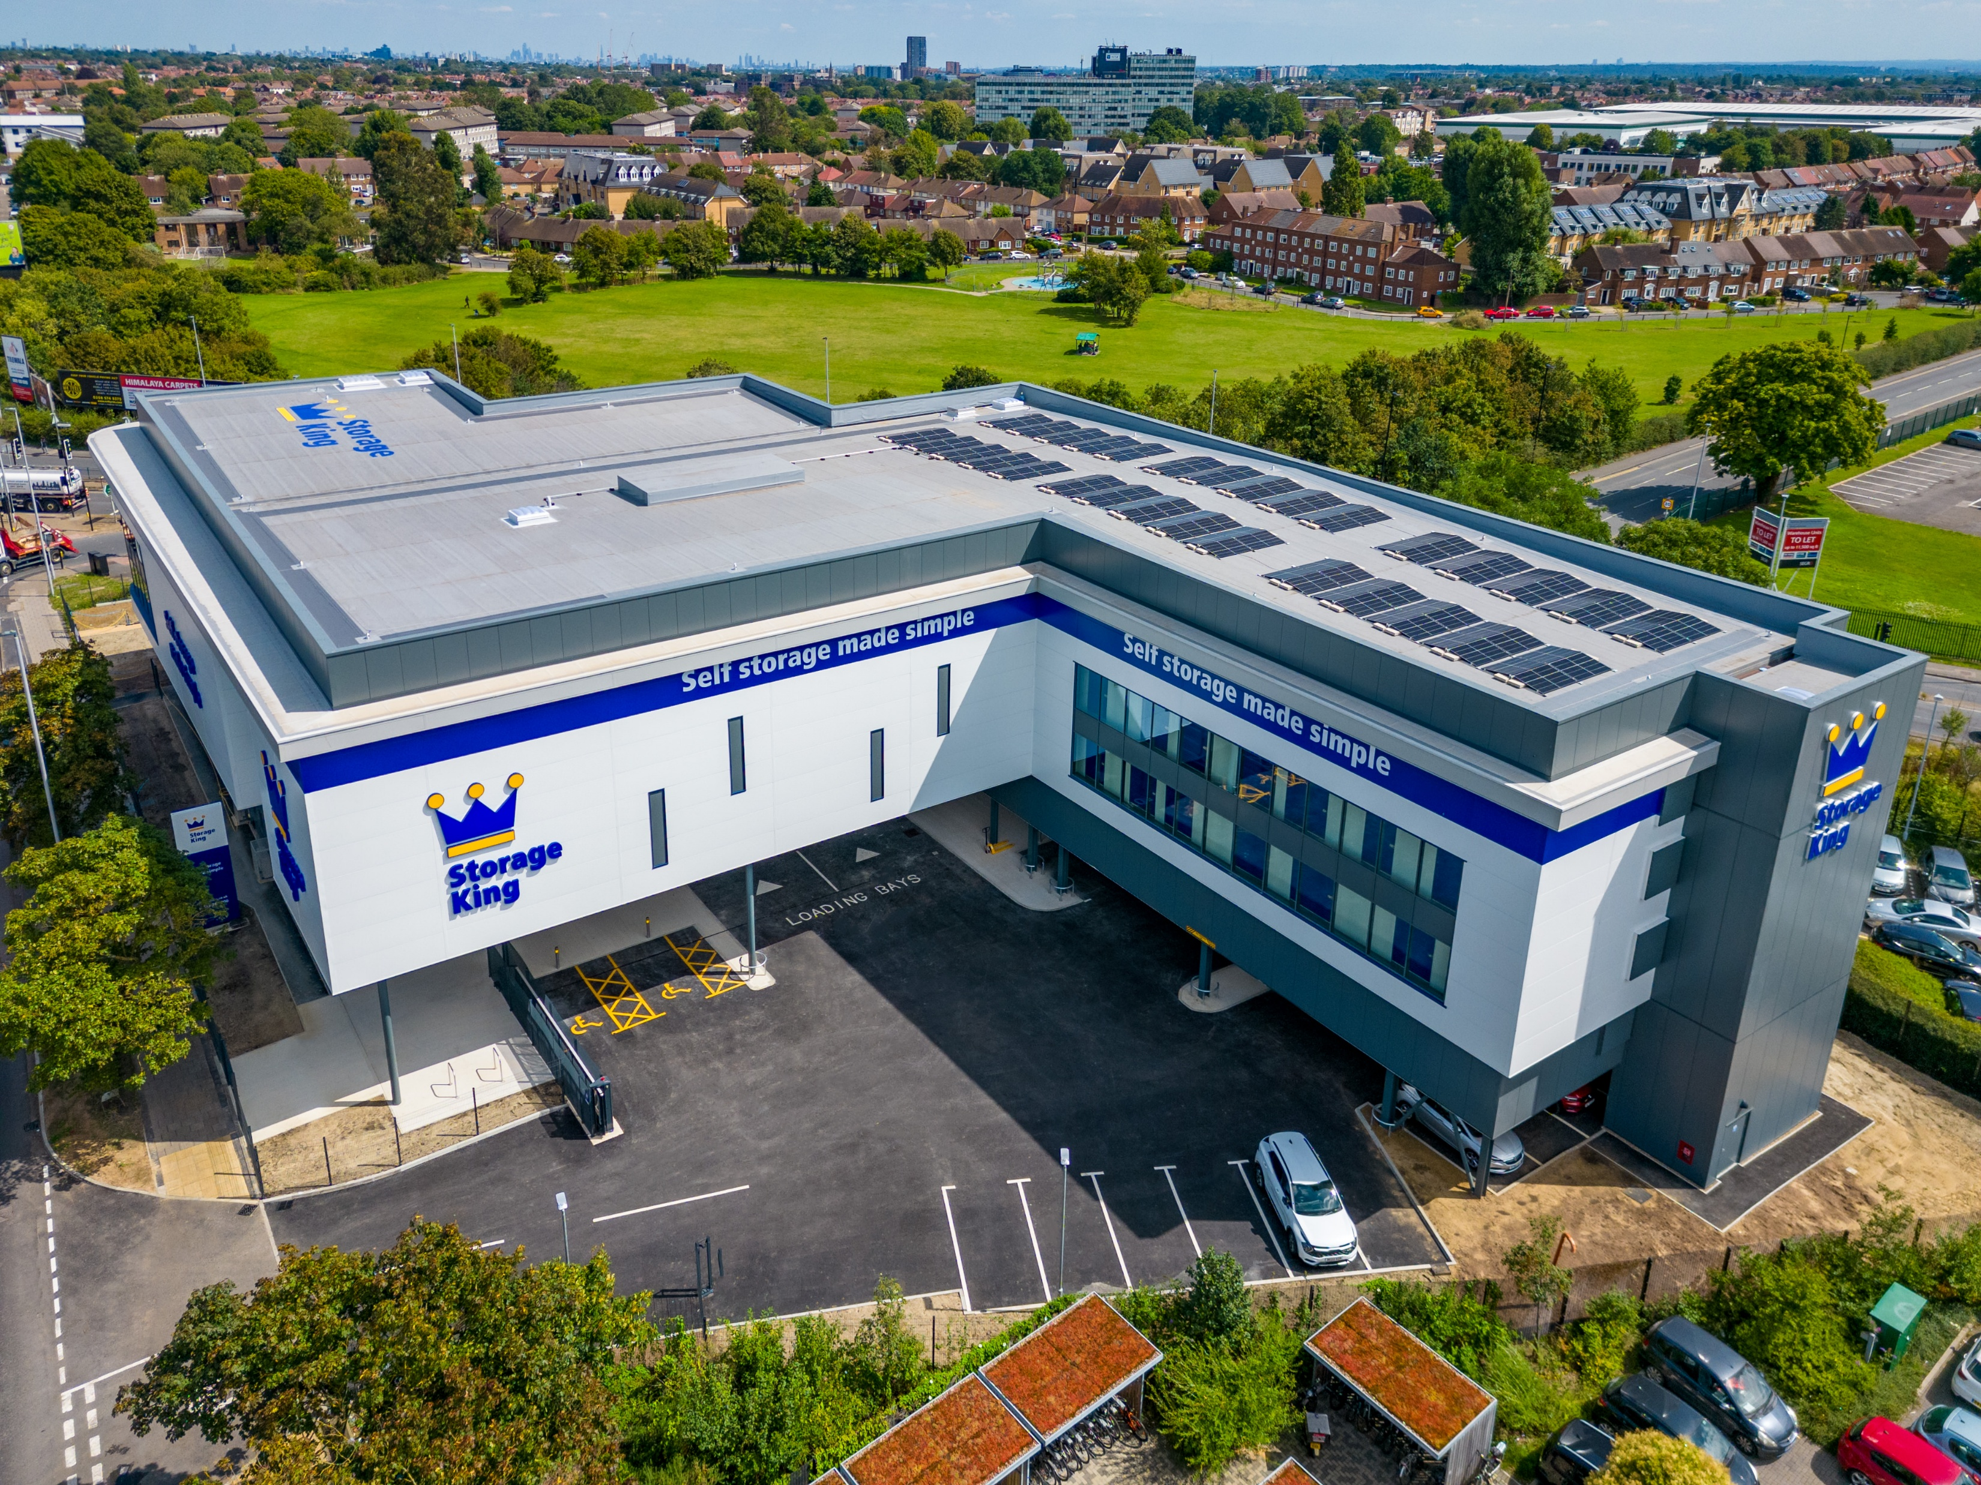
New business models to scale the sector
Meeting the challenge of rising demand, and providing new “fourth generation” stock which will out-position older stock
Building innovation with technology, security and design
New building types to focus on immediate catchments or new customers
Attacking the cost base :
  reduced headcount in staffed stores
  expansion of centrally managed
  economies of market share
  efficient buildings
  watching property taxation
The rapid rise of the third-party managers beyond the UK
The rise of the self storage developer
The attractiveness of leaseholds
Sale and manage backs to recycle capital
New ways for capital to access the sector – JVs / Recaps / Pref Equity
New models to challenge older stores and business models

Slide 23
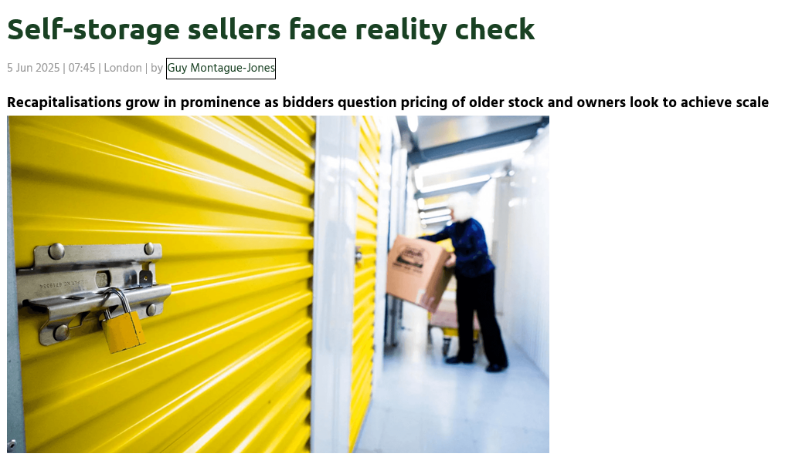

Slide 24
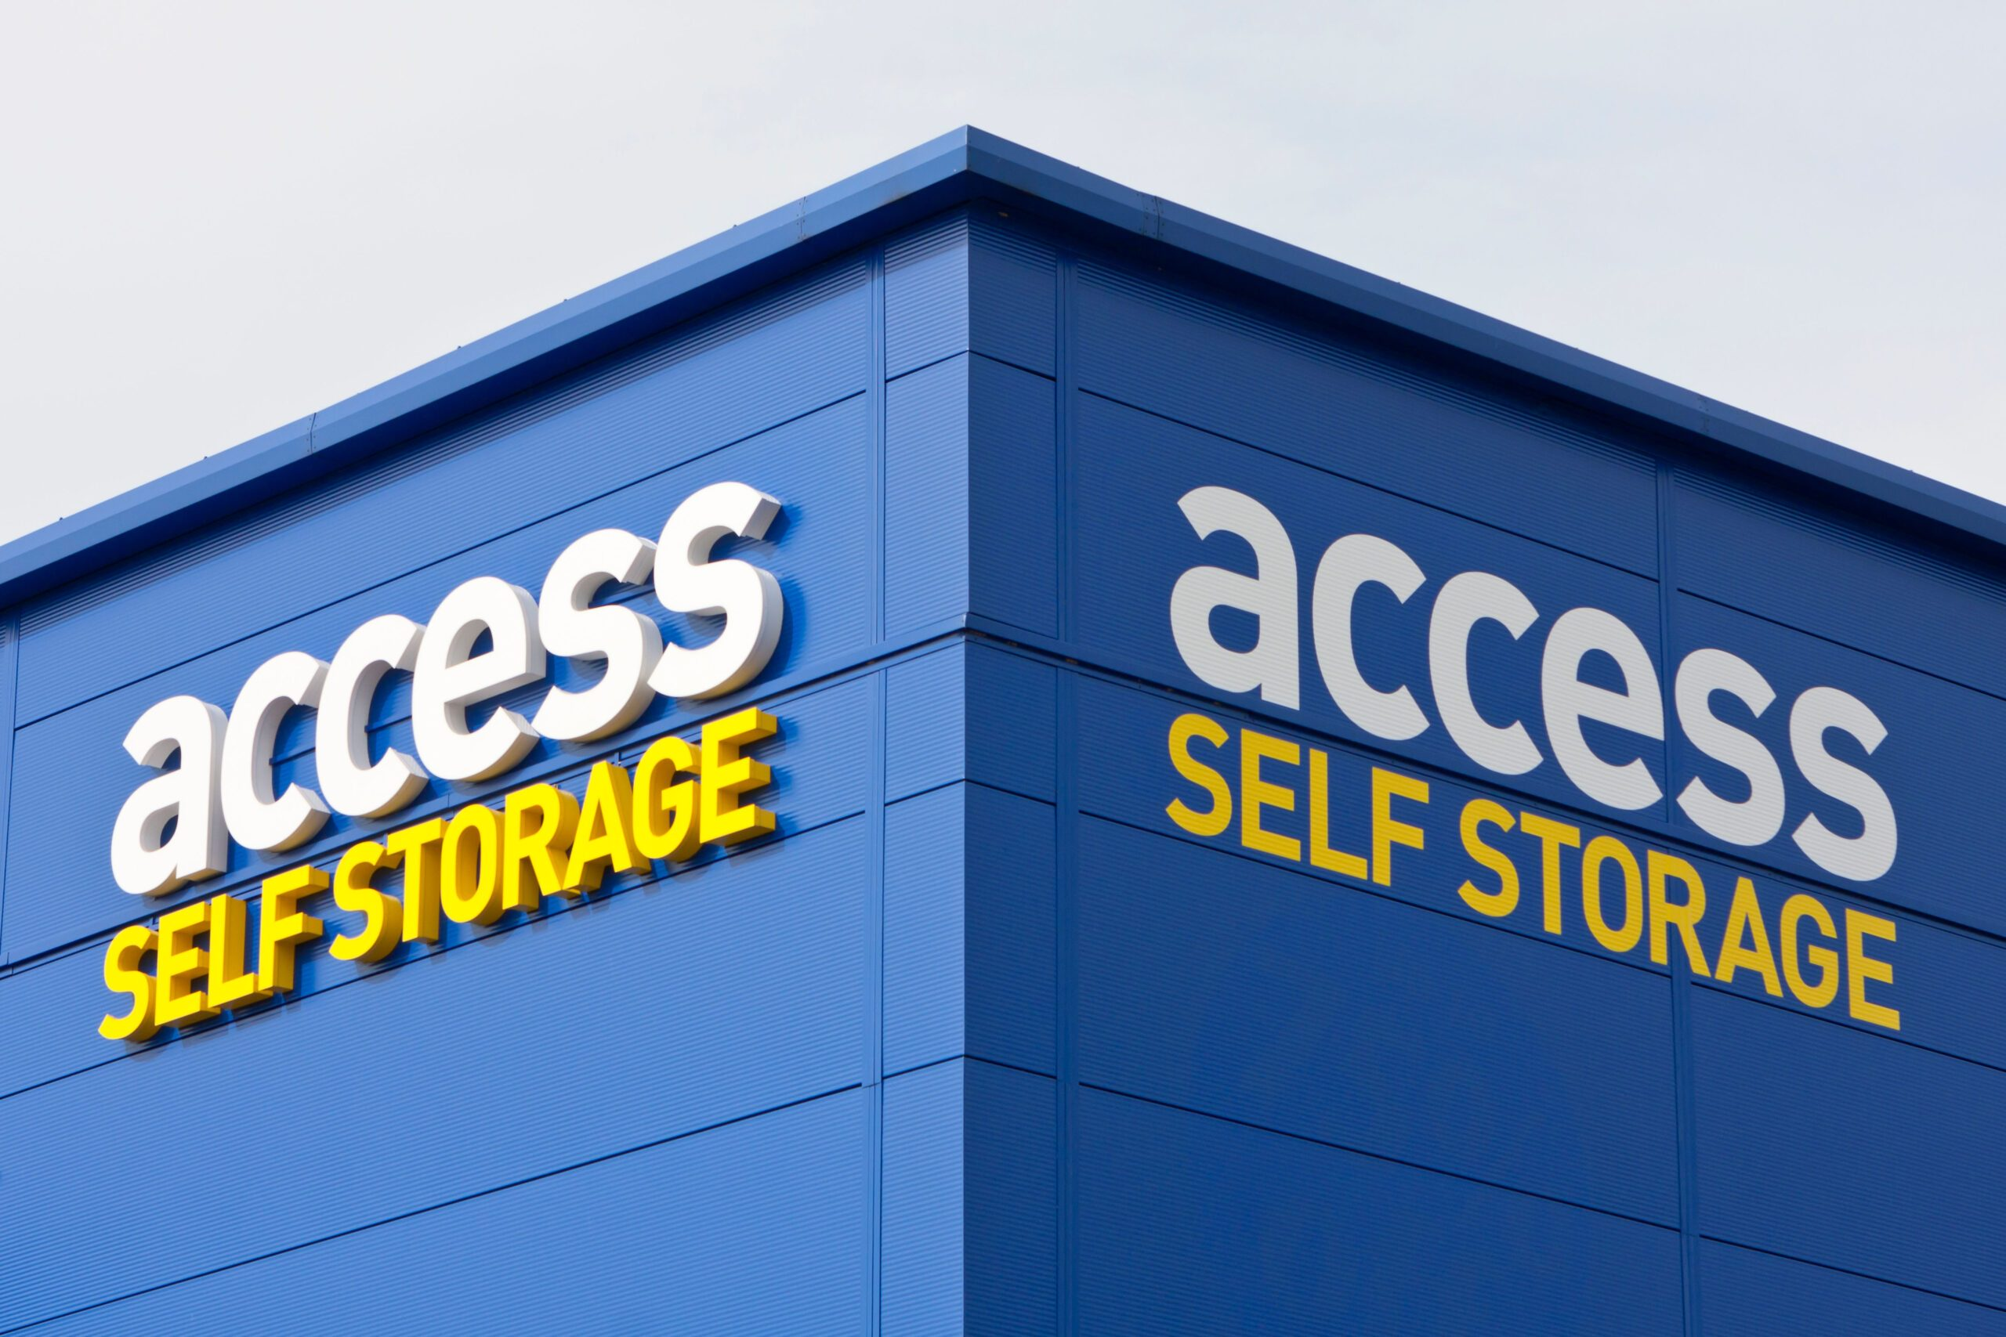
Building self storage for the future
Quality, transparency and data are key to attract a lower cost of capital with values driven by a growth story
Building for data : the ECRI approach; elasticity, churn, rates by unit size
Building for the new customer
Building new product that can scale or strategically fit scalers
Building in the right micro location
Building for a management solution
Building for dominance and price leadership
Building sustainable efficient buildings based on technology, security, prominence with mixed use
Building for change

Slide 25

Contact us
Ollie Saunders
Head of Savills Self Storage
+44 (0) 7939 272426
Ollie,saunders@savills.com
Disclaimer: The material in this presentation has been prepared solely for informational purposes and is strictly confidential. Any disclosure, use, copying or circulation of this presentation (or the information contained within it) is strictly prohibited, unless you have obtained Savills prior written consent. Neither this presentation nor any part of it shall form the basis of, or be relied upon in connection with, any offer or transaction, or act as an inducement to enter into any contract or commitment whatsoever. NO WARRANTY OR REPRESENTATION, EXPRESS OR IMPLIED, IS GIVEN AS TO THE ACCURACY OR COMPLETENESS OF THE INFORMATION CONTAINED HEREIN AND SAVILLS IS UNDER NO OBLIGATION TO SUBSEQUENTLY CORRECT IT IN THE EVENT OF ERRORS. Savills shall not be held responsible for any liability whatsoever or for any loss howsoever arising from or in reliance upon the whole or any part of the contents of this document or any errors therein or omissions therefrom.
OPERATIONAL
CAPITAL MARKETS
Website
Social

