Slide 1
Operational AI
And how it can help optimise efficiency
By Martin Wild, MD & Co-Founder

Slide 2
AI – something the world has never seen before…
…Is that actually true?
Source: https://www.independent.co.uk/

Slide 3
So why has AI only been in the media recently?
More and more data is available.
Increased computing performance.
Well-functioning AI interfaces are widely available to the public.
ChatGPT has demonstrated a performance that has not been seen before.
Source: https://joshbersin.com/

Slide 4
Who develops AI?
All of us do!
AI engineer builds AI models using machine learning algorithms and deep learning neural networks.
The actual learning process is done by the algorithm itself through trial and error.
The more people use AI, the more it becomes useful.
Source: https://wingarc.com.au/

Slide 5
What are the limitations of AI?
Putting facts in context.
Common sense reasoning.
Bias
Creativity
Source: https://bard.google.com/chat

Slide 6
How can I use AI for my self- storage business?

Slide 7
Use AI for creating content
SEO-optimised blogs and articles. Be careful, Google might know if you haven't put your own thoughts on paper.
Generating self-storage images.
Read more here on how Google penalises AI-generated content! https://developers.google.com/search/blog/2023/02/google-search-and-ai-content

Slide 8
Predictive Analytics
Smart analytics
Adjust rental prices based on market demand
Optimising occupancy rate and automating yield management
And a lot more...

Slide 9
Automated customer service
Chatbots powered by AI can handle routine customer inquiries
Freeing up staff time
Improving response times
Available 24/7
Can lead to increased customer satisfaction and retention rates

Slide 10
Chatbots for operators
Create customised reports in no time
Get answers quickly through the chat instead of searching for data in the system yourself.
Can act as a universal search engine for your self-storage business

Slide 11
Voice control with AI
"Hey Self Storage Software! What is my current occupancy rate, and what is the average rate per square meter comparing this year to last year?"
Operator
"How much space do I need to store a couch, a table, and four chairs?"
Customer

Slide 12
How do we ensure that AI is not providing inaccurate information to me and my customers?
We have to feed the AI with the right data, write good prompts, and be as precise as possible.

Slide 13
The tools that my team and I use on a daily basis.

Slide 14
AI-supported programming
Source: https://github.blog/2021-06-29-introducing-github-copilot-ai-pair-programmer/

Slide 15
DeepL.com

Slide 16
ChatGPT - OpenAI
Writing Emails much faster and more accurately.
Creating the outlines of articles and LinkedIn Posts
“Using voice control, ChatGPT has become my right-hand assistant.”

Slide 17
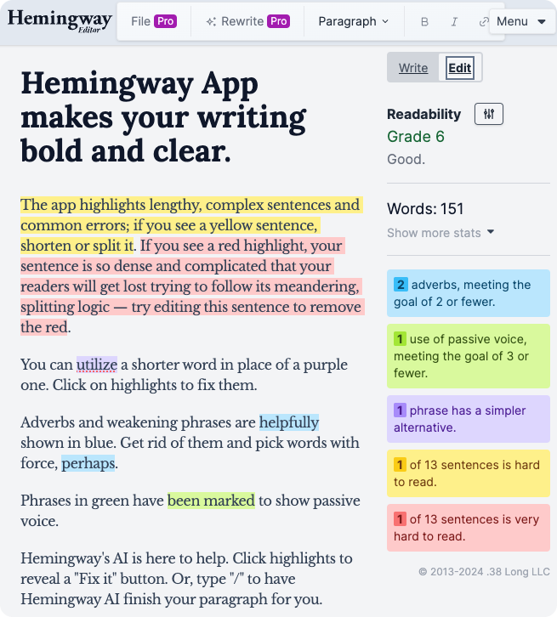
HemingwayApp.com
Makes writing unique.
Cuts out the "waffle".
A good filter for your ChatGPT written content so it appears "more human".

Slide 18
Tome.app for creating presentations

Slide 19
Is AI going to replace us?...
...No, it's going to change the way we work!

Slide 20
“AI Won’t Replace Humans - But Humans
With AI Will Replace Humans Without AI”
Source: https://hbr.org/2023/08/ai-wont-replace-humans-but-humans-with-ai-will-replace-humans-without-ai

Slide 21
Martin Wild
Managing Director
COO, Co-Founder
+43 720 883 702
martin.wild@kinnovis.com

