Slide 1


Slide 2


Slide 3
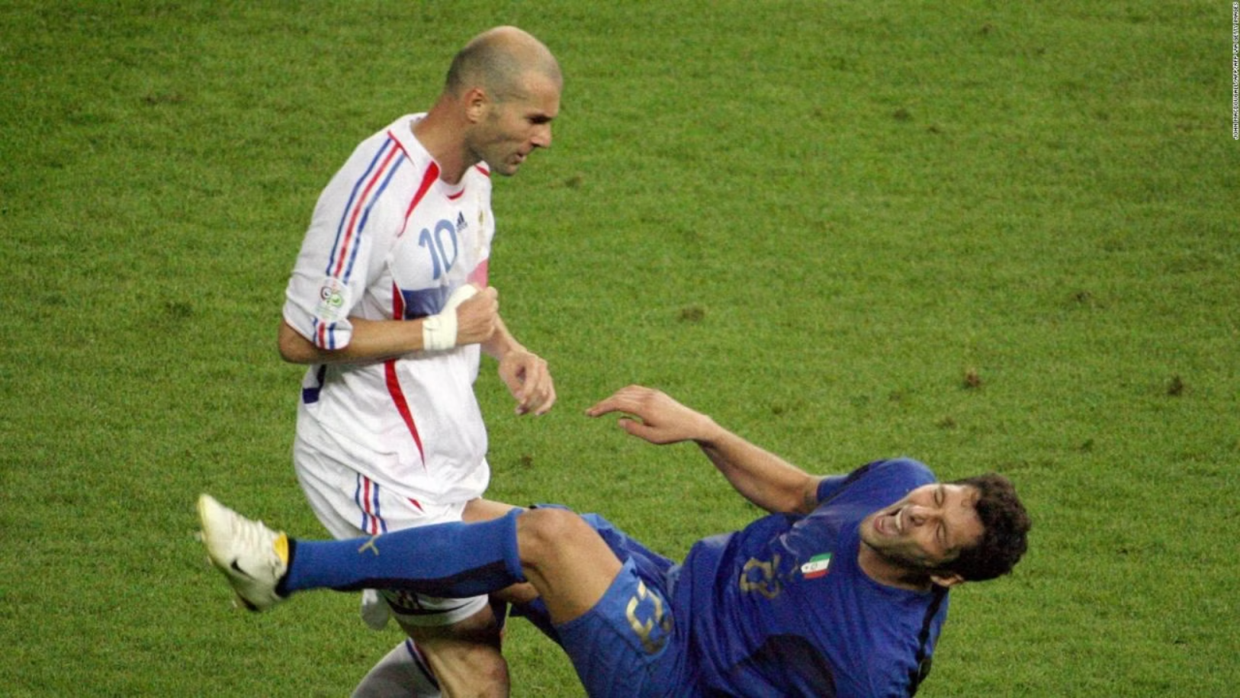

Slide 4


Slide 5


Slide 6
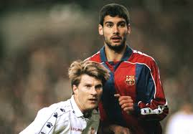

Slide 7


Slide 8


Slide 9
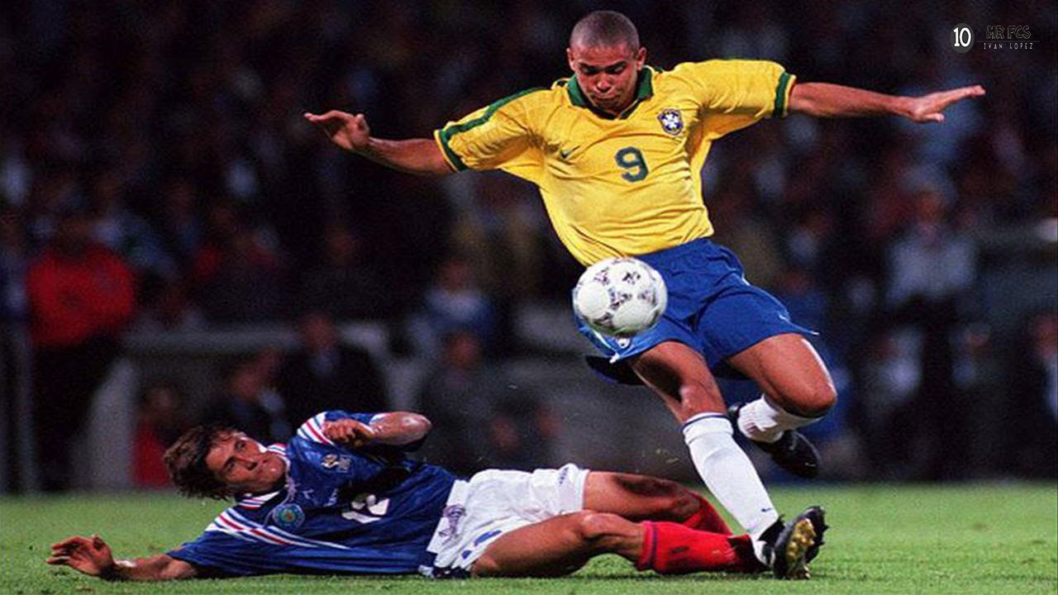

Slide 10


Slide 11
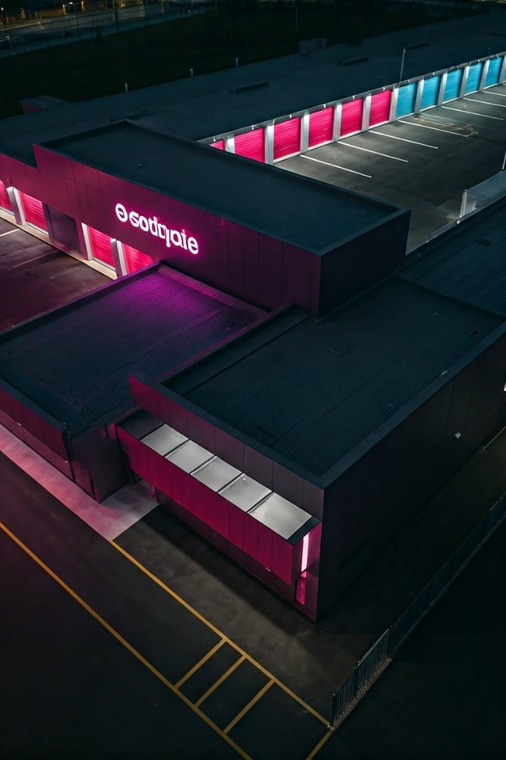
Football Strategies for Self Storage
Attack, Defend, and Dominate. Ready to Play?
Notes:
🎤 Football Strategies for Self Storage: Attack, Defend, Dominate. Shall we play?
Today we’re going to compare the main roles in a football match with self storage — and see how you can use football strategies to grow and protect your business.
ARE YOU A STRIKER, ALWAYS LOOKING FOR NEW CUSTOMERS?
A GOALKEEPER, DEFENDING YOUR PROFITS?
OR A MIDFIELDER, KEEPING EVERYTHING UNDER CONTROL?
Football and self storage need the same things:
A CLEAR STRATEGY, VISION, AND A WELL-PLACED TEAM.
Use these tactics, and
YOU WON’T JUST COMPETE — YOU’LL WIN. ⚽💥

Slide 12




Know Your Competition: the Opponent
Scout competition facilities
Focus on nearby rivals
Analyze market signals
Only those within 10-minute drive matter
Full + high prices = strong demand; empty + cheap = warning
Check prices, promotions, occupancy rates
Notes:
Slide 2 – The OPPONENT: Who are you playing against?
In football, if you should always study your opponent.
In Self Storage, it’s exactly the same — your opponent is the competition.
Do your homework. Visit their sites, check their prices, promotions, and occupancy.
10 MINUTES DRIVE:
But don’t waste time analyzing everyone. Your real competition is anyone within a 10-minute drive. That’s your battlefield.
And always pay attention to their strategy:
If they’re full and their prices are high, that’s a good sign — there’s demand.
But if they’re empty and offering big discounts… be careful. Maybe something’s wrong
Let me give you a real example.
We had a competitor just 100 meters from one of our centers.
They were 20 euros cheaper — around 25% less.
Did we lower our prices? No. We waited until they were full… and then we raised ours.
It was 6 months with slow pace of move-ins, but it made sense.
PRICE IS ALWAYS THE LAST THING YOU SHOULD TOUCH.
IN A PRICE WAR, there’s only one winner: the customer. And you’ll end up losing your margin.
If you ever need to do DISCOUNTS — because sometimes you have to — make sure they’re
ALWAYS TEMPORARY DISCOUNTS, never permanent.
For example:
It’s much better to offer the first two months at half price than a 20% discount forever.
Why? Because customers stay an average of 14 months.
Do the math. The temporary discount makes you more money.

Slide 13




The Fans: Your Customers
Happy customers stay longer
Satisfied clients become your best advocates
Google reviews matter
Digital reputation drives new business
Build community
Referral programs and exclusive discounts create loyalty
Notes:
Slide 3 – The Fans: Turn your CUSTOEMRS into superfans
In football, the fans are everything.
No fans? No atmosphere, no money, no club.
In Self Storage, it’s exactly the same — your customers are your fans. Treat them well, and they’ll stay loyal for years.
DO NOT DO OFFLINE MARKETING IF YOU HAVE NOT COVERED ONLINE MARKETING
In my centers, we run
GOOGLE REVIEW CAMPAIGNS all the time.
We give them a small gift — usually a cold beer — for leaving a review.
It’s simple, it’s cheap… and it works like magic.
Some of the top marketers in Self Storage tell me we probably have the highest number of Google reviews in the world.
And it’s not because we’re the biggest — it’s because we take this seriously.
Let me ask you: don´t you check Google Reviews before buying something?
Exactly! Your customers do the same when they’re looking for storage.
20% THROUGH GOOGLE MAPS is the new shop window. Treat it as a priority. It can give you up to 20% of new customers every month if you take it seriously.
Most of your competitors ignore it — or they do it badly. That’s your chance to stand out.
Work on it consistently, and you’ll have the crowd cheering for you every single day. 📣

Slide 14
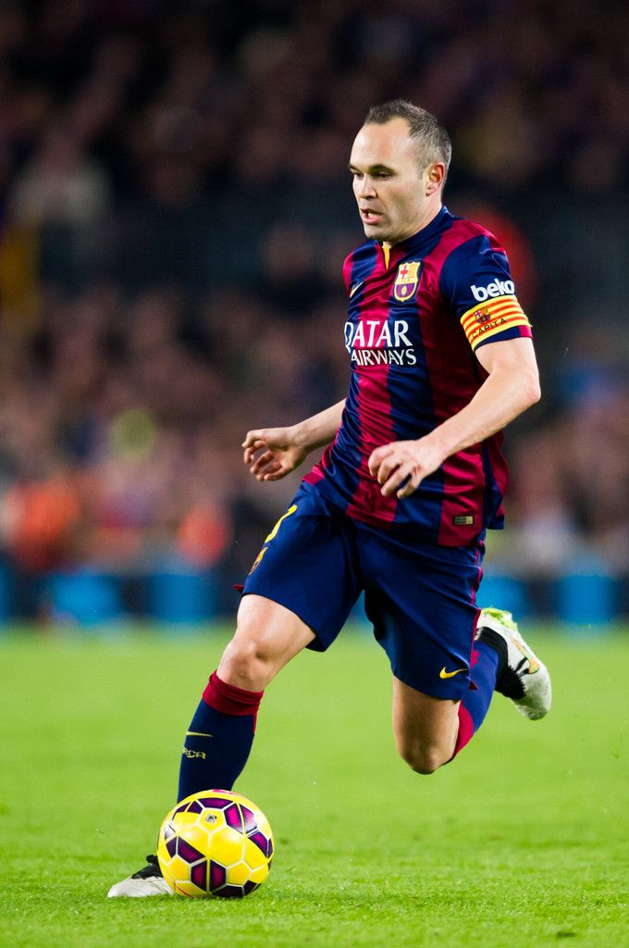



Choose Your Playing Field:
Your Market
Test market demand
Run fake ads before investing in locations
Target established neighborhoods
Older areas with limited space = higher demand
Urban vs. Industrial
City: proximity is key; Industrial: visibility matters
Notes:
Slide 4 – The Playing Field: Know your market
You don’t play the same at home as you do away.
And in Self Storage, your playing field is your market.
BEFORE INVESTING BIG, TEST THE DEMAND.
THREE WAYS TO TEST THE DEMAND CHEAP AND EASY
Fake ads
Mistery Shopper
Old neighbourhodd that the buildings do not have parking
We always run test ads on local aggregator websites — ads like ‘Storage available soon’ — just to see who’s interested.
Sometimes we get 40 or 50 customers already signed up before we even open the doors, because we’ve been doing presales during the construction phase.
That’s not luck. That’s knowing your field.
Have in mind that on average you can make a contract for every 4 leads you receive.
TWO PLACES TO PUT YOUR NEW SELF STO
Old neighborhoods? They’re a goldmine.
Tiny flats, no storage, people desperate for space.
In those areas, you don’t sell storage — you solve a real problem.
Location, Location, Location:
TWO OPTIONS FOR LOCATIONS
- In the city center, proximity wins — people want something close, even if it’s a bit more expensive.
- In industrial zones, visibility is key. If they can’t find you easily, they won’t rent from you. In industrial areas I prefer to be with the façade of my facility to a highway or in the main street of the industrial area.
If you control the playing field, you control the game.

Slide 15
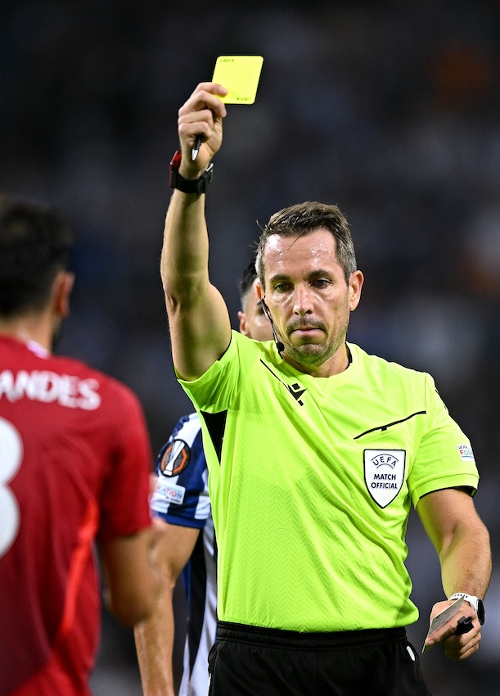



The Referee: Your Contract
Clear contracts
Avoid problematic customers with solid agreements
Payment management
Handle late payments firmly but professionally
Regulatory compliance
Follow local laws to avoid fines and legal issues
Notes:
Slide 5 – The Referee: THE Rules
The referee doesn’t score goals… but he can definitely ruin your game if you break the rules.
In Self Storage, the rules are your contracts and your processes.
YOUR CONTRACT
Here’s a simple trick:
Rent a small unit (a locker or a Manhatan size) from the top 3 or 4 operators in your country.
Take their contracts, give them to your lawyer, and use the best clauses from each one.
For 150 to 200 euros, you’ll probably end up with the strongest Self Storage contract in your market.
Cheap, fast, and effective.
LATE PAYMENTS
Automate your reminders.
And remember this — the first 7 days after a missed payment are critical.
If you do not ask them for your money for too long, the chances of recovering your money drop dramatically.
Act fast, stay consistent, and always follow your process.
If you play by the rules — and make sure your customers do too — you’ll stay in control of the game. ⚖️

Slide 16
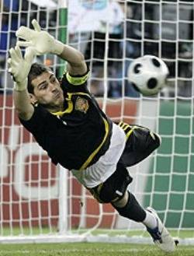
Goalkeeper:
Protect Your Cash Flow
100%
Cash is vital
6+
Months of capital
30%
Profit margin
Notes:
Slide 7 – Goalkeeper: Protect your cash
The goalkeeper is your last line of defense.
Without cash flow, you’re done.
ALWAYS HAVE CAPITAL FOR 6 MONTHS OF EXPENSES.
TWO MONEYS
When you run out of cash everything else does not matter. It does not matter if your facility is the most beaufull
In my first center, we opened in September… worst idea ever!
We ran low on cash by January.
If I hadn’t kept reserves, we wouldn’t be here today. 🧤💸

Slide 17

Defender:
Your Team and Operations
Staff Training
Process Optimization
Well-trained team keeps operations stable
Streamline operations for efficiency
Customer service skills
Automated billing
Facility maintenance
Digital contracts
Security procedures
Remote monitoring
Facility Maintenance
Keep property in top condition
Regular inspections
Preventive repairs
Cleanliness standards
Notes:
Slide 8 – Defense: Your team
Defense wins championships!
IF YOU ARE A BUSINESS ONWER AND YOU HAVE 10 EMPLOYEES.
You DEPEND on those 10 people, they do not depend on you. once you realise it, everything will be much easier for you
SELECT PEOPLE THAT WORKS IN YOUR ORGANISATION BETTER THATT YOU
It is very easy to get the best employees in self storage in compare with other busneses. We compete for employees with restaurantes, pubs, shops in shopping mall and hotels.
Since we have in comparison much less employees WE CAN GIVE THEM MUCH BETTER WORKING CONDITIONS IN TIME, HOLIDAYS AND MONEY.
Henry Ford said once:
“The only thing worse than training your employees and having them leave is not training them and having them stay.”

Slide 18







Midfielder: Marketing
Customer Conversion
Targeted Advertising
Online Presence
Notes:
Slide 8 – Midfielder: Marketing and lead generation
Midfield is where the magic happens.
And in Self Storage, marketing is your playmaker.
It’s what controls the flow of the game and creates opportunities to score.
In my case, 70% OF OUR CLIENTS COME FROM GOOGLE.
, and
20% OF THOSE FIND US DIRECTLY THROUGH GOOGLE MAPS.
If you’re not ranking well on Google Maps, you’re leaving 10 to 12 new customers on the table every month.
And that’s not a guess — that’s real data from my centers.
We invest €2,000 a month in Google Ads for each facility, and it brings us new customers every single day.
25% CONVERSION RATE
But here’s the key:
EVERY NEW CUSTOMER IS WORTH €1,400.
WHY?
Average stay: 14 months
Average monthly bill: €100
€100 × 14 months = €1,400
That’s your Customer Lifetime Value (CLV).
Call Center when you have already your facility number two
It’s an investment with a clear and predictable return.
Control the midfield, and you control the entire game. 🎯

Slide 19




Striker:
Score More Revenue
Annual rate increases
Raise existing customer rates by 15% yearly
Upsell premium options
Insurance, climate control, premium units
Retail sales
Locks, boxes, packing supplies
Notes:
Slide 9 – Striker: Raise prices and maximize revenue
Strikers score goals.
And in Self Storage, if you’re not raising prices, you’re not scoring.
In my centers, we
INCREASE RATES BY 15% EVERY YEAR.
What happens?
About 10% of customers complain, and around 5% leave after 60 days.
Do they move out because of the price increase? Maybe yes, maybe no. We will never know.
Some people leave for many reasons — price is just the easiest excuse.
But the mayority of the peoplestop renting a Self Storage only when they do not need it anymore.
And the reality is:
THE EXTRA REVENUE FROM THE CUSTOMERS WHO STAY MORE THAN MAKES UP FOR THE FEW WHO LEAVE.
But don’t stop there.
You also need to upsell:
✅ Insurance – make it mandatory if you can.
✅ VIP units – ground floor, light inside the unit, easy access, wider door.
✅ Padlocks
ADMIN FEE – simple add-ons that boost your average ticket.
Strikers aren’t afraid to shoot.
If you want to win, you need to attack your revenue and maximize every opportunity. 💥
BARBIE??? CHARGE THE MAXIMUM THAT YOUR CUSTOMER IS WILLING TO PAY YOU FOR A STORAGE. WHAT CAN YOU DO?

Slide 20
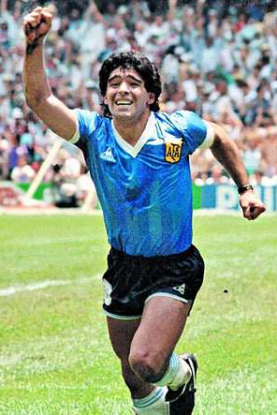
Your Championship Strategy
Scout the Market
Research competition and identify prime locations
Build Strong Foundation
Secure adequate capital and establish efficient operations
Execute Marketing Game Plan
Implement digital strategy to attract customers
Maximize Revenue
Strategic pricing and upselling to boost profits
Notes:
Slide 10 – Conclusion: Play to win
Use these football strategies and you won’t just play —
You’ll win.
Self storage isn’t about surviving —
It’s about leading.
Have a plan.
Defend your ground.
Now…
Go for the trophy!
Thank you!
See you on the pitch! ⚽🏆

