Slide 1
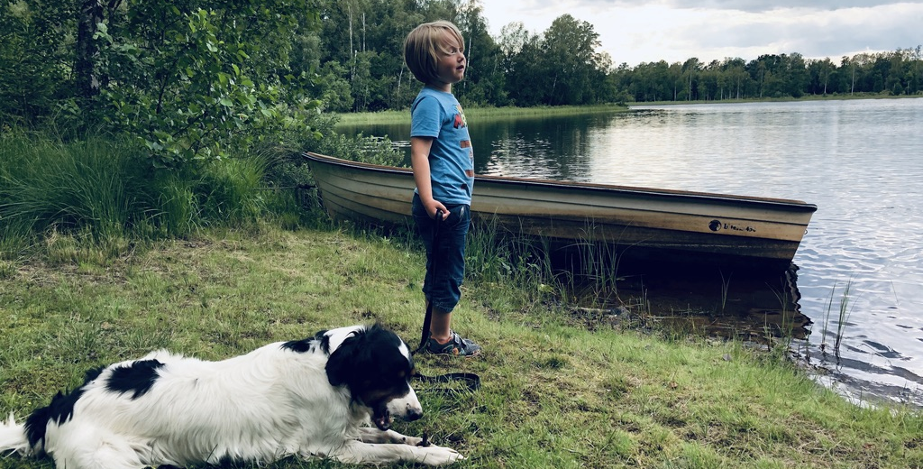

Slide 2
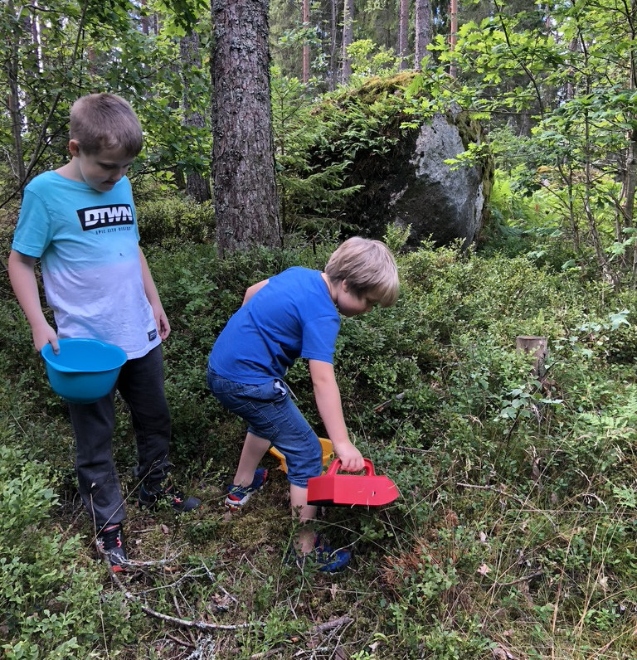
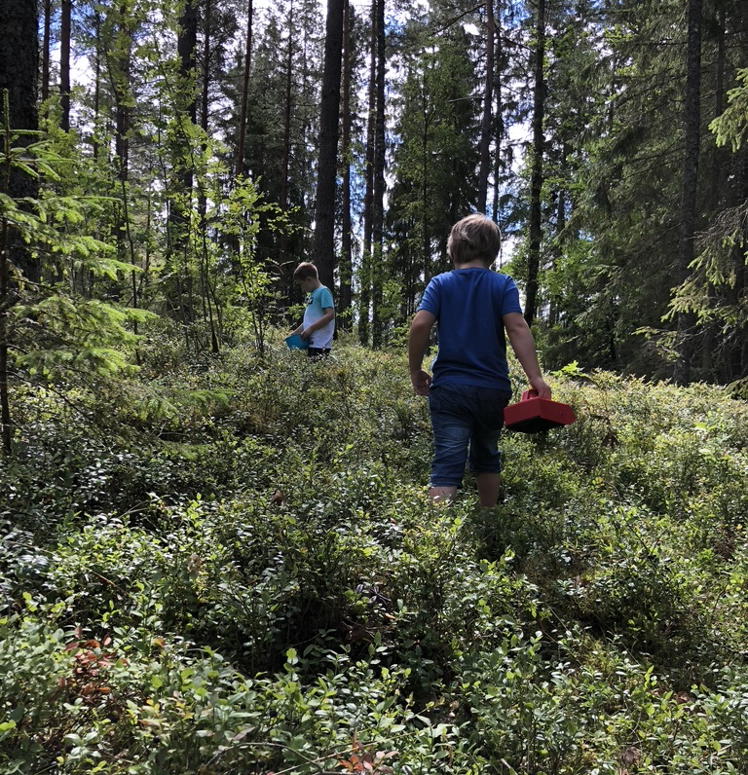

Slide 3
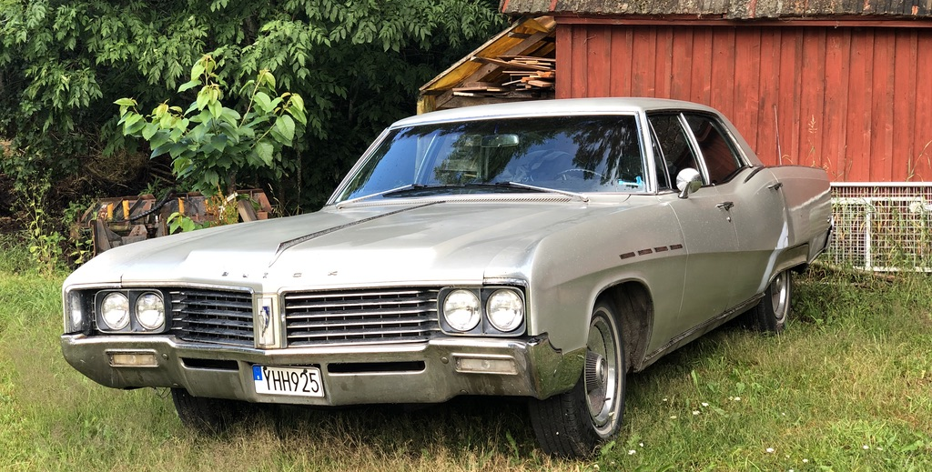

Slide 4

The Fast and the Curious:
Building Trust before Your Customer Hits the Brakes

Slide 5
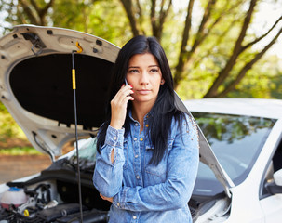
Higher stress

Slide 6
Low technical understanding

Slide 7
Putting something valuable in others’ hands

Slide 8
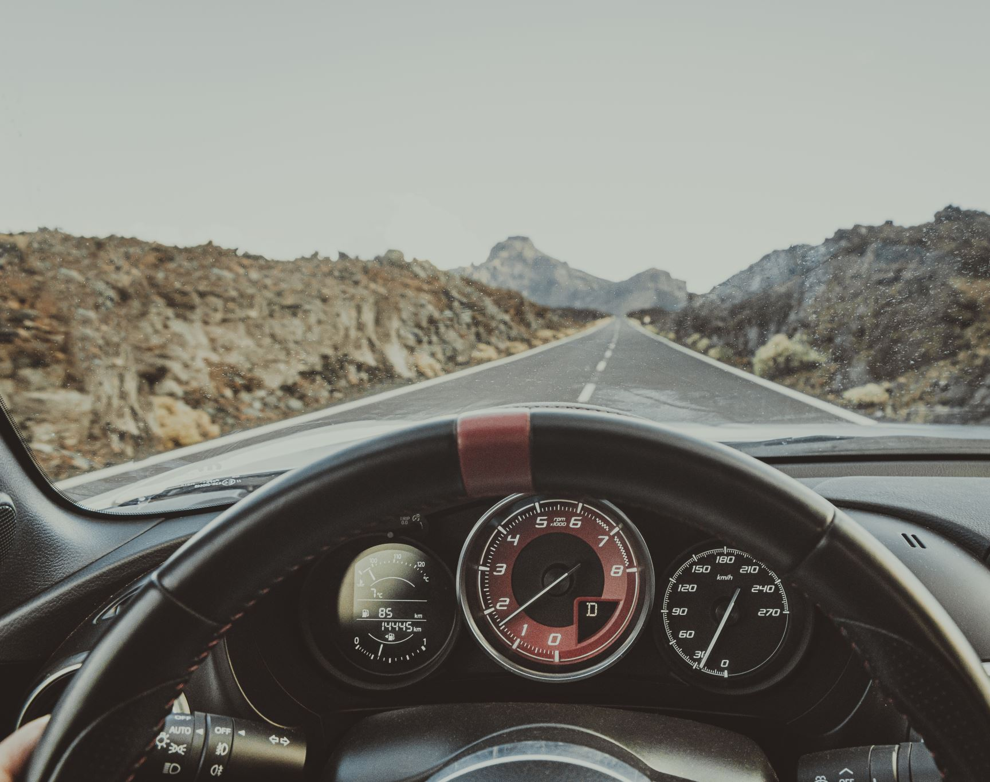
Is your sales process manual, automatic or self-driving?

Slide 9
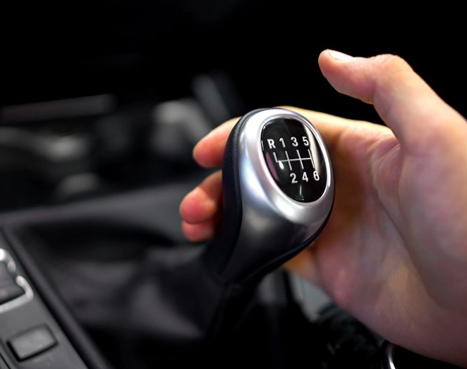
Manual transmission for Boomers and older Gen X
Notes:
We shift the gears ourselves – it’s triggered by a human
We feel in control but it takes effort, skill and attention.
Custom quotes
Many customer touch points
Reliance on the salesperson’s individual expertise and rapport
Trust is built through the person, not through the brand or the system.
Works best for: Baby Boomers and older Gen X

Slide 10
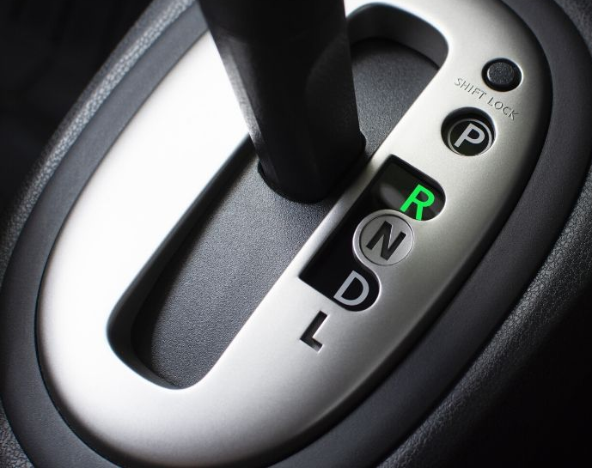
Automatic transmission for younger Gen X and Millennials
Notes:
Gears are shifted for us: sales person is still driving but there’s less friction.
Automatic emails / SMSs / workflows
Guided selling through website rools
Trust is built through predictability, responsiveness and design
Customer expects ease without feeling abandoned
But if automation feels robotic or inflexible, trust drops
Works best for: Younger Gen X and Millennials

Slide 11
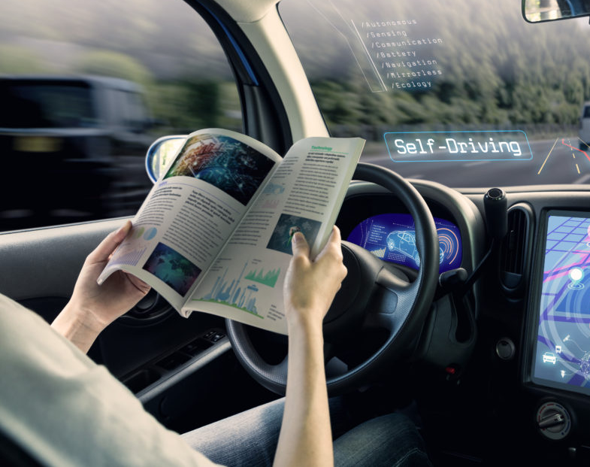
Self-driving cars for Gen Z (and Alpha)
Notes:
No human interaction unless something goes wrong. Fully automated.
It needs to be extremely trustworthy, or you will never get in the car.
Instant quotes, online booking, AI support.
Trust is built through a seamless UX, transparency, reviews and brand credibility.
Works best for digitally native segment. (Gen Z and next Gen Alpha)

Slide 12
Trust in Transmission
Transmission type | Sales process | Customer role | Trust factor | Generation
Manual | Relationship-led | Driver | Trust the sales person | Boomers + older Gen X
Automatic | Digitally assisted human | Co-pilot | Trust the system | Younger Gen X + Millennials
Self-driving | Fully automated | Passenger | Trust the brand + tech | Gen Z (+Alpha)
Notes:
Relationship-led

Slide 13
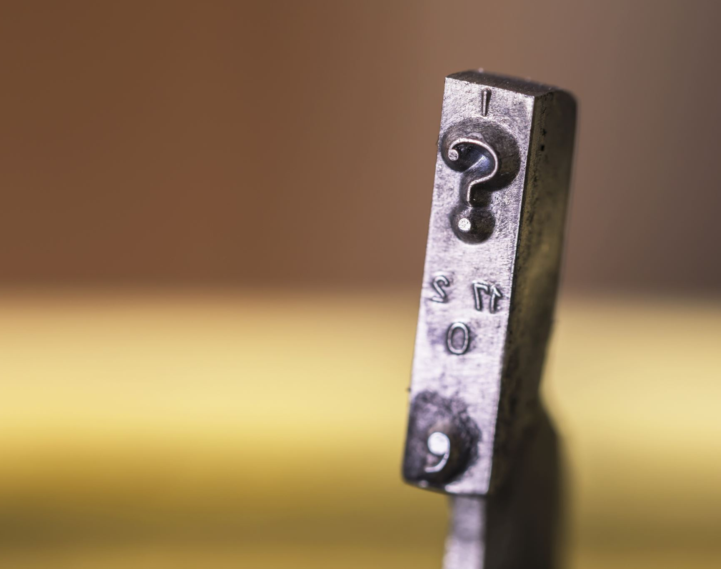
Who is in control?

Slide 14

How much of a buying decision happens before we get contacted?
Notes:
70-90% depending on which research you look at

Slide 15

Customers are more educated when we speak to them

Slide 16

Omni-channel selling
Notes:
More than one way to close a deal – the customer gets to decide

Slide 17
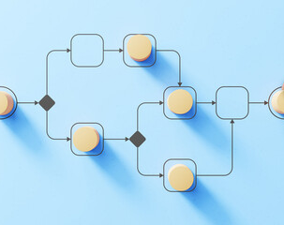
Omni-process selling
Notes:
More than one way to close a deal – the customer gets to decide

Slide 18

Initial recognition:
3 touchpoints
Notes:
Recognises name and offering

Slide 19
Familiarity:
7 touchpoints
Notes:
Understands who you are and what you offer, may consider renting from you.
Familiarity – listening to song.
Plant or animal that is familiar – safe. So familiarity is also evolutionarily.

Slide 20
Trust:
27 touchpoints
Notes:
Trusts enough to buy from you or recommend you
20 years ago, number was 4-5 touchpoints.

Slide 21
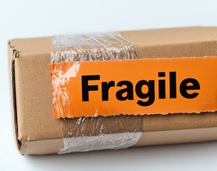
Confidence and caution
Notes:
Someone in Europe today is at least 10-20 times more likely to encounter a scam attempt compared to 20 years ago

Slide 22

Consistency
Notes:
This is a constant
Hasn’t changed in the digital space

Slide 23
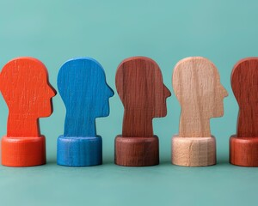
Make it targeted and personalised
Notes:
Use the data we are already collecting to personalise

Slide 24

Social proof
Notes:
Reviews
Responding to negative reviews

Slide 25

Using video
Notes:
Rory’s example of car sales man

Slide 26

html emails vs plain text emails

Slide 27

Making it easy
Notes:
Not just driver in trust but driver in customer loyalty

Slide 28

When do you change the channel on your customer?
Notes:
More than one way to close a deal – the customer gets to decide
Are you changing channel on purpose?

Slide 29
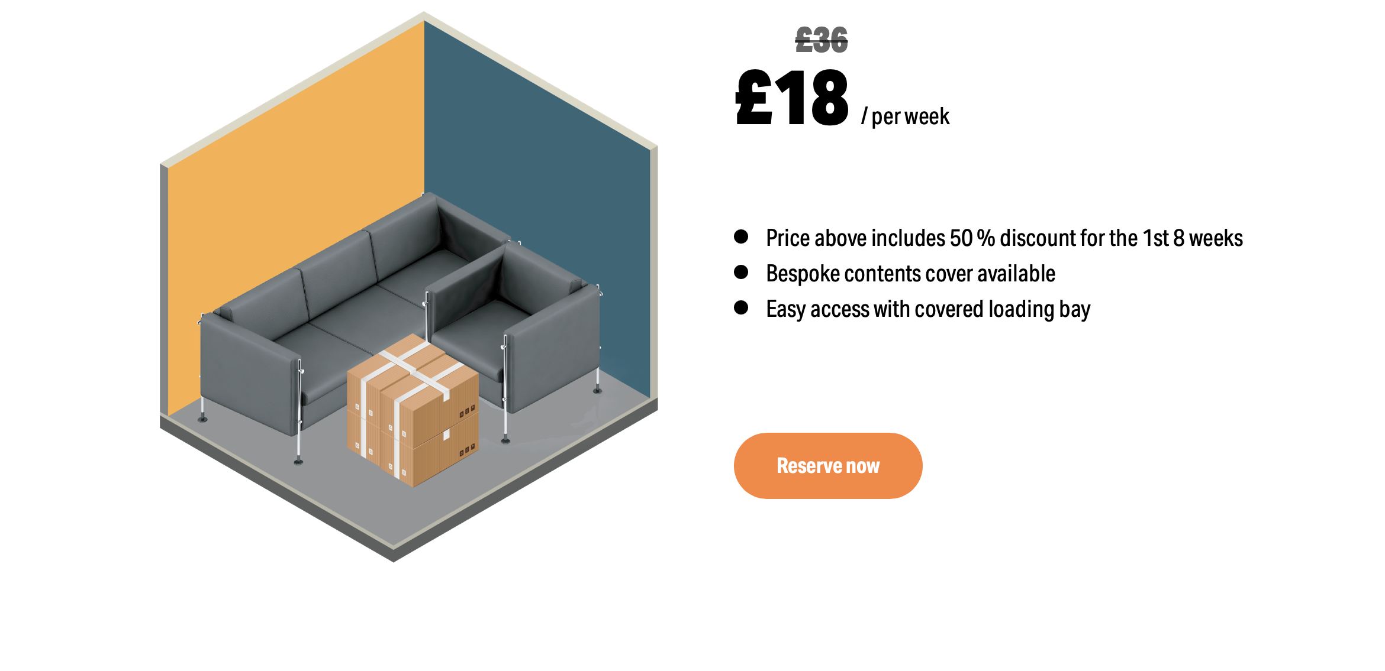
Hear from our customers
More about our security
How we care for the planet
Notes:
Show them price + option to reserve
If they’re not ready? Go hunting on the website for content.
Only conversion path is price.
Let go of control and keep control at the same time, do something like this
If you’re not ready to book…
Multiple online buying paths

Slide 30


