Slide 1
Unlocking Local Demand:
Multi-Channel Marketing for Self Storage
Nordic Conference 2025
Notes:
Thanks
About me
DBM

Slide 2
Marketing isn’t about selling - it’s about understanding
Developed by me
Notes:
Once upon a time -
Small operator - rural - started out great - slowly google ads stopped working - filling up units became really hard.
Focusing on urban families, students, movers and homeowners
Local market was rural, entrepreneurs, tradespeople
He’d been focusing so much on using digital marketing tactics best used for urban, inner city markets that he’d forgotten to use irl, networking, local press, community relationships to reach his target audience.

Slide 3










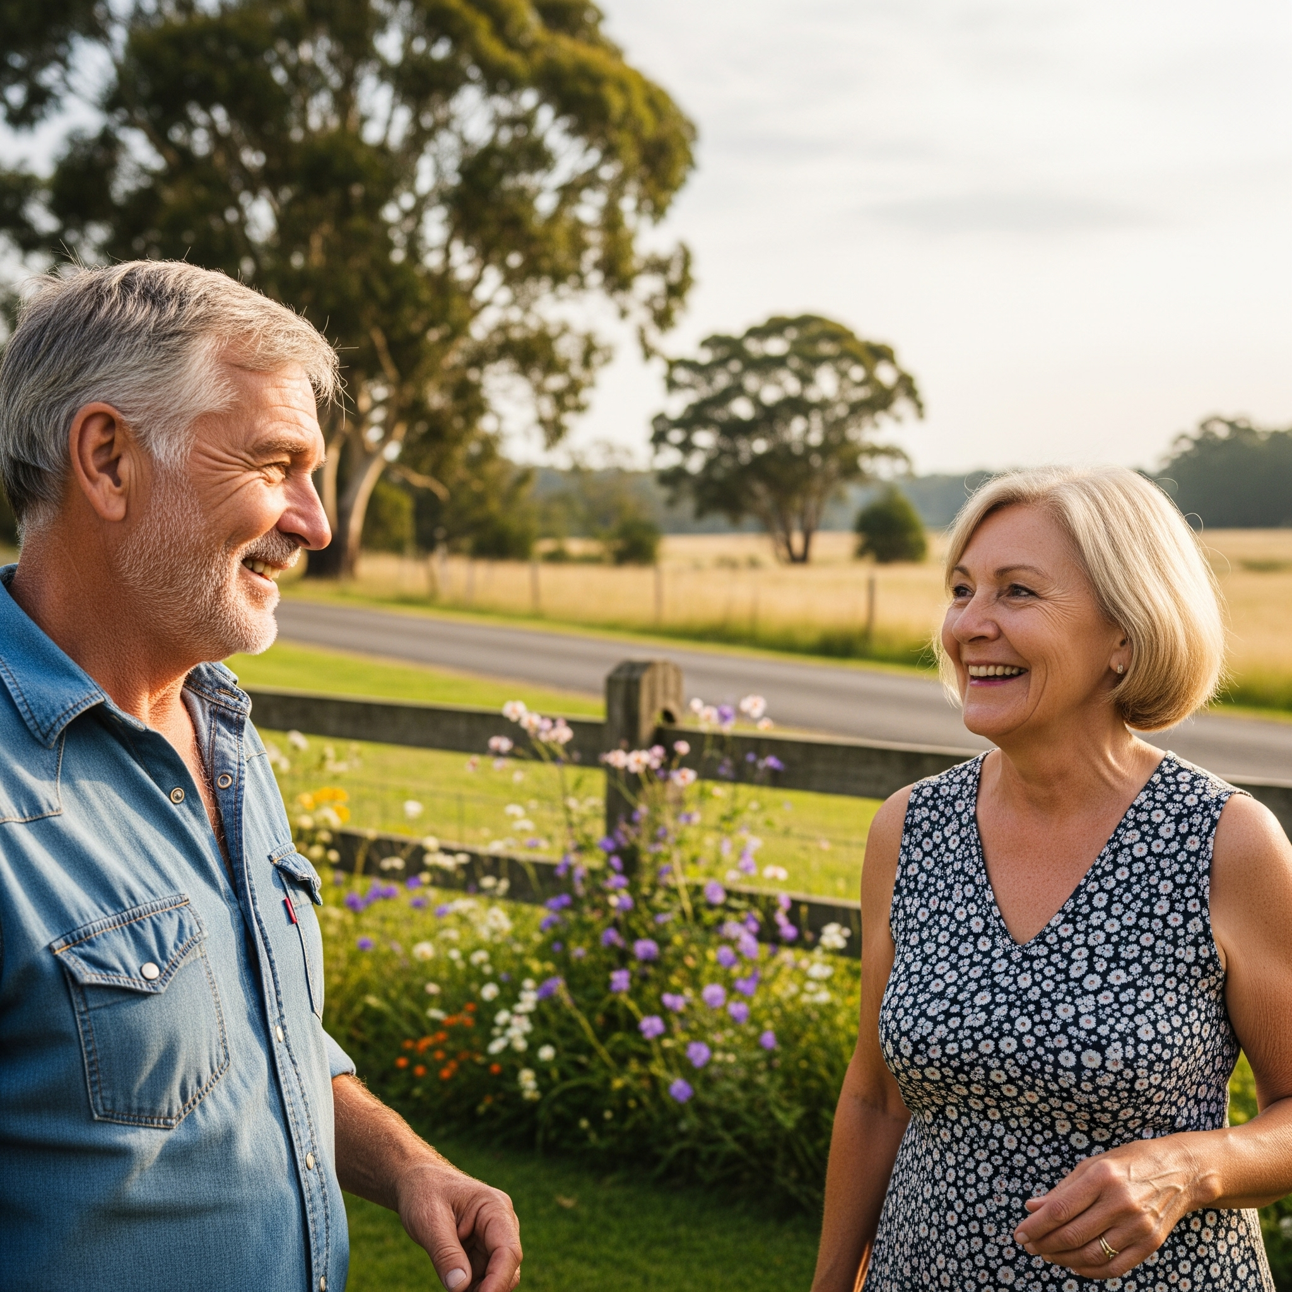













Local Markets
Market A
Market B
Market C
Market C
Market D
Company Name
Nordic Conference 2025
Market A
Young, urban dwellers
Market B
Rural, downsizing retirees
Market C
Entrepreneurs, tradespeople
Market D
Suburban growing families
Notes:
Marketing the same to everyone = marketing to no one. One size fits all does not apply to marketing strategies.

Slide 4
Marketing isn’t about shouting the loudest - it’s about listening better.
Developed by me
Notes:
That operator didn’t have a marketing problem,
he had an understanding problem.
our industry doesn’t rely on mass demand,
it relies on hyper-local, specific, time-sensitive triggers.
So today, talk about understand your local market — and how to use that insight to make smarter, more effective marketing decisions.

Slide 5
The hyper-locality of self storage
How does that impact our marketing decisions?
Notes:
So how local is your local market…? What does that mean for our markets?

Slide 6
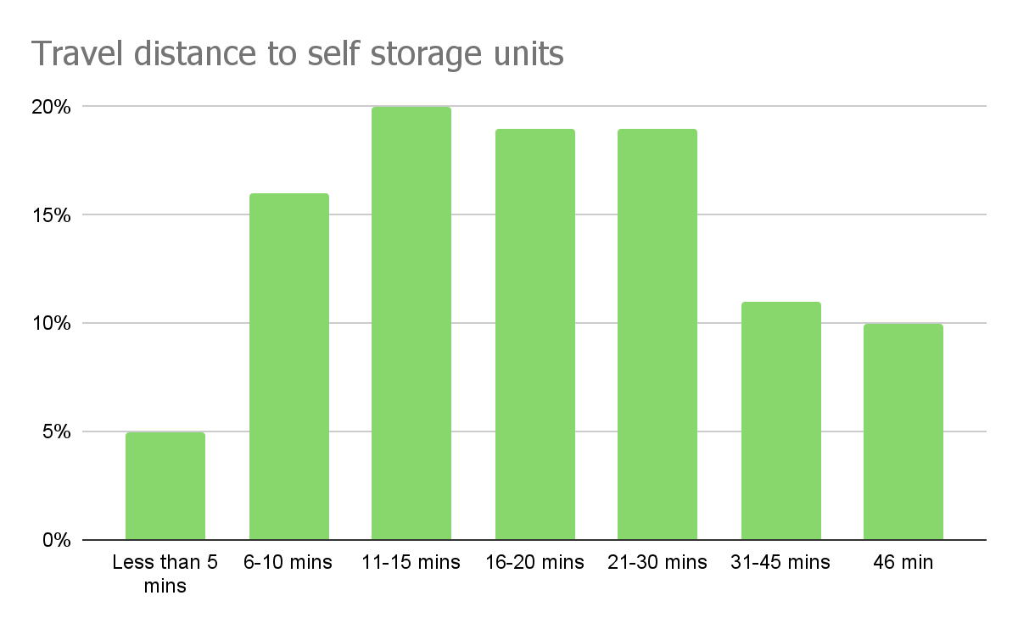
Company Name
Quarter
Month Year
*customers travel less than 30 minutes to their self storage destination - SSAUK 2025 report
Notes:
The SSAUK’s 2025 report provides a terrific picture of how far customers are willing to travel to self storage sites.
3308 individuals completed this year’s SSAUK report

Slide 7
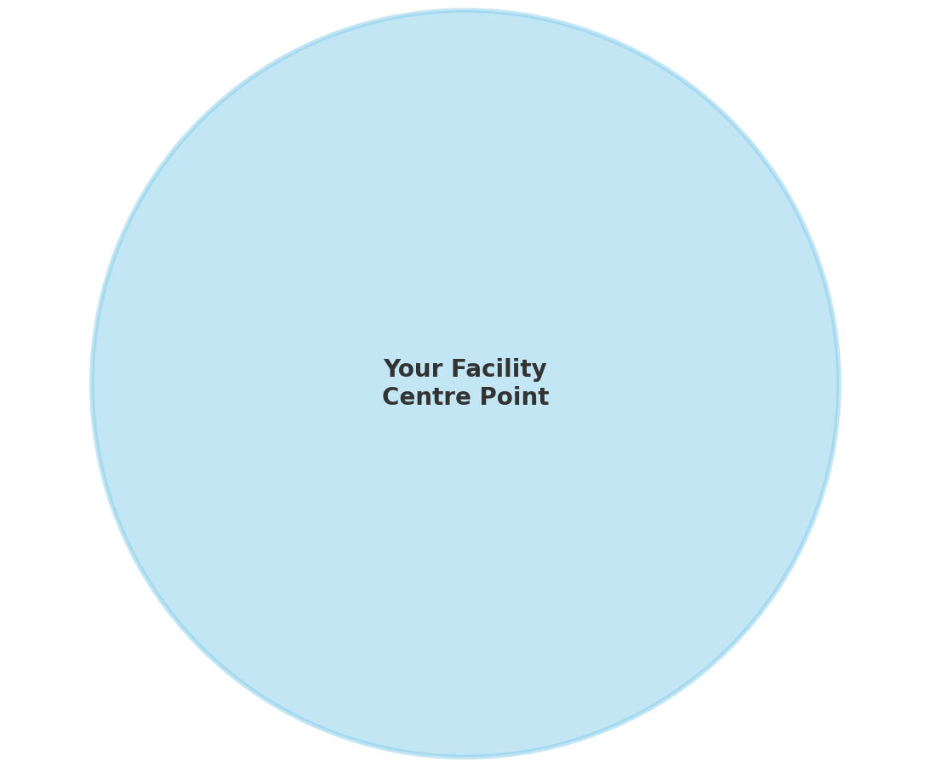
Catchment area: 15 min drive radius
10km (6.2 miles) driving at 40km/h
Estimated coverage area is 314km²
Notes:
Basing this on 15 minute drive - a circumference of around 10km (6.2m)
That looks like this on a map…

Slide 8
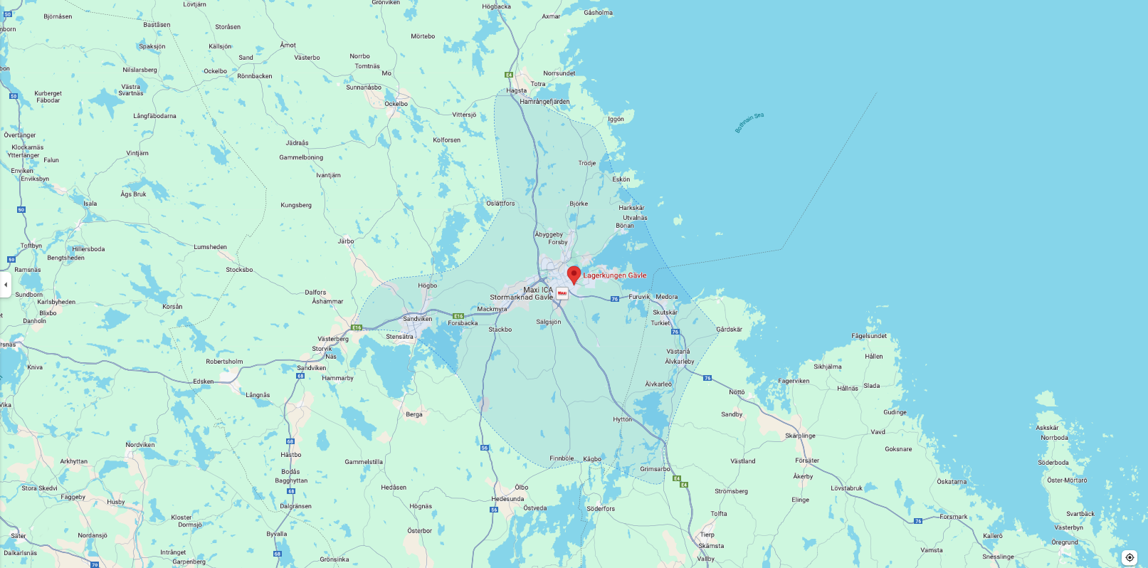
Gävle, Sweden - Rural-ish
Notes:
15-20 min drive - rural area

Slide 9
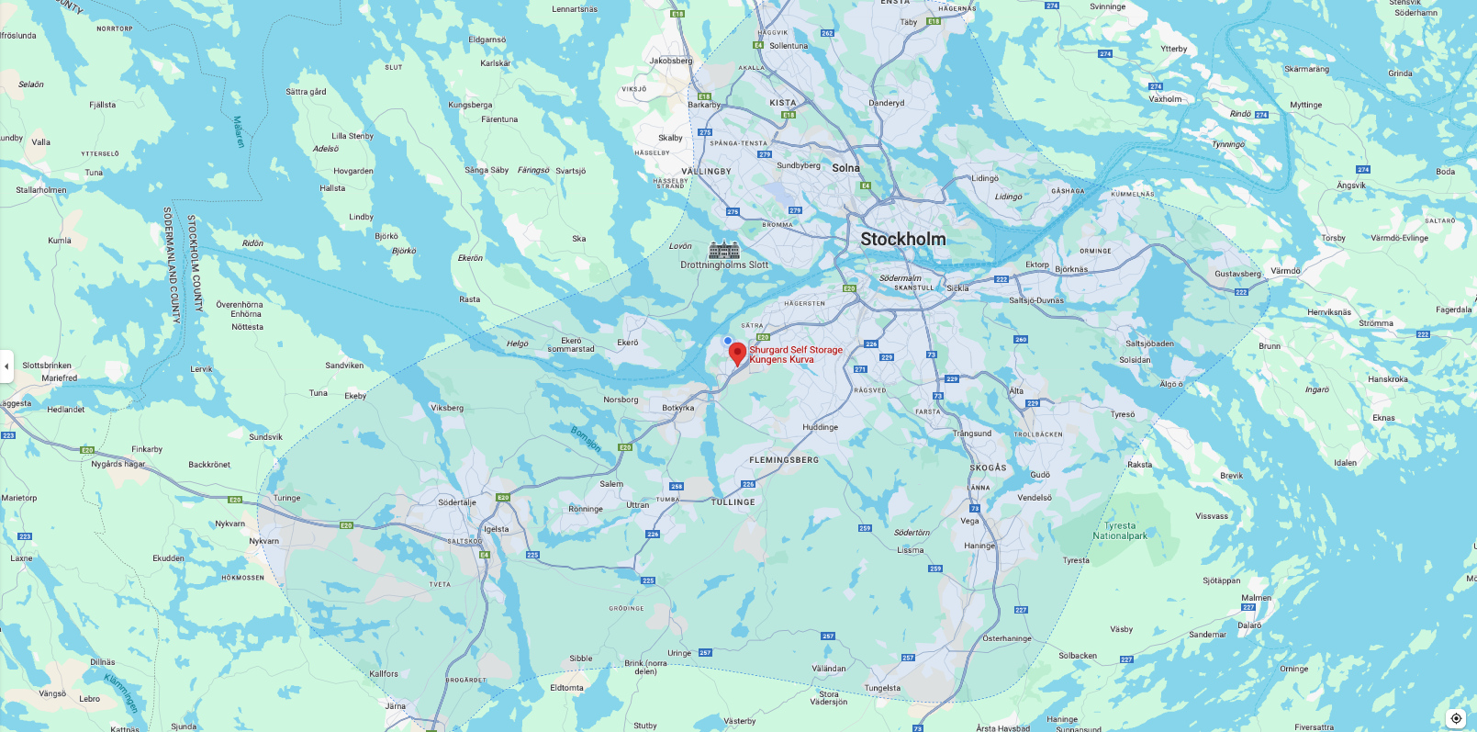
Stockholm, Sweden - Urban sprawl
Notes:
15-20 min drive - rural area
Immediately you can even see geographical differences between these two markets without knowing much about their demographics, housing tenure, socio economic status.
We’ve established that local demand is key - how do you find it, measure it and speak to it?

Slide 10
Getting to know your local market
Marketing Feasibility 101
Notes:
We need to create a framework for local insight - often called a feasibility study but for Marketing - how feasible is our local market?

Slide 11
Feasibility Tools
Developed by me
Nordic Conference 2025
National Statistics
SCB.SE, dst.dk, https://www.ssb.no/
Local Government sites
Municipal or Kommun websites
Google Trends
Free keyword and search research tools
Data services
Buy in services from responsible data handlers

Slide 12
Demographics
Age (+ generational label)
Income
Gender
Life-stage
Socio-economic status
Occupation group
Geographical setting i.e. urban/suburban/rural

Slide 13
Housing tenure
Housing ownership status (owners or renters).
Housing types (new flats, old flats, villas, radhus, gård).
Postcode identification.
Property development in the local area (new flats??)

Slide 14
Search Volume
Keyword search volume per month + Avg CPC costs.
Identify most common keywords in your local area (Google trends).
Compare your town vs region.
Do you local customers use the same keyword as the rest of the region?

Slide 15
Competitors
Map them
Price them
Identifier your differentiating USPs compared to them.
Identify their promotions.
Check their reviews.

Slide 16
Marketing SWOT
Identify strengths, weaknesses, opportunities and threats in your local area.
I.e. saturated market, unique offerings, untapped market, lack of visibility.

Slide 17
Identify Your Local Markets /Audience profiles
Market A
Market B
Market C
Market C
Market C
Market C
Market D
Market D
Company Name
Nordic Conference 2025
Audience Profile / Market D
Age: 35-40
Gender: Female
Lives in a rented flat
Employed (pt/ft)
Job: Dental Hygienist
Married
2 kids and growing
Biggest problem - lack of space, unable to renovate, can’t afford to move, needs affordable, reliable storage.
Notes:
With the feasibility insights under your belt - you can begin to build audience profiles and make additional inferences about these audiences issues, problems and how we can solve them.

Slide 18
Multi-Channel Marketing in Local Markets
Developed by me
Nordic Conference 2025
Notes:
So how do we know where to show up in local markets for these audience profiles?

Slide 19
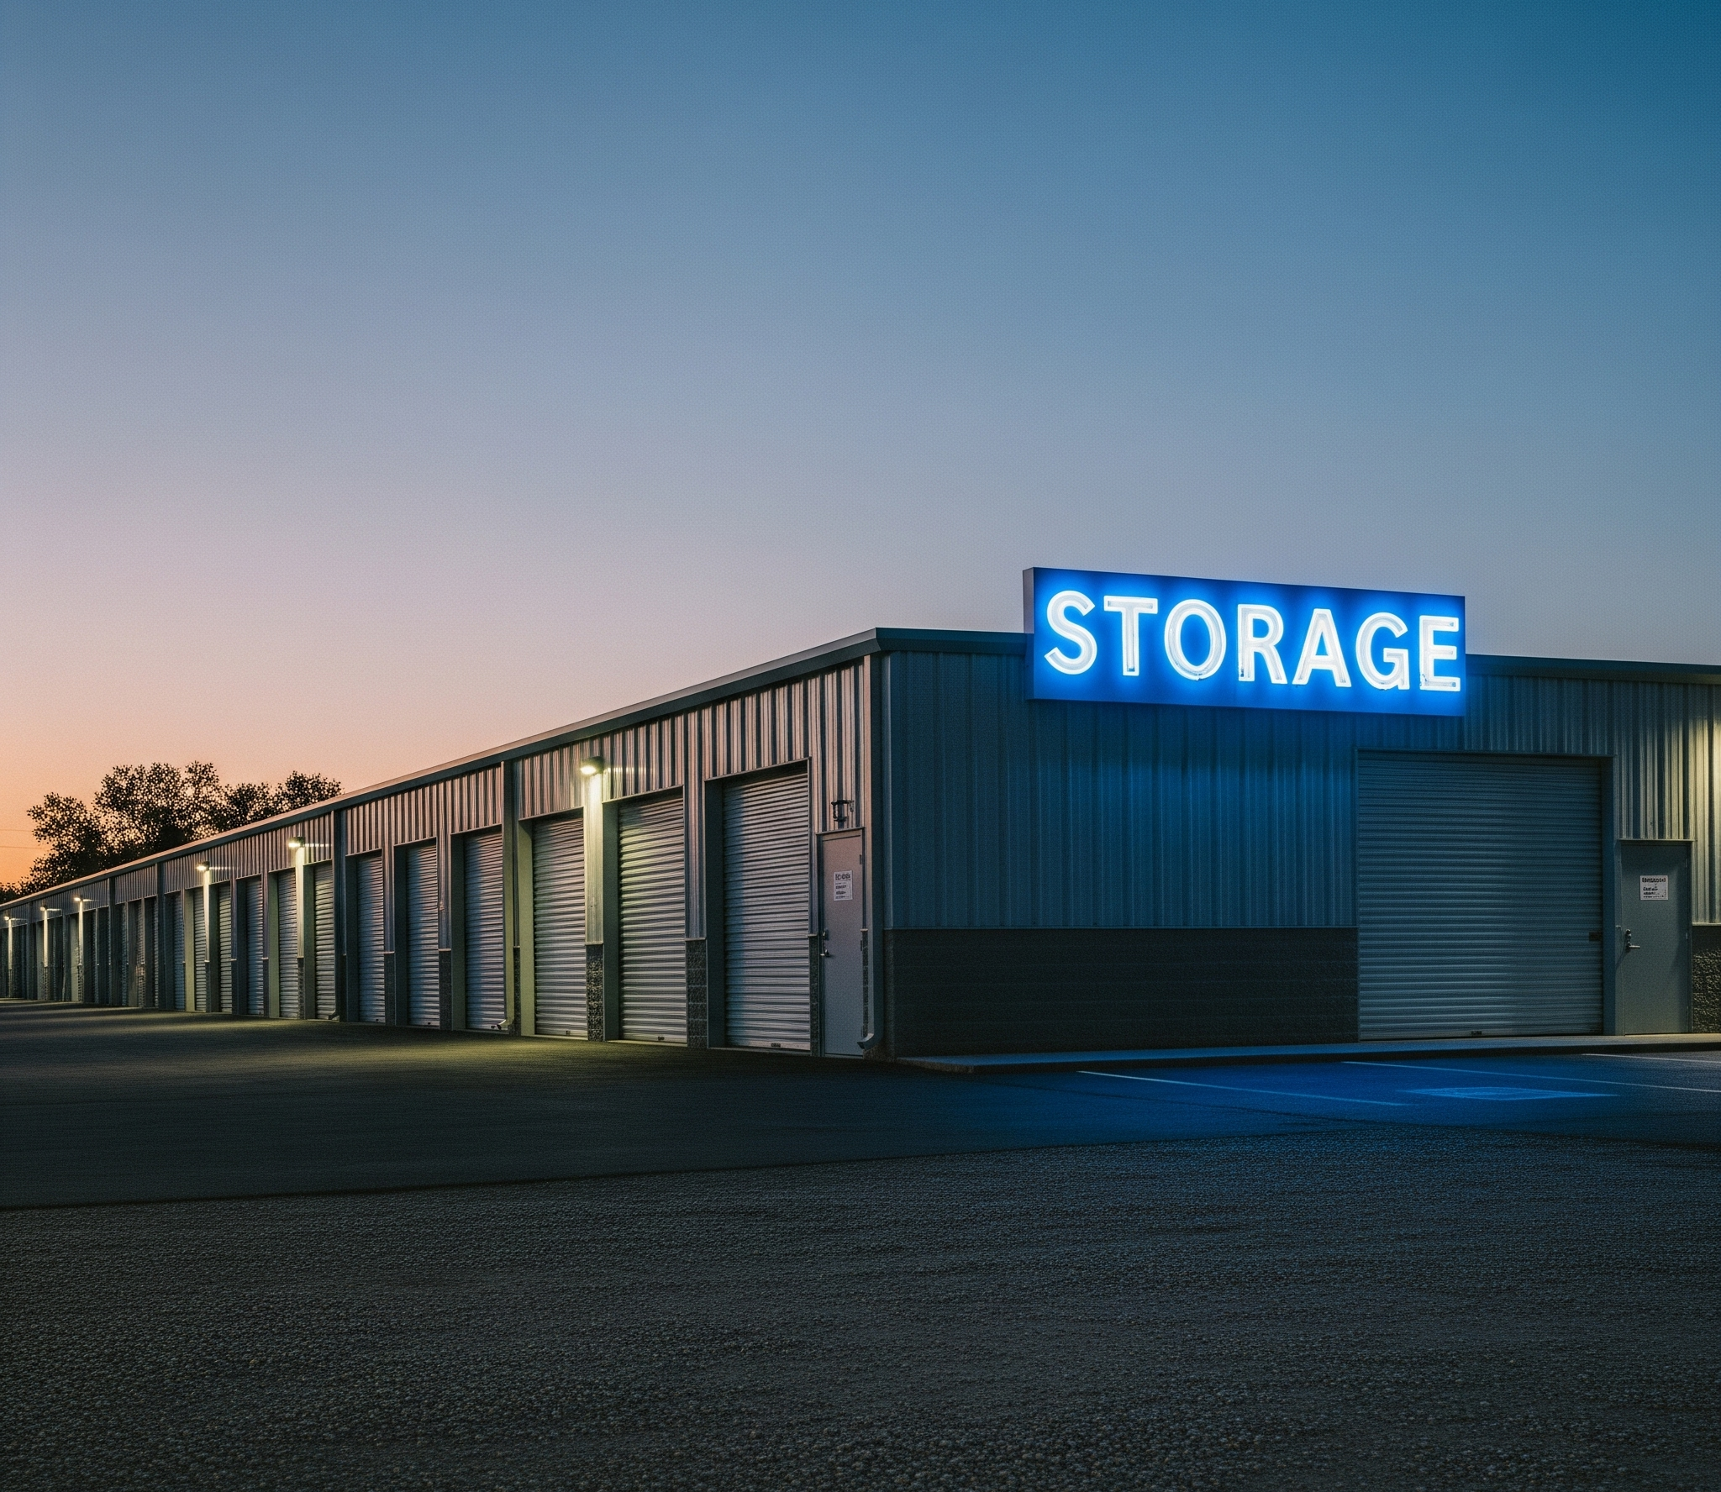
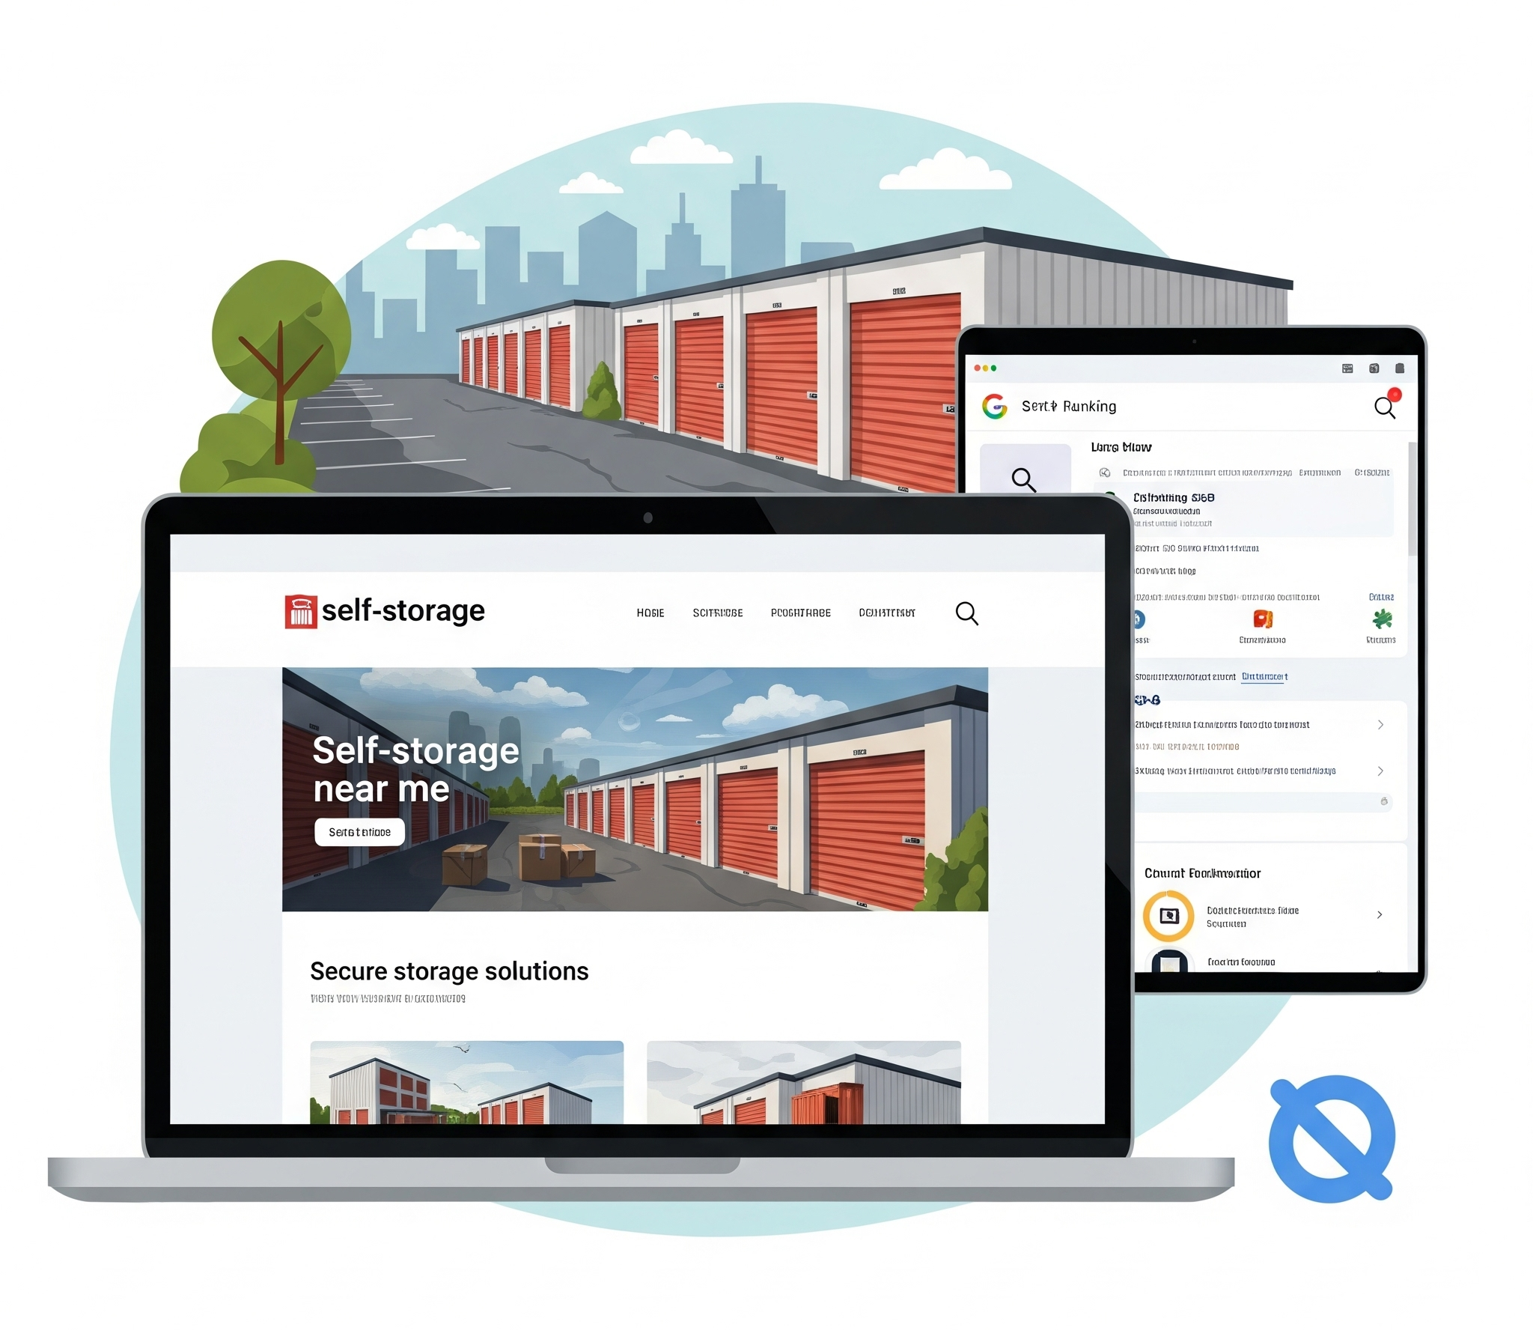
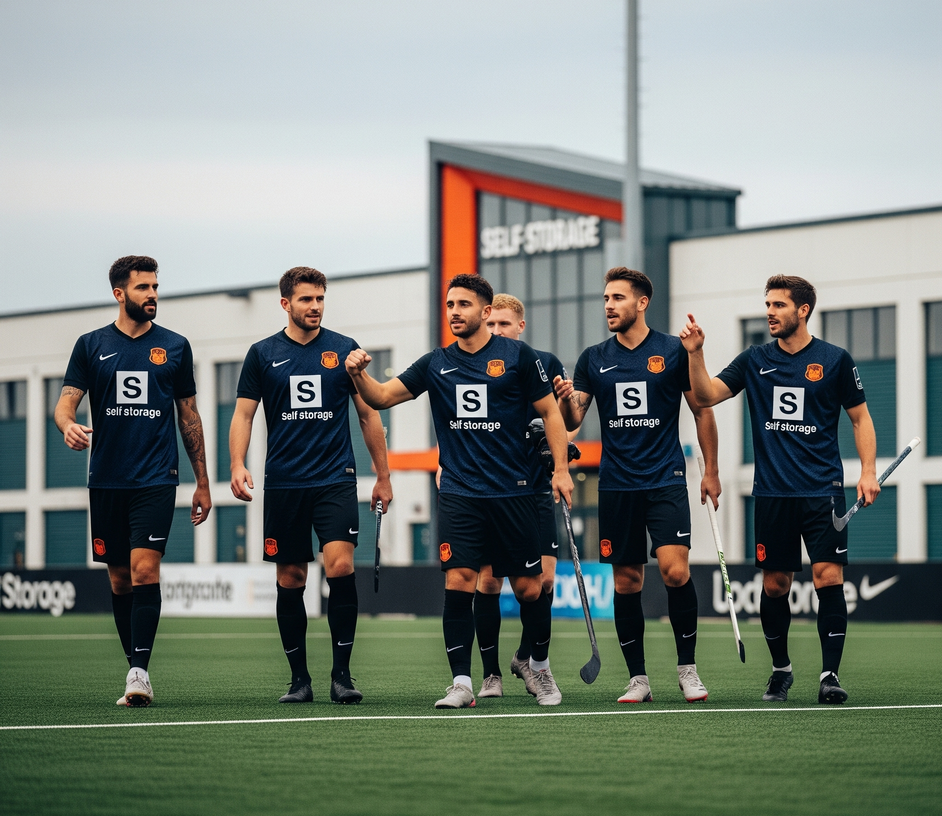
Your marketing channels by group
Developed by me
Nordic Conference 2025
Physical
Digital
Community
Signage
Flyers
Decals
Referral cards
Merchandise
OOH ads
Website
Local SEO
Google Ads
Meta Ads
Tiktok ads
Organic Social
Online groups
Sponsorships
Local Charities
Grassroots groups
Local Press
School fairs
Business partnerships
Notes:
So - It’s not about being everywhere - it’s about being in the right places, consistently
Basic marketing channels can be broken down into 3 groups

Slide 20
Local Markets
Market A
Market B
Company Name
Nordic Conference 2025
Market A
Young, urban dwellers
Market B
Rural, downsizing retirees
Market A
Young, urban dwellers
Market B
Rural, downsizing retirees
Notes:
For the purposes of clarity - focus on 2 markets with very different attributes, needs, touch points.
During our work with operators in different markets rural, urban, suburban - we’ve pinpointed how different channels afford different results depending on the market you are operating in.

Slide 21
Effort vs. Impact Marketing Matrix
Developed by me AB
Nordic Conference 2025
Urban: higher density, digital-savvy, more competitors, less reliance on car travel
Rural: wider spread, stronger community ties, often less saturated with digital noise
Channel Type
Effort
Urban
Rural
Notes
PPC / Google Ads
Local SEO / Maps
Meta Ads
Community Sponsorships
Signage & Van Branding
Local Press/Radio
Notes:
Using a matrix it’s clear to see the various impact different marketing channels can have on different markets.

Slide 22
Effort vs. Impact Marketing Matrix
Developed by me AB
Nordic Conference 2025
Urban: higher density, digital-savvy, more competitors, less reliance on car travel
Rural: wider spread, stronger community ties, often less saturated with digital noise
Channel Type
Effort
Urban
Rural
Notes
PPC / Google Ads
Medium
⭐⭐⭐⭐
⭐⭐
Strong in dense, competitive markets. Weak if search volume is low.
Local SEO / Maps
Meta Ads
Community Sponsorships
Signage & Van Branding
Local Press/Radio
Notes:
PPC / essential to know the search volume in your local area of the keywords you are specifically looking for. Is there much competition in your local area - why would pay for clicks when you are the only competition in local areas.
** this is becoming a more difficult marketing stream to master - larger operators are dominating in areas that they don’t even serve, frustratingly.

Slide 23
Effort vs. Impact Marketing Matrix
Developed by me AB
Nordic Conference 2025
Urban: higher density, digital-savvy, more competitors, less reliance on car travel
Rural: wider spread, stronger community ties, often less saturated with digital noise
Channel Type
Effort
Urban
Rural
Notes
PPC / Google Ads
Medium
⭐⭐⭐⭐
⭐⭐
Strong in dense, competitive markets. Weak if search volume is low.
Local SEO / Maps
Medium
⭐⭐⭐⭐
⭐⭐⭐⭐
Essential in both; fewer rural competitors gives advantage.
Meta Ads
Community Sponsorships
Signage & Van Branding
Local Press/Radio
Notes:
One of the most important marketing streams for all operators no matter where you are. On avg 80-70% of online bookings or enquiries use online maps (google and apple) at some point in the customer journey. A vital sources for local services - social proof, images and expectation setting, distance (it removes a huge amount of anxiety and frustration from the customer journey and purchase decision process.

Slide 24
Effort vs. Impact Marketing Matrix
Developed by me AB
Nordic Conference 2025
Urban: higher density, digital-savvy, more competitors, less reliance on car travel
Rural: wider spread, stronger community ties, often less saturated with digital noise
Channel Type
Effort
Urban
Rural
Notes
PPC / Google Ads
Medium
⭐⭐⭐⭐
⭐⭐
Strong in dense, competitive markets. Weak if search volume is low.
Local SEO / Maps
Medium
⭐⭐⭐⭐
⭐⭐⭐⭐
Essential in both; fewer rural competitors gives advantage.
Meta Ads
Medium
⭐⭐⭐️
⭐⭐⭐⭐
Works well in rural - community based groups and information sharing
Community Sponsorships
Signage & Van Branding
Local Press/Radio
Notes:
It may not be a high converting but it can have a huge impact on brand awareness and brand recall when the need arises for customers. Remarketing via Meta for customers that have landed on your website browsing can capture ‘low hanging fruit’.

Slide 25
Effort vs. Impact Marketing Matrix
Developed by me AB
Nordic Conference 2025
Urban: higher density, digital-savvy, more competitors, less reliance on car travel
Rural: wider spread, stronger community ties, often less saturated with digital noise
Channel Type
Effort
Urban
Rural
Notes
PPC / Google Ads
Medium
⭐⭐⭐⭐
⭐⭐
Strong in dense, competitive markets. Weak if search volume is low.
Local SEO / Maps
Medium
⭐⭐⭐⭐
⭐⭐⭐⭐
Essential in both; fewer rural competitors gives advantage.
Meta Ads
Medium
⭐⭐⭐️
⭐⭐⭐⭐
Works well in rural - community based groups and information sharing
Community Sponsorships
Low
⭐⭐
⭐⭐⭐⭐
High trust-building in rural; often overlooked.
Signage & Van Branding
Local Press/Radio
Notes:
Building bridges in the community plays a very important role in smaller communities. Trust, a sense of giving back, supporting grassroots community organisations can help educate potential customers about your services and build brand awareness.

Slide 26
Effort vs. Impact Marketing Matrix
Developed by me AB
Nordic Conference 2025
Urban: higher density, digital-savvy, more competitors, less reliance on car travel
Rural: wider spread, stronger community ties, often less saturated with digital noise
Channel Type
Effort
Urban
Rural
Notes
PPC / Google Ads
Medium
⭐⭐⭐⭐
⭐⭐
Strong in dense, competitive markets. Weak if search volume is low.
Local SEO / Maps
Medium
⭐⭐⭐⭐
⭐⭐⭐
Essential in both; fewer rural competitors gives advantage.
Meta Ads
Medium
⭐⭐⭐️
⭐⭐⭐⭐
Works well in rural - community based groups and information sharing
Community Sponsorships
Low
⭐⭐
⭐⭐⭐⭐
High trust-building in rural; often overlooked.
Signage & Van Branding
Low
⭐⭐⭐️
⭐⭐⭐⭐
Great in both, crucial where pass-through traffic is high.
Local Press/Radio
Notes:
Signage is essential - especially on well positioned buildings/facilities. But, it isn’t about how big the phone number is on the side of the building. Signage plays a role in the brand recall at category entry points or customer ‘need states’. It must act as the red thread that allows customers to associate their need with your solution (your entire reason for marketing).

Slide 27
Effort vs. Impact Marketing Matrix
Developed by me AB
Nordic Conference 2025
Urban: higher density, digital-savvy, more competitors, less reliance on car travel
Rural: wider spread, stronger community ties, often less saturated with digital noise
Channel Type
Effort
Urban
Rural
Notes
PPC / Google Ads
Medium
⭐⭐⭐⭐
⭐⭐
Strong in dense, competitive markets. Weak if search volume is low.
Local SEO / Maps
Medium
⭐⭐⭐⭐
⭐⭐⭐
Essential in both; fewer rural competitors gives advantage.
Meta Ads
Medium
⭐⭐⭐️
⭐⭐⭐⭐
Works well in rural - community based groups and information sharing
Community Sponsorships
Low
⭐⭐
⭐⭐⭐⭐
High trust-building in rural; often overlooked.
Signage & Van Branding
Low
⭐⭐⭐️
⭐⭐⭐⭐
Great in both, crucial where pass-through traffic is high.
Local Press/Radio
Medium
⭐
⭐⭐⭐
Often affordable in rural; low competition for attention.
Notes:
Having played around with local press and radio … it is definitely a critical marketing stream for rural areas that still rely on local news organisations to disseminate information. Urban areas don’t tend to rely on local press in the same way.
Cost of these marketing streams in urban areas is also a factor in putting off most operators.

Slide 28
Knowledge is power in marketing - understanding your audience and local markets will make marketing decision-making more effective.
Developed by me
Notes:
Knowledge is power in marketing - understanding your audience and local markets will make marketing decision making more effective.Channel tactics only work when they speak to a known need — in a known place — at the right time.

Slide 29
Next
steps
Developed by me
Nordic Conference 2025
Start with understanding
Investigate your real local market
Choose 3–4 focused channels
Be consistent and local with your messaging

Slide 30
Any questions?
Ask away!
Jill Leckie - Developed By Me AB
Full Stack Marketing and Fractional CMO Services
jill@developedbyme.com
Notes:
We need to create a framework for local insight - often called a feasibility study but for Marketing - how feasible is our local market?

