Slide 1



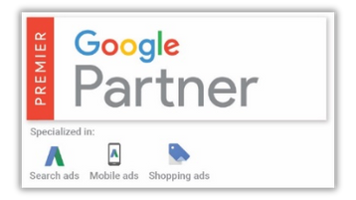

From Clicks to Customers:
Unlocking Google Ads strategies for sales growth
Laura Moxham
www.ybappc.co.uk
Notes:
Increasing customers require finesse and careful attention
Let’s kick off today’s session from CLICKs to CUSTOMERS to see who can do so with catching a t-shirt from THIS click?!
FREE digital review to help YOU get you more customers from your Google clicks

Slide 2
10 Secrets from generating 15,000 Storage Leads
Notes:
SSA - sharing insights and knowledge, we’re as a crucial part of that
Excited to share with you 10 secrets for generating 15,000 storage leads.
Insights are invaluable to help maximise your business’s growth
Competitive landscape
Buckle up to embark on unlocking secrets that can help transform your business

Slide 3

team@ybappc.co.uk
Data : no opinions only evidence
Over 12 months:
£251,017 ad spend
73,923 clicks
14,908 leads
£4.5m estimated sales value
50+ self-storage accounts
Notes:
Let the numbers do the talking
No just theory
Evidence-backed strategies to drive success in self-storage
Say goodbye to Q1 - great time to reflect and make growth for Q2

Slide 4

team@ybappc.co.uk
You will learn
1. Why Google isn’t helping your business
2. How to eliminate out of area enquiries
3. How you could double your ad spend
… for free!
Plus 7 more secrets costing you money right now
Notes:
Pitfalls
Misconceptions
Wonder why out area
Reveal strategies
Examples of clients as we go

Slide 5
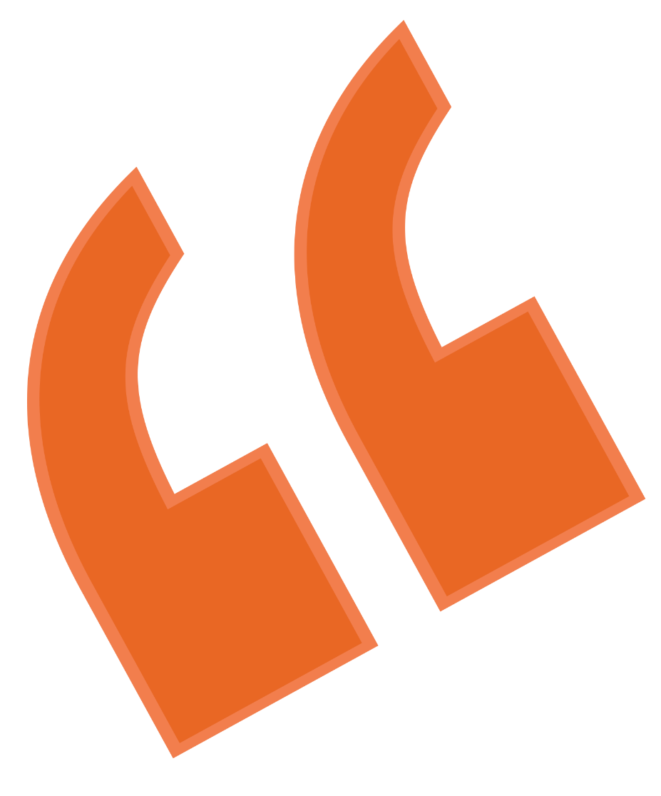
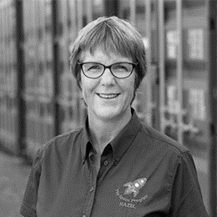
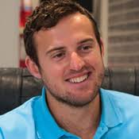
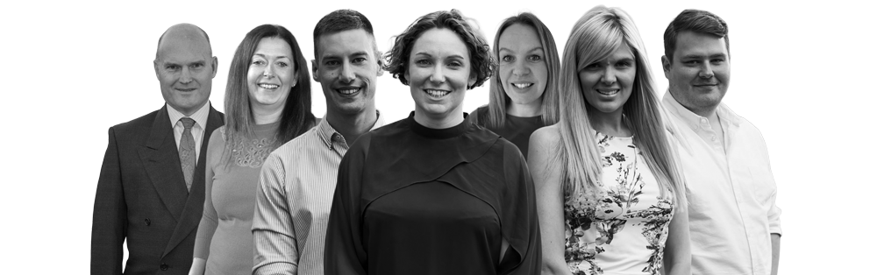
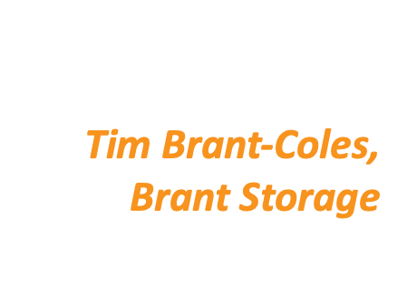
team@ybappc.co.uk
Who’s YBA?
SSA Supplier Partner 18 months
Top 3% Google Premier Partner
Self storage > 75k clicks & 15k in 12 months
Over £4m ad spend per year
“Our revenue is up 75%”
Hazel Edwards
Container Team
Notes:
Let me give context of why we are
LOVE the SSA – great fun people, share insights
Uniquely positioned
Our business - complexities of Google
Dry subject > exciting and passion.

Slide 6
10 Secrets from generating 15,000 Storage Leads
Notes:
Lets get into it

Slide 7
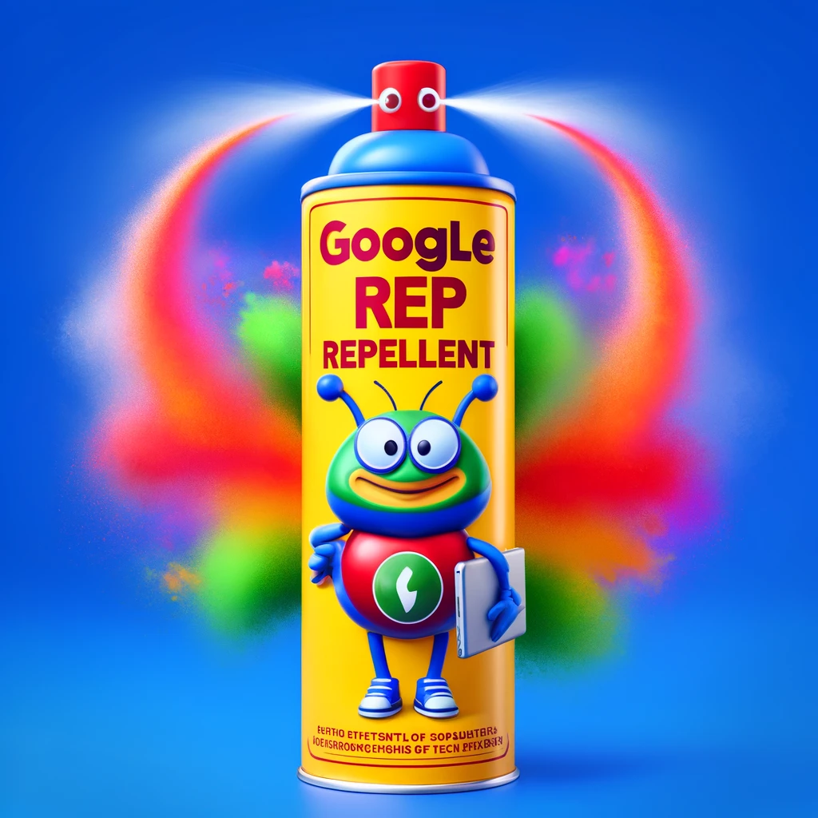
team@ybappc.co.uk
Buy a can of Google Rep Repellent
In app, emails, call you
Google is not your friend
Recommendations typically perform 21% worse
They have targets to hit
Notes:
Something that might surprise you
Get a can – it might be a good safeguard for you
“Oooooh Google’s calling”
Our analysis show

Slide 8
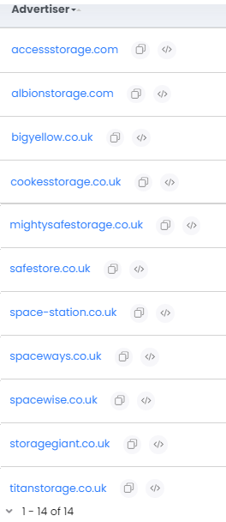
14 advertisers in Birmingham alone
Notes:
Here’s why
Roulette table – enough people at the table always win
Their goal is to ensure they have a selection of advertisers
4 spots

Slide 9
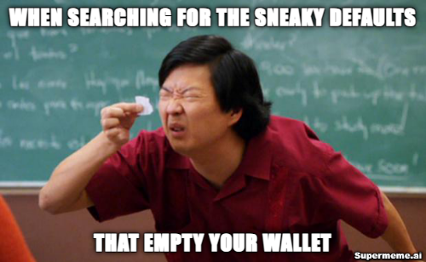
team@ybappc.co.uk
2. Turn off (most) defaults
2. Turn off most defaults
Notes:
Seemingly innocuous settings
Left unchecked empty your wallet
Hide areas and data
Reach wider audiences – less relevant
More spend

Slide 10
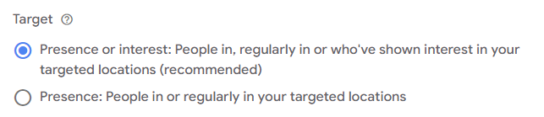
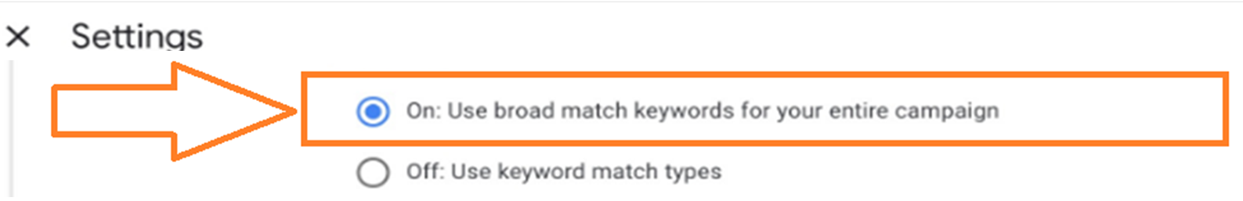
x
team@ybappc.co.uk
Attracts out of area leads:
Switches all keywords to ‘broad’
Notes:
2 examples
Broad match by default – spend money lots of wastage
Be in control
Operators get out of area enquiries
Phrase (lower volume) or broad (higher volume)
Brand > exact

Slide 11
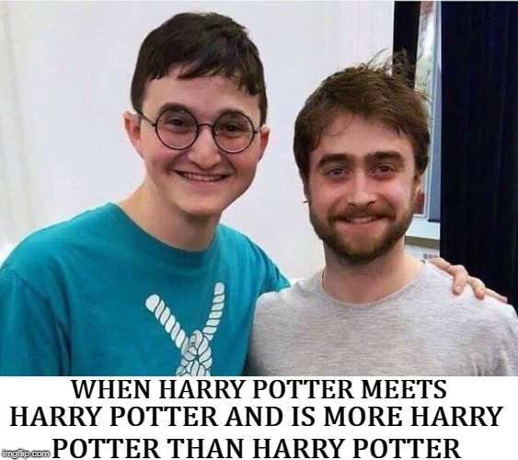
team@ybappc.co.uk
3. Find the right ‘match’ for you
Match types don’t mean what you think
Exact match [self storage] triggered these:
            portable storage units near me
            store your items
            storage inits
And 746 others!
Choose keyword match types deliberately
Notes:
Talk about match types
Not just keywords, but match types
Have different outcomes
Exact is not exact - incorporates close variants
We aware of what you’re dealing with
Changed definitions about 18 months ago
Depends what to use – goal, size, maturity of the campaign
New account – phrase
Mature - move to broad

Slide 12
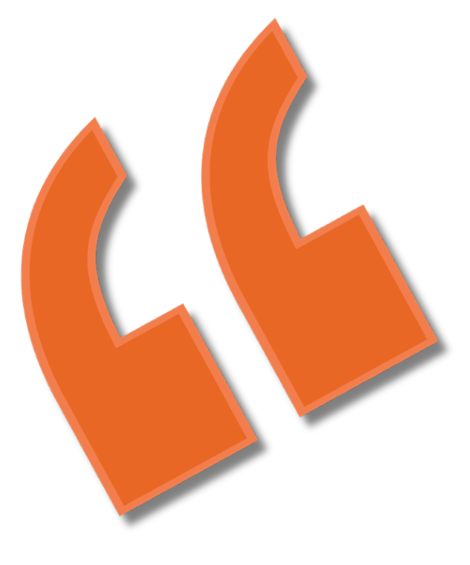
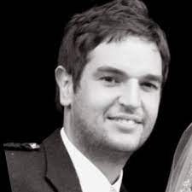

team@ybappc.co.uk
Client story – keywords
Within 3 months:
63% increase in leads (from 40 to 85 per month)
39% reduced cost per lead
375% increase in conversion rate
“Google Ads is a complex beast, YBA were able to turn it around. Now we have a great flow of enquiries”
Gerry Verner, MON Store
Notes:
Share real-life success story
Had good level of leads – no problems
Doing inhouse
Review
Broad keywords
Adjusted
Staggering change in results

Slide 13
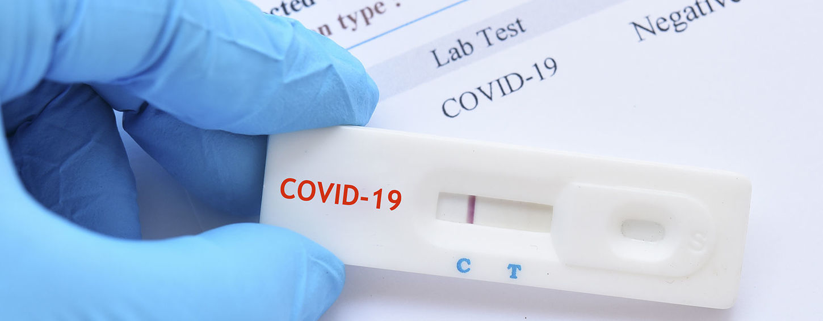
team@ybappc.co.uk
4. Positively Negative
‘Negatives’ are important
A daily / weekly task
90% of accounts reviewed don’t have account-wide negatives:
Notes:
Talked about keywords
Essential for keyword optimisation
Overlooked
Enhances targeting precision
Think of them as gatekeeper for your ads
Huge emphasis on adding keywords
50 clients - gathered a lot of data
Know what doesn’t work

Slide 14
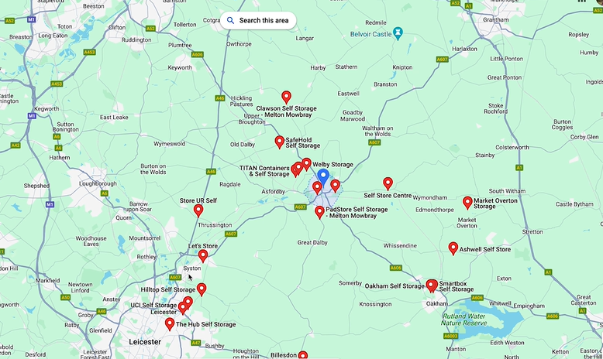
team@ybappc.co.uk
5. Location Location Location
Choose realistic areas to target
10 miles around?
      Where will people drive from?
      Who are they driving passed?
Competitors
List reasons you’re better
Feed into the ad copy
Notes:
Location is paramount
You picking the location
And how you look to prospects
Understanding driving patterns will help you
Increase performance and ROI
What set you apart?
Effective and compelling
Promos, location, features

Slide 15

team@ybappc.co.uk
6. Right Structure
Too many keywords (worked in 2020!)
Brand
Local
National
= More relevance
= More quality enquiries
Notes:
Lot of evidence of campaign structures that don’t lean into data
Too many keywords
What was good in 2020 is not in 2024
Aggregation of data
Brand – protection and halo effect with low CPL and pulls
Brand – 5% of your budget
Feed the machine

Slide 16
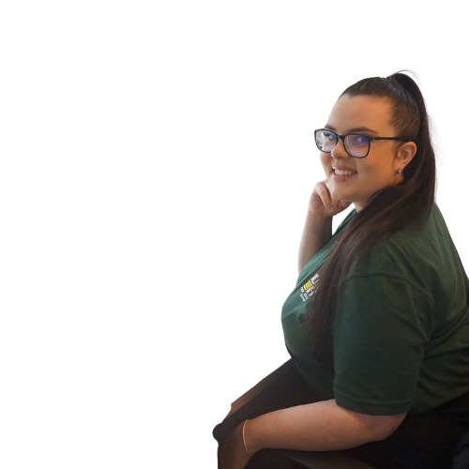
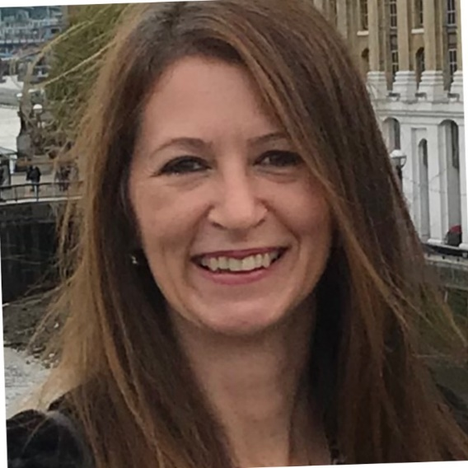


team@ybappc.co.uk
Client story – structure
Within 3 months:
95% increase in conversion rate
87% reduced cost per lead
“Our cost per lead is down massively and a nice increase in leads.”
Georgie Duke, Unit Group
“Our occupancy is up 30%”
Nicola Lobley, The Hive
Notes:
Unit Group
Before: Broad keywords, many campaigns
After: Fewer, more focussed keywords
Hive

Slide 17
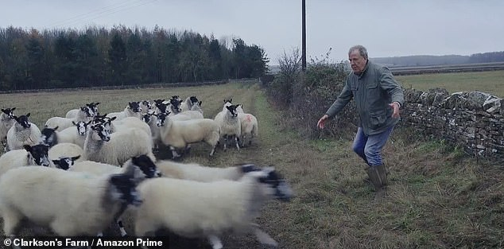
team@ybappc.co.uk
7. Double your budget for free
25%-35% of keywords we’re seeing haven’t converted over 6 months – kill these!
Reallocate this budget to best performers
Notes:
Your job – shepherd
Aim toward the lush green pastures, away from rocky terrain
Google ads is the same – direct spend to efficient fruitful areas
Not all keywords created equal
Cull underperformers
Balance

Slide 18

team@ybappc.co.uk
Client story – reallocate budget
Ad spend moved to better performing keywords
Within 2 weeks:
Doubled enquiries from same ad spend
“206% increase in enquiries in 2 weeks”
Edward Howard, Mega Storage

Slide 19
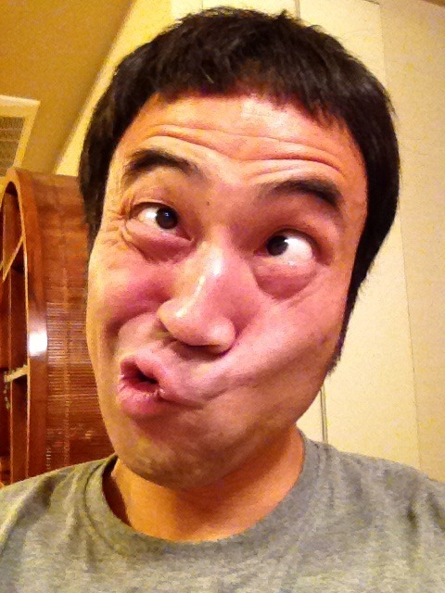
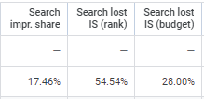
team@ybappc.co.uk
8. Make the right impression
= 82% of the time people are NOT seeing your ads
Notes:
This is what we see
Hidden feature & Hidden gold
Maximum impact
Depends on your goal
If new – 80% impression share
Rank or budget

Slide 20

team@ybappc.co.uk
Client story – impression share
Before:
    14% search impression share
    62% non converting keywords
Within 6 months:
    Spend on better performing keywords
Notes:
Low SIS & poor performing keywords
Outcome

Slide 21

team@ybappc.co.uk
9. Tracking
QUOTE
REQUESTS
PHONE CALLS
LIVE
CHAT
BOOKINGS
Notes:
Foundational & critical
Don’t keep yourself in the blind
80% of audits find 1 or more tracking problems
Guess-work
Feed the machine the right stuff
Rubbish in rubbish out

Slide 22
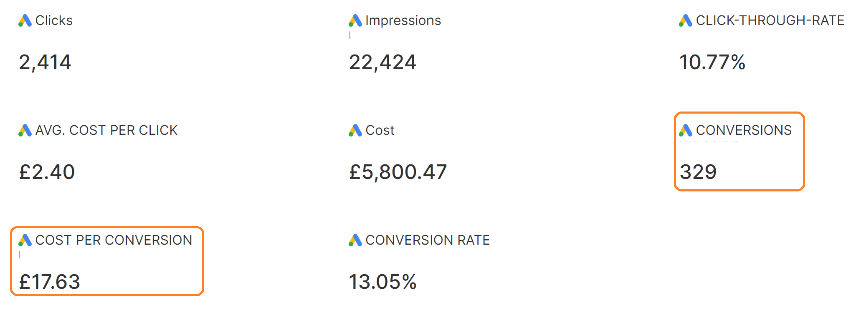
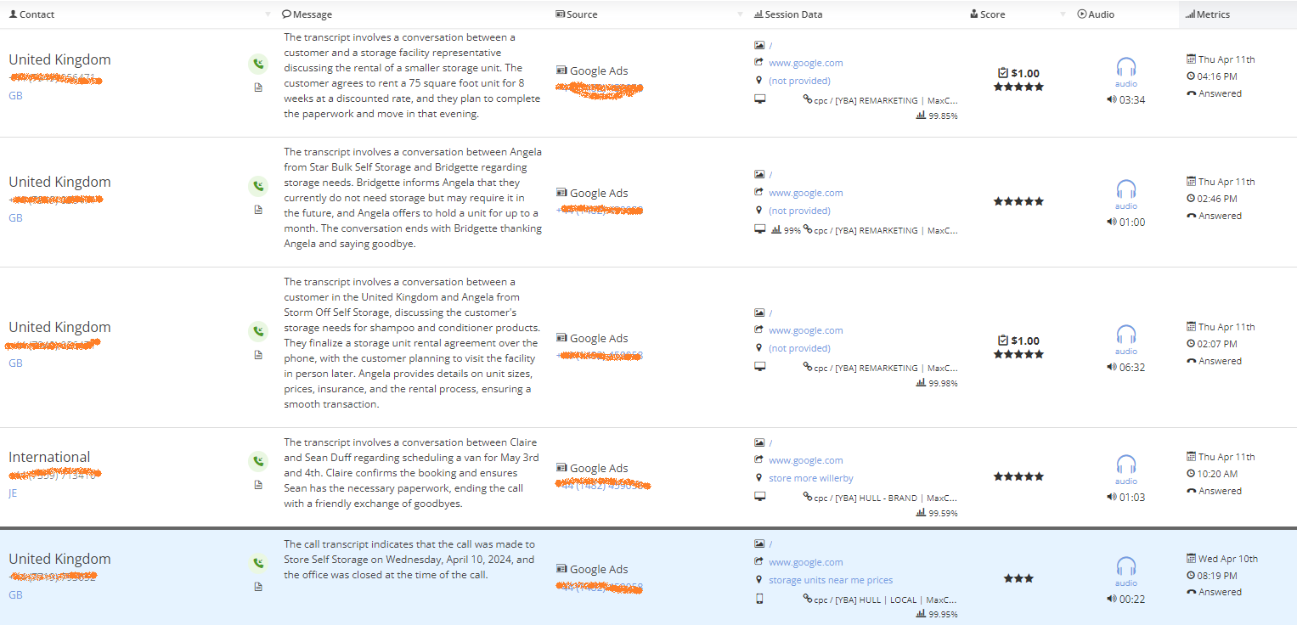
team@ybappc.co.uk
Notes:
Dashboard
AI transcription

Slide 23
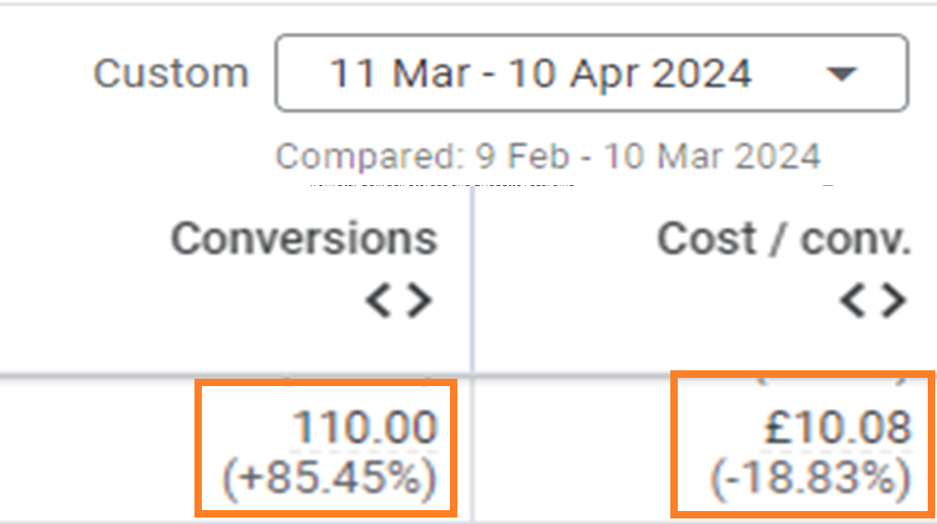
team@ybappc.co.uk
Client story – Tracking
Fixed call tracking (not just clicks)
Correct tracking feeds the algorithm
Results in 1st month:

Slide 24
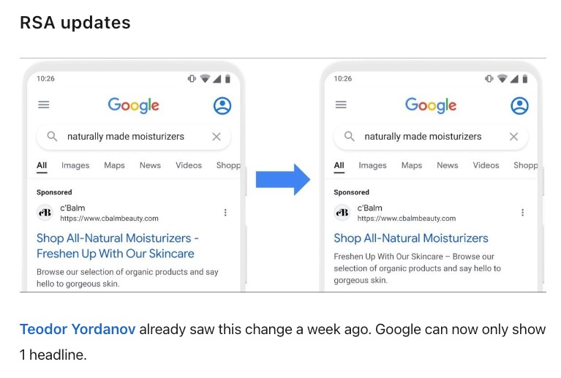
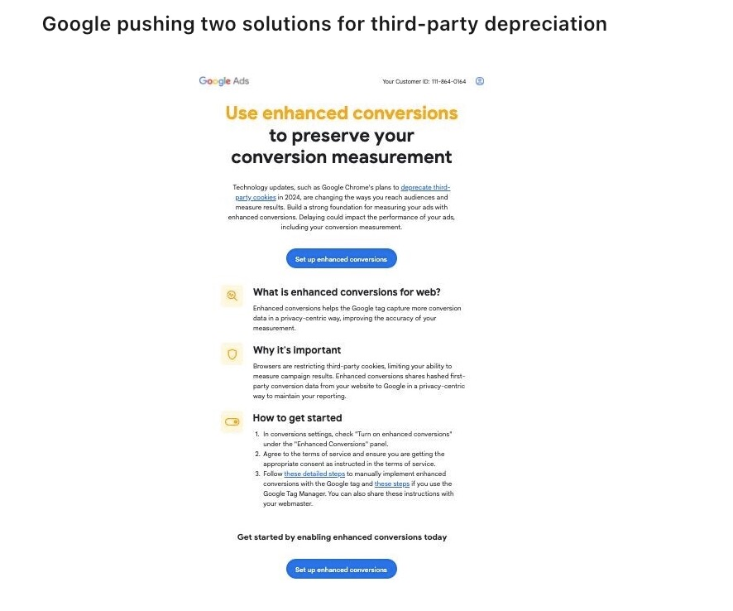
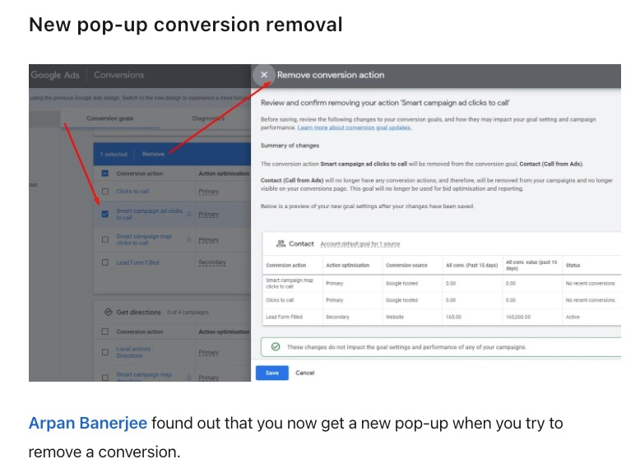
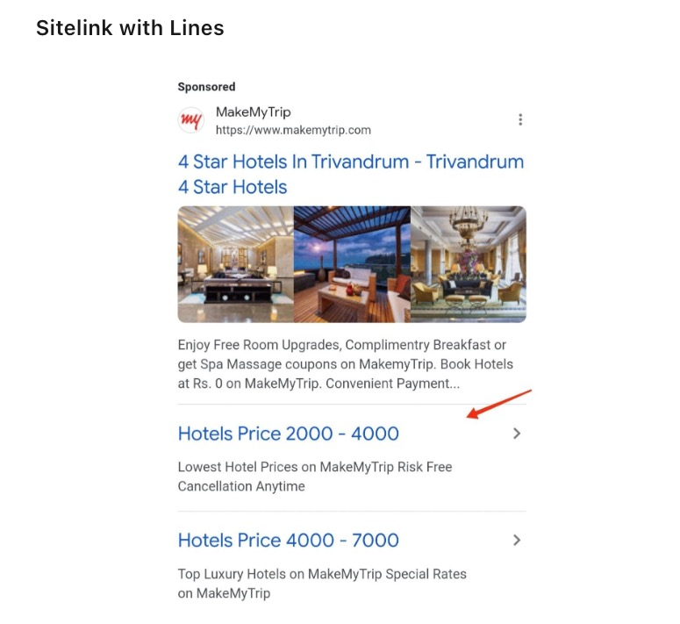
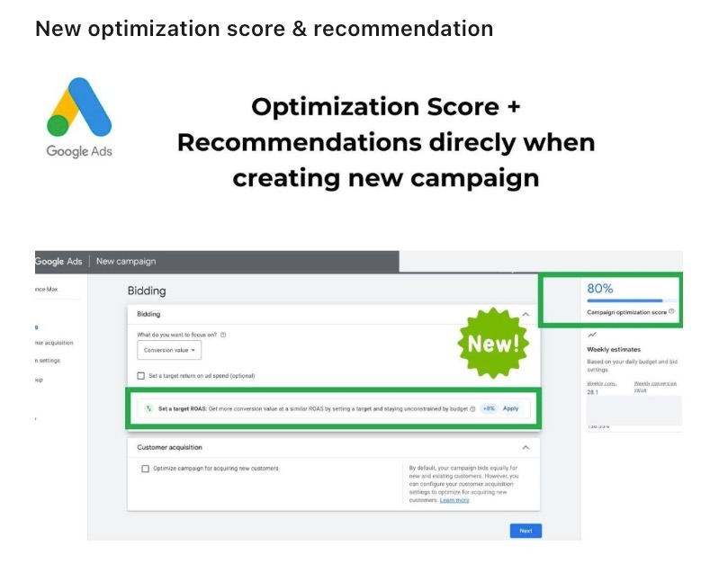
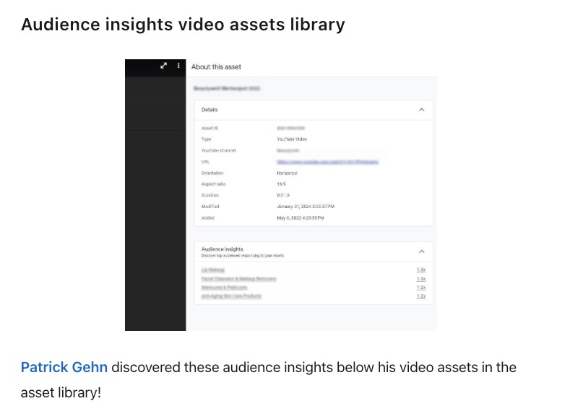
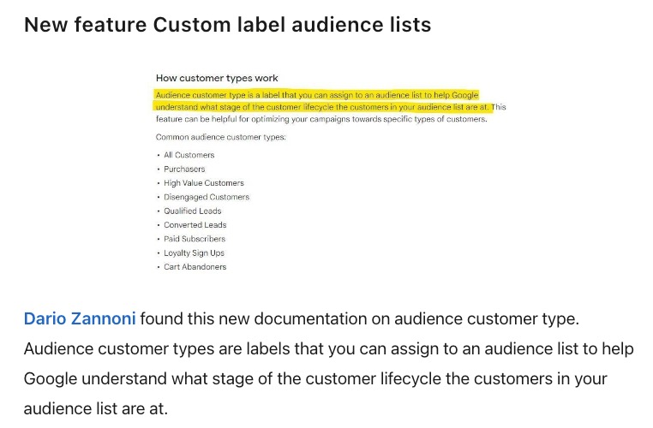
team@ybappc.co.uk
10. Keep up!
Pace of change has never been faster
Feb ‘24 sample of changes
Notes:
Rate of change
Whether us our somebody else
You need somebody to stay on top of the changes
Big one soon Enhanced Conversions > cookie policies

Slide 25

team@ybappc.co.uk
Takeaways
Google’s not your friend
Right setup for your goal
Pace of change - lots to do!
Notes:
Wrap up today's presentation
Reflect on what we've uncovered
Dissected areas to generate you more clicks and customers
Armed with these insights, it's time to take action
Optimizing your current Google Ads strategy, refining your targeting, or implementing new techniques, the potential for growth is within reach.
We're here to support you every step of the way
Free
. Let's harness the power of data-driven decisions and propel your self-storage business to new heights. Thank you for your attention, and let's embark on this journey together."

Slide 26
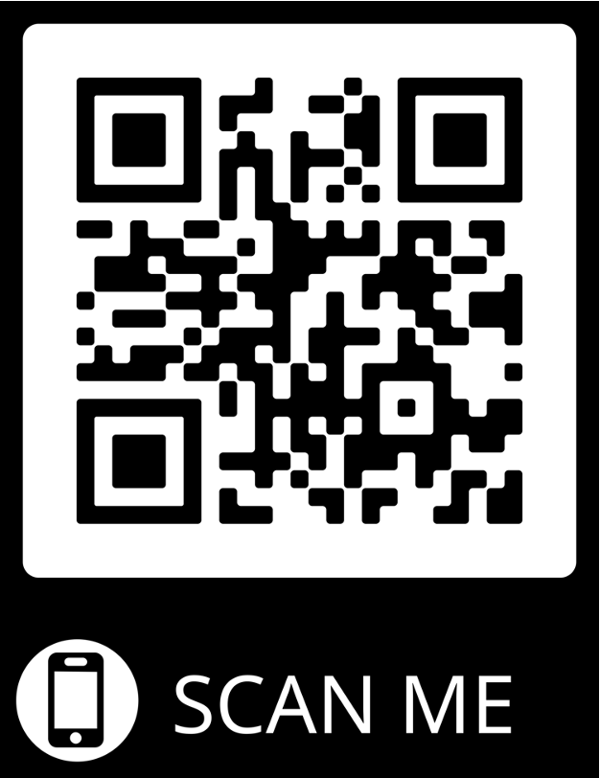
YOUR FREE GIFT
Getmoreleads.ybappc.co.uk
team@ybappc.co.uk

