Slide 1


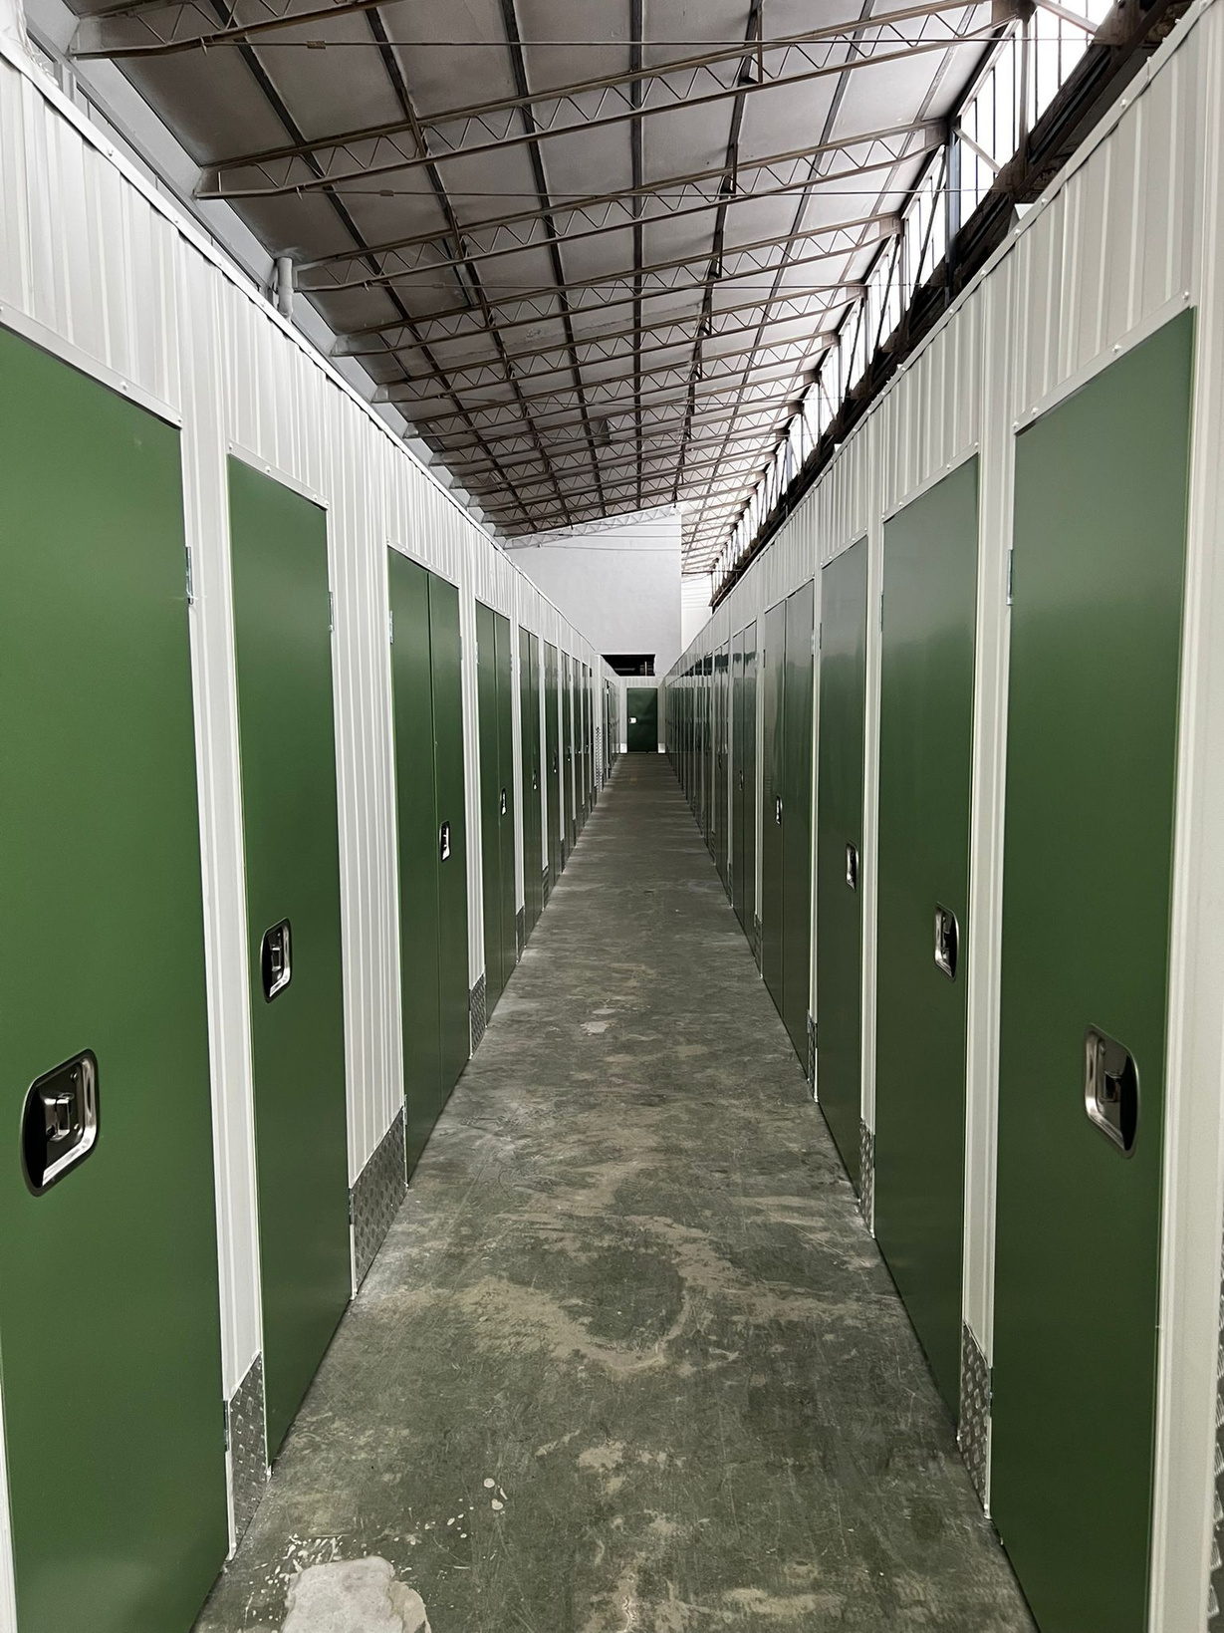



STORAGE
PRODUCTION
EUROPE
Construction of SELF STORAGE
according to your needs
www.spe.com.pl | sales@spe.com.pl | + 48 606 130 220 |

Slide 2


2024
SELF STORAGE
www.spe.com.pl | sales@spe.com.pl | + 48 606 130 220 |

Slide 3
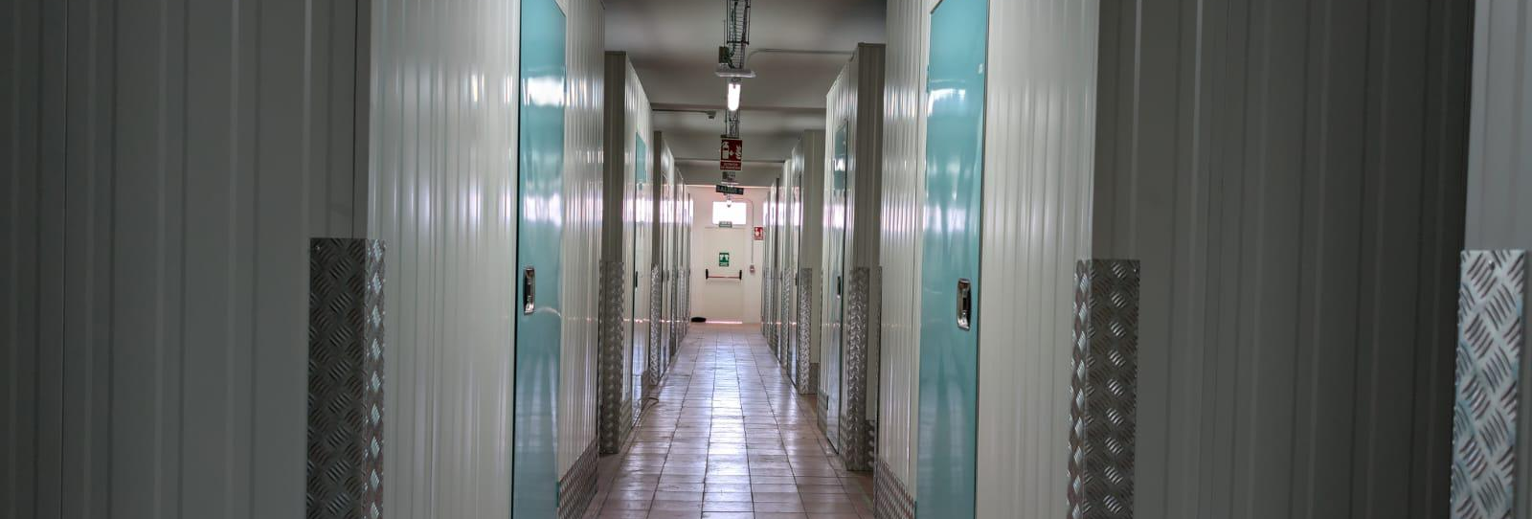

Success is when preparation meets opportunity.
SENEKA
www.spe.com.pl | sales@spe.com.pl | + 48 606 130 220 |

Slide 4
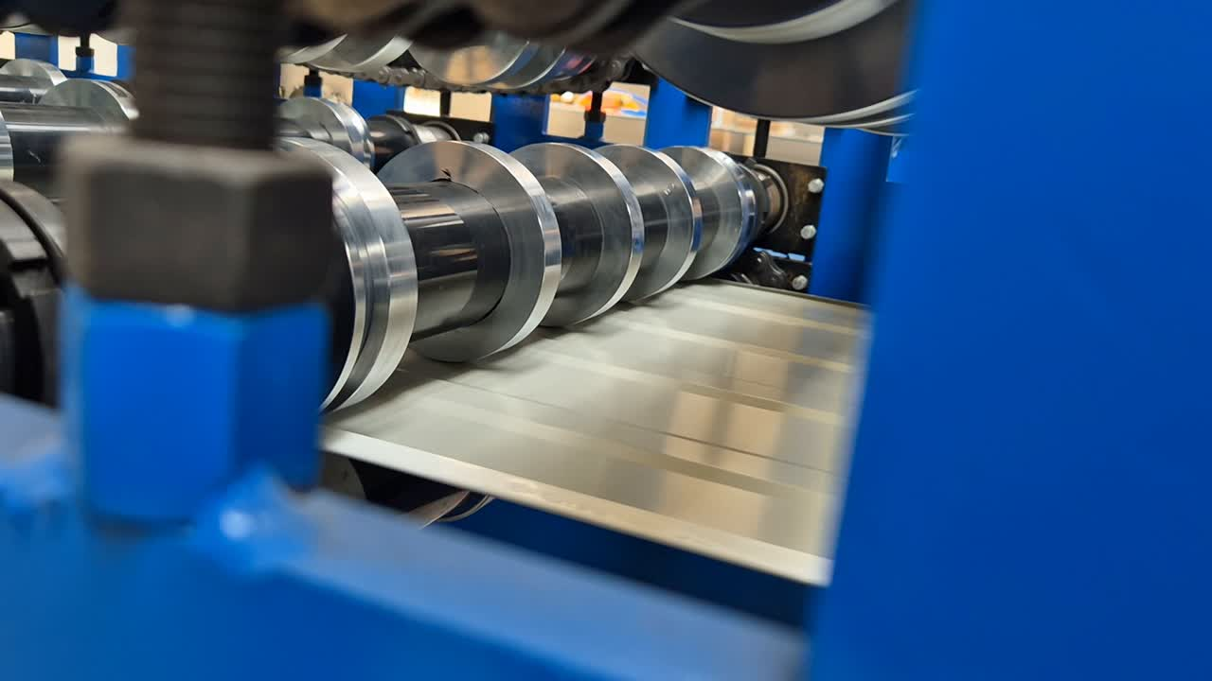
STORAGE PRODUCTION EUROPE
OWN PRODUCTION
www.spe.com.pl | sales@spe.com.pl | + 48 606 130 220 |

Slide 5




STORAGE PRODUCTION EUROPE
CONCEPT
PRODUCTION
ASSEMBLY
AFTER-MARKET CARE
www.spe.com.pl | sales@spe.com.pl | + 48 606 130 220 |

Slide 6
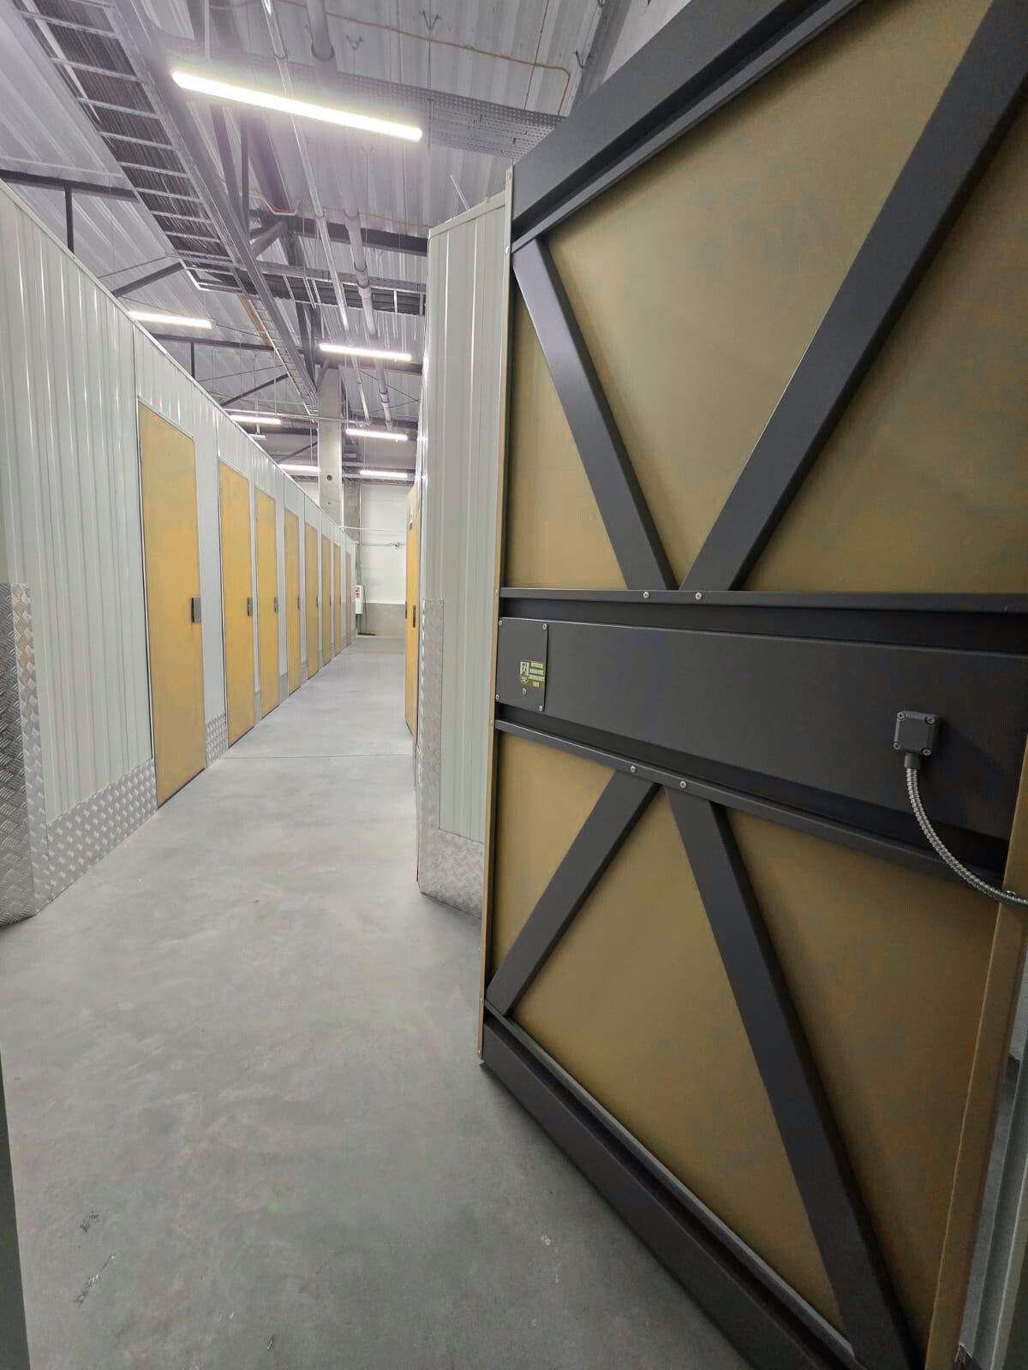
WEBSITE
www.spe.com.pl
E-MAIL
sales@spe.com.pl
LET'S STAY IN TOUCH
TELEPHONE
+48 606 130 220

