Slide 1
2024 I&L - market Self storage
Intelligent Investment

Slide 2
Global Overview
Our RISE-values
Respect Integrity
Service Excellence
$31.9B
#135
~115,000
2023 Revenue
2023 Fortune 500 ranking
Employees globally
118 years
95+
500+
Operation in US 25 years in Sweden
of the Fortune 100 are clients
Offices
100+
#1
Countries where CBRE serves clients
Lipsey #1 brand for 22 consecutive years

Slide 3
CAPITAL MARKETS & ADVISORY TEAM
RESEARCH
Oliver Close
Senior Director
Self Storage Valuation & Advisory
Rod Greenland
Associate Director
Self Storage Valuation & Advisory
Gareth Sandbrook
Associate Director
Self Storage
Valuation &
Advisory
Alice Marwick
Associate Director
OPRE Research
The leading European advisory team in the self-storage sector.
CBRE offers an unrivalled depth of experience in the self storage sector, combining the latest market knowledge with iron-clad client relationships.
Callum Paddock
Director
Self Storage Investment Properties
Alfie Stephenson
Associate Director
Self Storage Investment Properties
Alice Lang
Associate Director
Self Storage Investment Properties
Ben Linsey
Senior Analyst
OPRE Research
REAL ESTATE INVESTMENT BANKING (REIB) TEAM
DEBT & STRUCTURED FINANCE TEAM
Julian Allen
Managing Director
Head of Real Estate Investment Banking, Europe
Pablo Callejo
Executive Director
Executive Director Head of REIB, OPRE Continental Europe
Chris Gow
Head of D&SF
Head of OPRE Real Estate Investment Banking
Stephen Barr
Senior Director
OPRE Debt & Structured Finance
Tariq Hayat
Senior Director
Head of OPRE Real Estate Investment Banking
Tamer Ben-Nagi
Director
Real Estate Investment Banking
Harry Burgess
Associate Director
OPRE Debt & Structured Finance
Katarina Olsvik
Senior Analyst
OPRE Debt & Structured Finance

Slide 4
Agenda
(Economy)
Swedish I&L market
Industry Awareness
Industry Performance
Self-Storage – International perspective

Slide 5
Sweden Industrial and Logistics
1

Slide 6
Swedish economy expecting positive GDP growth in 2025-2026
Swedish Economy
CBRE House view, April 2024

Slide 7
INVESTMENT MARKET SWEDEN
VOLUME PER SEGMENT (SEK MILLION)
sHARE BY SECTOR, 2016 TO 2024
CBRE Research, April 2024

Slide 8
INVESTMENT MARKET SWEDEN
PRIEM YIELD (%)
Prime Yields INDUSTRIAL AND LOGISTICS (%)
CBRE Research, April 2024

Slide 9
Interest margin looks to start to stabilize as a volatile interest rate stabilize
Logistics & Industrial prime yield vs 10-year government bond
INVESTMENT
CBRE Research, April 2024

Slide 10
Interest margin looks to start to stabilize as a volatile interest rate stabilize
Breakdown Inudstrial investment and share of foreing investment
INVESTMENT
CBRE Research, April 2024

Slide 11
Industry Awareness
2

Slide 12
Sweden has the 2nd highest industry awareness
Notes:
Public awareness varies from country to country. Awareness is highest in the UK and Sweden at 88% but drops to 45% in Italy. Recent store openings in Sweden have naturally increased visibilitiy

Slide 13
Strongest Awareness in South Sweden
Results from 2022 Public survey

Slide 14
People above 45 have better awareness
Results from 2022 Public survey

Slide 15
Lack of understanding
Results from 2022 Public survey

Slide 16
Current use
Results from 2022 Public survey

Slide 17
Brand awareness in Sweden
How many self storage businesses can you name?
Results from 2022 Public survey

Slide 18
Brand awareness by country
Results from 2022 Public survey

Slide 19
Industry Performance
3

Slide 20
Occupancy below European average

Slide 21
Return per sqm (ex vat)

Slide 22
Self-Storage International Perspective
4

Slide 23
European Self Storage Transaction Volumes
Total Europe Self Storage Investment Volumes (£m) 2018-2024 (Pipeline)
2023 EU Self Storage Investment Volumes by Buyer Type

Slide 24
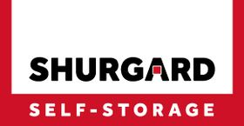
Buyer Universe
INSTITUTIONAL MONEY MANAGERS/ REIT / SOVEREIGN WEALTH
PRIVATE EQUITY
OPERATORS

Slide 25
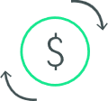
Market Trends and Investment Drivers
Winter workshop 2024
01
02
03
04
Robust trading
Fragmented
Record highs
Lack of supply
Extremely robust trading performance set to continue Operators moving ARR and Occupancy % to tackle inflation concerns
European self storage market - fragmented but ripe for consolidation and growth
Weight of capital targeting EU self storage sector at record high
Investors frustrated by lack of sizable quality platforms in market

Slide 26
Market Trends and Investment Drivers
Winter workshop 2024
05
06
07
08
Partnerships
Safe haven
Debt market
Increase in deal flow
Scarcity of experienced management teams capable of navigating and driving business growth
Safe Haven Sector 2nd strongest total return sector though GFC
Self storage debt market accretive but will be under pressure - Alternative lenders key / others underwriting ungeared
Deal flow expected to increase – driven by historic benchmark transactions

Slide 27
2023 KEY DEALs
One asset in Poland
Buyer: Stokado (Redefine Properties and Griffin Capital Partners)
Seller: Top Box Self Storage
Seven assets in Germany
Buyer: Shurgard
Seller: Top Box Self Storage
Price: €69.2 million
142 Stores in the Nordics
Buyer: Nuveen
Seller: SSG ASA (City Self Storage /OK Minilager)
Comment: Listed company, share deal
Price: €470 million
Four stores in UK
Buyer: Nuveen
Seller: Easistore
Comment: First acquisition for Nuveen’s pan-European diversified value-add strategy
Price: Conf

Slide 28
2023 – 2024 KEY DEALs
Two stores in UK
Buyer: Mayfair Capital
Seller: GoStore
Comment: Occupancy potential
Price: £15-20 million
Six Stores in Germany
Buyer: Shurgard
Seller: Pickens
Price: €120 million
26 Stores in UK
Buyer: Shurgard
Seller: Lok'N Store
Comment: Listed company, share deal
Price: €374 million

Slide 29
Valuation Approach
Winter workshop 2024
DCF
Cashflow Projection
Analysis of Trading
Key Value Drivers

Slide 30
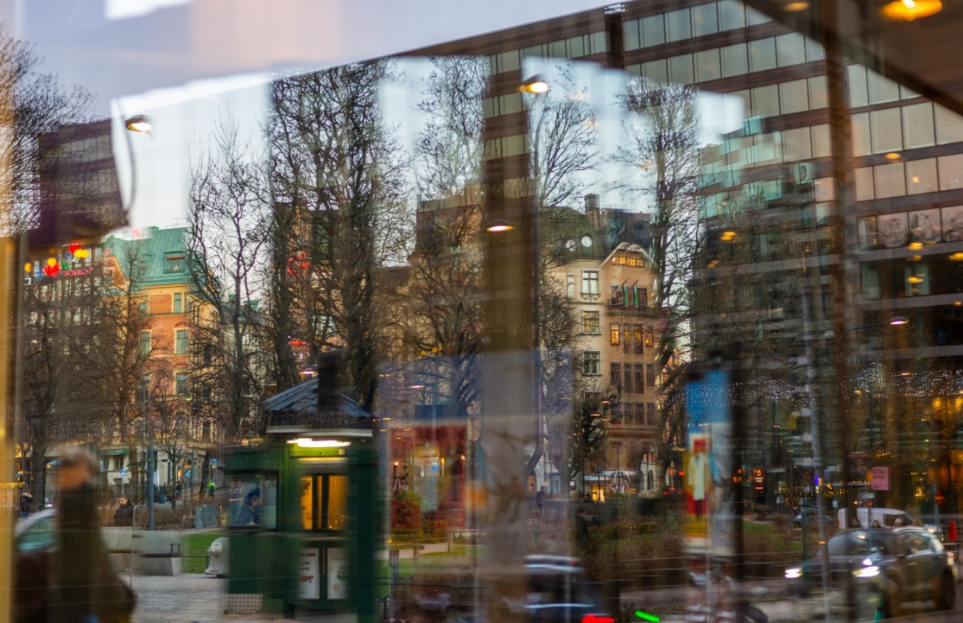
THANK YOU
FOR MORE INFORMATION
Andreas Eckermann
Head of Gothenburg, Senior Director
CBRE Sweden
Andreas.eckermann@cbre.om
CBRE Sweden

