Slide 1

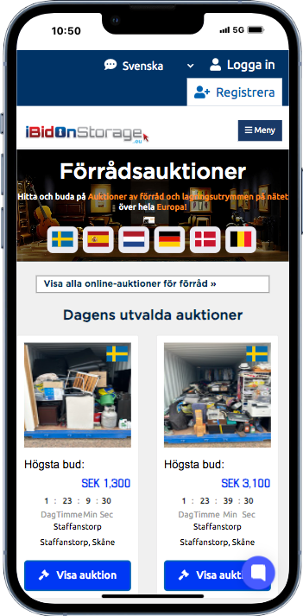















Online Storage Auctions:
Dealing with Abandoned Contents
Currently operational in the
following countries:
www.ibidonstorage.eu

Slide 2

www.ibidonstorage.eu | www.ibidonstorage.co.uk
ABOUT ME
My Storage Journey
  Born in Cape Town, South Africa.
  Chartered Accountant with a background in corporate finance and private equity.
  Career was developed in the storage sector, as my family established their first storage business in the mid 1990’s.
  Committed full time to the self-storage industry in 2016.
  Own and manage a small portfolio of 5 self-storage facilities (4 in South Africa and 1 Northern Ireland).
  Founded iBidOnStorage in Europe and the UK – an online storage auction business with over 250 storage registered brands.
  Full time storage geek who can be found boring friends and colleagues about storage at any social opportunity.

Slide 3
FIND THE EASY WINS
www.ibidonstorage.eu | www.ibidonstorage.co.uk
When I took over managing our small portfolio of storage facilities, they were performing well with occupancies of 90%+ but profits were not growing. Having been to many self storage conferences, we introduced several of the ideas introduced.
We kept things simple:
  Identify dead space (introduce lockers, undercover parking, reduce road widths,)
  Increase prices and create a revenue management strategy
  Introduce dynamic pricing
  Spend money on a good website
  Outdoor signage is key
  Added more unit types
  Increased Google Ads spend and find an expert
  Make friends with your competitors
  Started using iBidOnStorage which helped bad debt recoveries, lowered risk and helps the original customer by reducing the debt owed to the operator.
This led to a doubling of profits within 3 years.

Slide 4
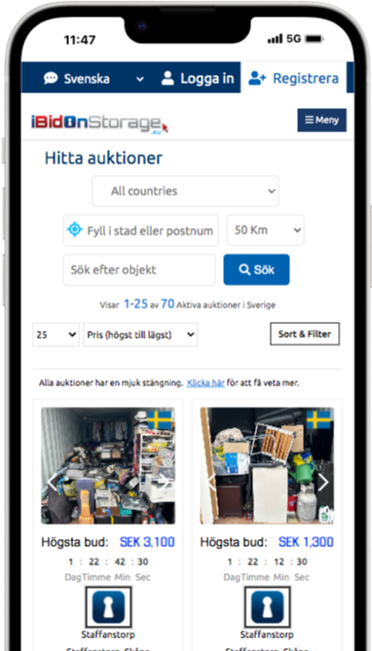
www.ibidonstorage.eu | www.ibidonstorage.co.uk
HISTORY OF ONLINE STORAGE AUCTIONS
Online storage auctions dedicated specifically to the self-storage industry began gaining traction in the 2010’s, with a few notable milestones:
Key Timeline:
2009–2011: The concept of online storage auctions emerged more visibly, largely due to the popularity of TV shows like Storage Wars (which debuted in 2010) and Auction Hunters.
2011: Launch of Opentech’s StorageTreasures.com, one of the first and still the largest dedicated online storage auction platforms. Today they list over 50,000 auctions a month.
2012–2014: The model began to scale as storage operators saw it as a way to reduce the cost and complexity of hosting in-person auctions.
2015 onward: Online storage auctions became an industry norm, supported by increasing digitization across the storage industry.
2020: Launched in UK and Europe with iBidOnStorage.
It is estimated that over 80% of all abandoned storage contents in mature markets like the US and Australia, are now sold through dedicated online storage auctions. This is because it works.

Slide 5
INTRODUCING EUROPEAN STORAGE AUCTIONS: iBidOnStorage.eu
www.ibidonstorage.eu | www.ibidonstorage.co.uk
  Created by Industry Specialists based on the industry’s needs.
  The iBidOnStorage software has been operating in Canada and the US for over a decade. It is tried and tested.
  The UK and Europe’s first dedicated auction platform specialising in Self Storage Auctions.
  Allowing industry members to follow ONE process, mitigating risks and ensuring faster clearance of abandoned contents
  Sold over 14,000 units in the UK and Europe since 2020, with 25,000+ registered bidders.
  And we sell for over 250 brands (1,000+ facilities) including Pelican Self Storage, Green Storage, 1Box, Lagerbox, Safestore, Access Self Storage, Hyrbox, Storage King and Prinsens Lager.
  Sweden and Denmark our best results: average price of €200+ in Europe and closer to €300 in Sweden (SEK 3,220) and Denmark €250 (DKK 1,860).

Slide 6
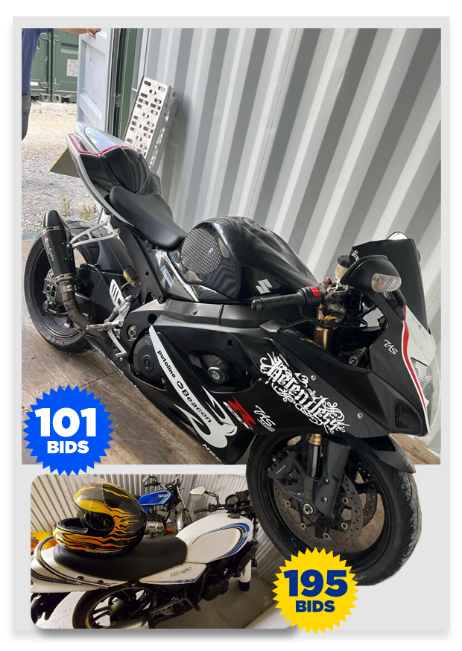
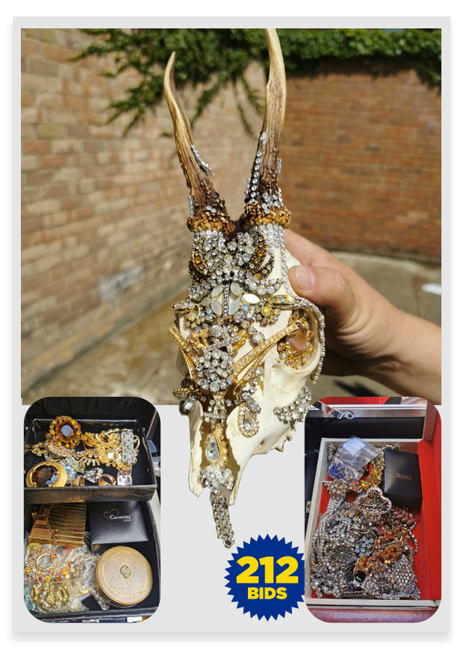
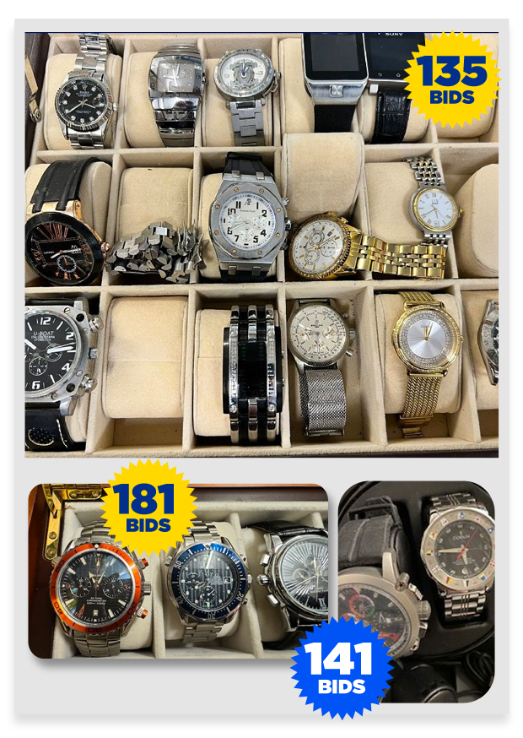
THE WEIRD AND WONDERFUL FINDS
If you can think it we have sold it!
www.ibidonstorage.eu | www.ibidonstorage.co.uk
Motorcycles
Jewel Encrusted Skulls?
Branded Watches

Slide 7
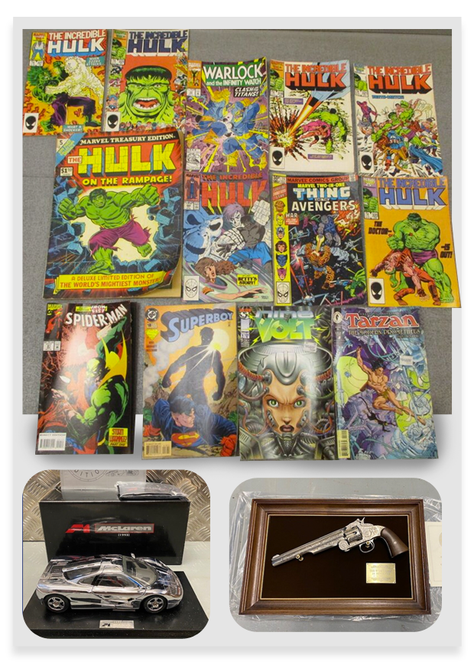
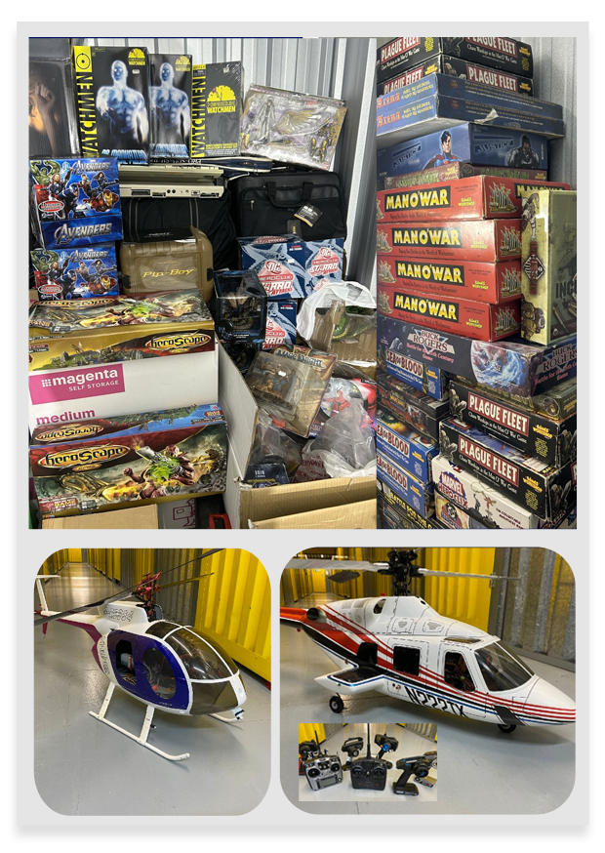
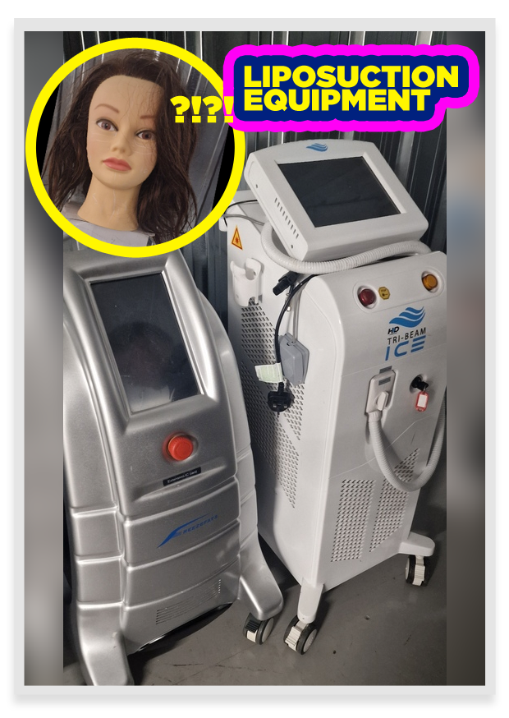
THE WEIRD AND WONDERFUL FINDS
www.ibidonstorage.eu | www.ibidonstorage.co.uk
Collectables
Liposuction Equipment

Slide 8
www.ibidonstorage.eu | www.ibidonstorage.co.uk
DON’T RISK IT.
The risky business of selling a customer’s contents:
  Nobody wants to sell a customer’s contents. It’s the riskiest element of operating a storage business. If you can’t prove the market set the price secured for a unit, you are at risk and could be facing a reputation or litigation risk. Join 1,000 storage facilities in the UK and Europe that are selling the right way. The more operators following the same selling process will protect your storage business and the industry as a whole.
  Never dispose the contents of a customer’s storage unit assuming it has no commercial value. This involves RISK. List the unit on iBidOnStorage and if it does not receive a bid, then “the market” has told you it has no value. Result = RISK mitigated.
  Furthermore, to mitigate risk, all sellers can include their own terms and conditions for each auction.

Slide 9

WHY ONLINE AUCTIONS WORK
www.ibidonstorage.eu | www.ibidonstorage.co.uk
A public auction is best because an operator must be seen to have made reasonable attempts to secure the best possible price
It takes seconds to list an auction and there is no time-wasting negotiating with auctioneers.
Empty your unit at NO COST: No collection fees, No admin fees or hidden costs and No ongoing commitment
The iBid platform sells over 90% of units listed and ALL goods are removed too.
You will be paid within 5 working days of the auction closing
Sell anonymously (if required); showing your brand gives the auction more credibility.

Slide 10









www.ibidonstorage.eu | www.ibidonstorage.co.uk
ADVANTAGES OF USING OUR PLATFORM
Higher prices & faster clearance of unwanted goods
Take control through simplicity - you choose the auction parameters
Advertising to achieve better results
Achieved through a larger, targeted audience. Bidders have 72 hours to collect goods at their cost, so units can be re-let to paying customers
You choose the auction parameters. List auctions, modify auction contents and remove auctions at any time at no cost.
We actively promote current and upcoming auctions via social media and automated emails are sent to buyers within 200 mile proximity of a Sellers facilities to generate maximum interest.

Slide 11

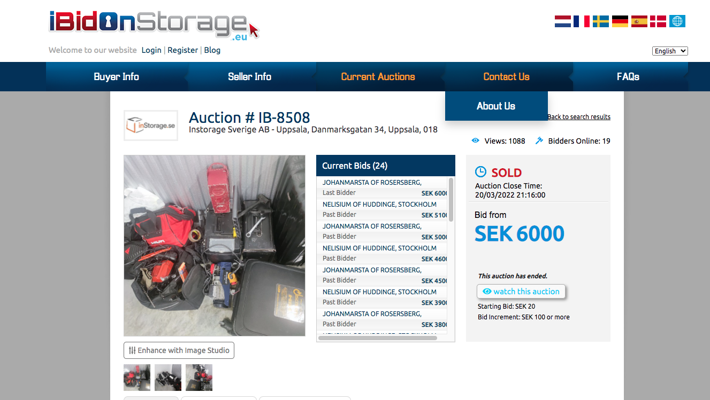

MARKETING
www.ibidonstorage.eu | www.ibidonstorage.co.uk
We send approximately 50,000 emails per month to European bidders informing them of auctions listed or soon to be sold.
We average 250,000 website views a month on our European site.

Slide 12



www.ibidonstorage.eu | www.ibidonstorage.co.uk
MORE ADVANTAGES OF USING OUR PLATFORM
Nothing but storage
auctions
Mandatory cleaning deposit
All sold units are archived
Minimising the risk of auctions going unnoticed on sites that sell everything.
The winning buyer pays a refundable cleaning deposit as an assurance they will “take everything in the unit”.
All data associated with your auction gets archived (bidding history, number of views, pictures, date and time).

Slide 13
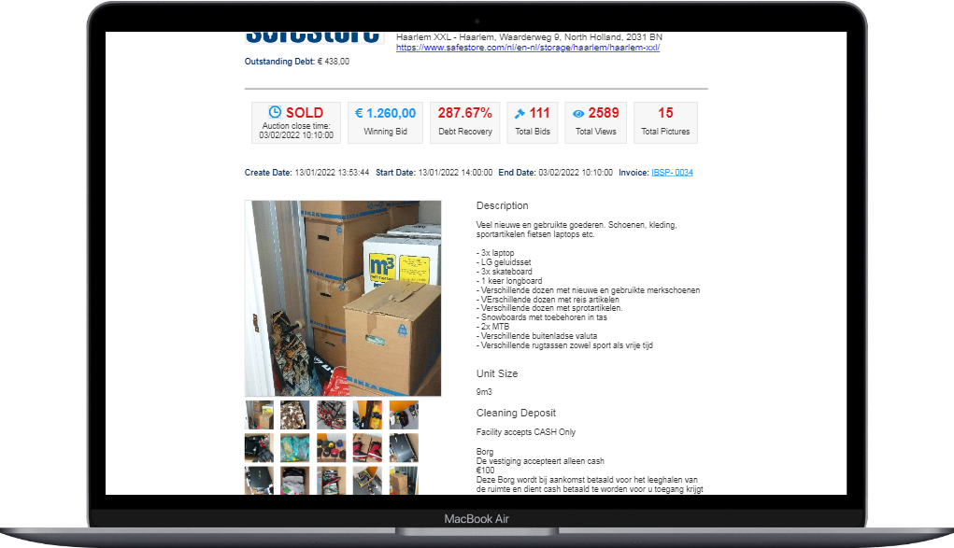
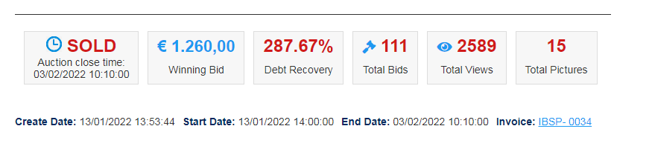
CONTINUOUS INNOVATION
www.ibidonstorage.eu | www.ibidonstorage.co.uk
Download Audit Trail of Auction Results, proving that the market set the price and mitigating their Seller risk.
Improving Bidder Integrity Through Triggers: record individual device IDs, credit card info, passwords, physical address etc
Cater for Manless facilities: We administer Cleaning Deposits, ensure sellers can send gate or unit IDs
Introduced AI to identify if goods are left inside units, if cleared the seller can release the Cleaning Deposit

Slide 14
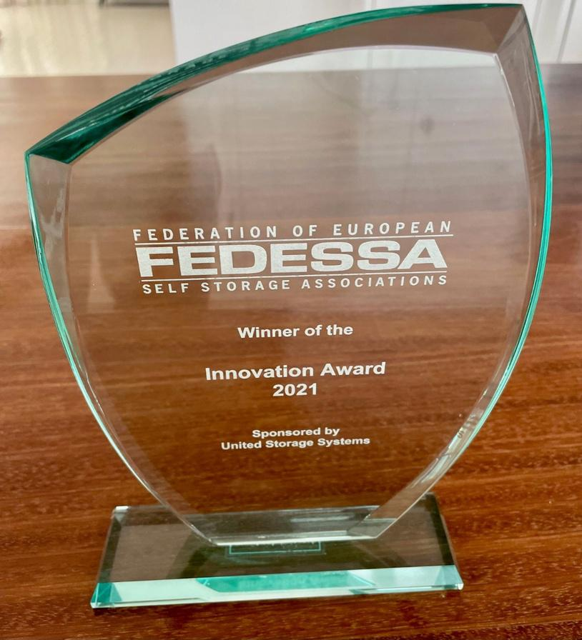
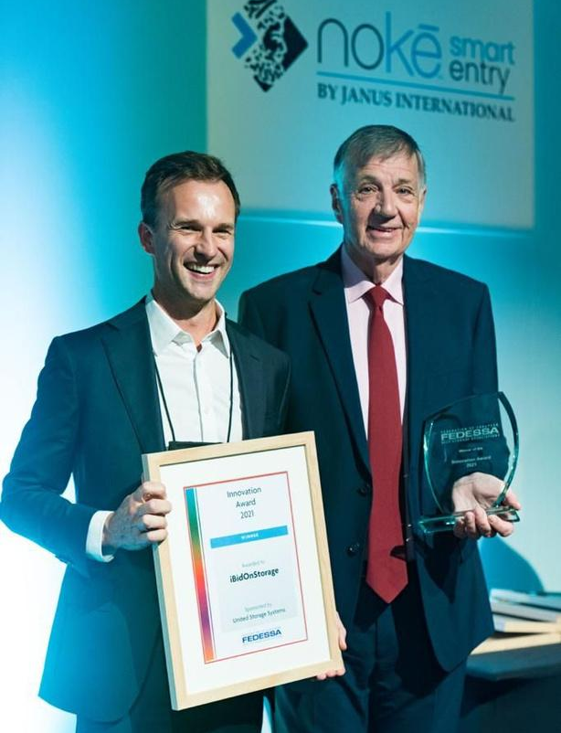
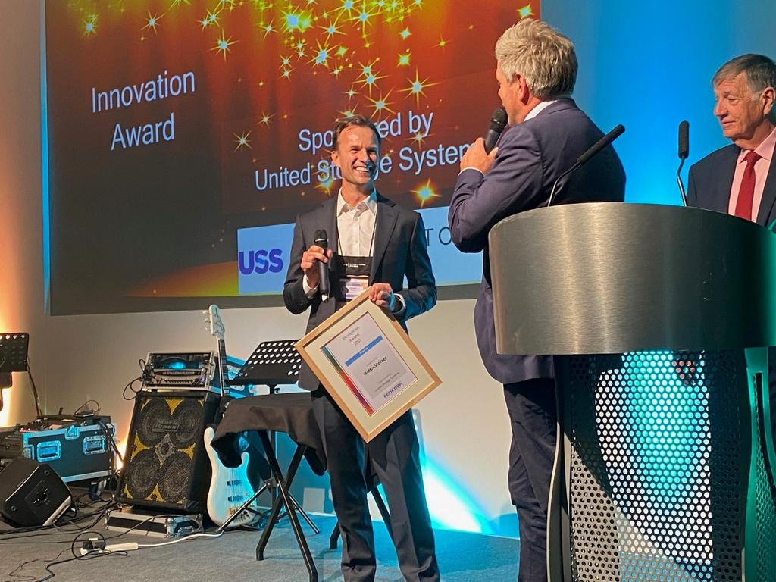
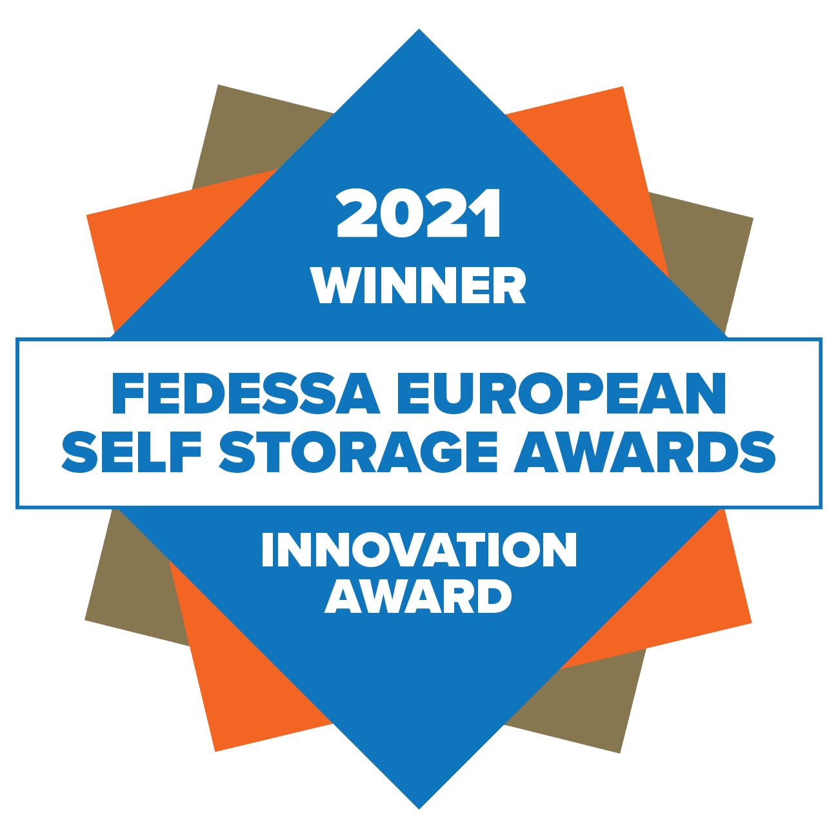


Winners of the FEDESSA Innovation Award - 2021
Finalist for the SSAUK 2023 & 2025 Innovation Award at the Self-Storage Conference & Tradeshow in Birmingham and Telford, United Kingdom.

Slide 15

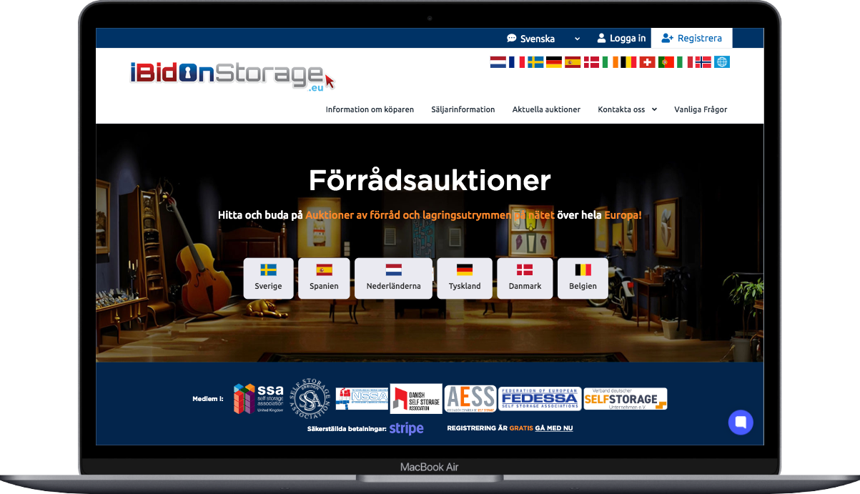

www.ibidonstorage.eu | www.ibidonstorage.co.uk
OUR TECHNOLOGY
We can integrate with self storage software
Purpose built storage auction platform – Our website is not wordpress or another off the shelf website with plugins. iBidOnStorage is purpose built by self storage operators for the self storage industry and includes soft-close too.
We can and do make bespoke changes when requested by operators.

Slide 16
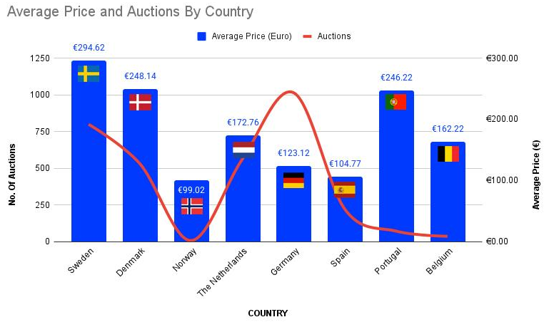
“SHOW US THE MONEY”
www.ibidonstorage.eu | www.ibidonstorage.co.uk
United Kingdom
No. of Auctions: 9,100
Average Price (€):
€240

Slide 17
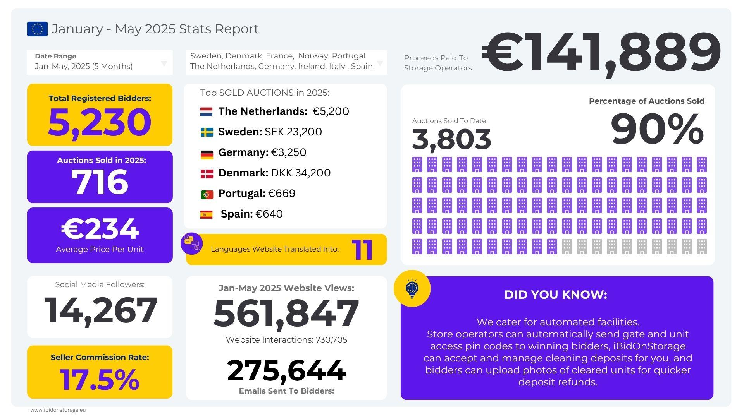
WHAT DO THE STATS SAY
www.ibidonstorage.eu | www.ibidonstorage.co.uk

Slide 18



www.ibidonstorage.eu | www.ibidonstorage.co.uk
WHAT DO OUR SELLERS SAY ABOUT US
“Since we started to use iBidOnStorage to sell all our abandoned units we have seen a significant increase in the value we get out of a unit - with zero costs. We also see a great benefit in being able to download all the auction results with full details, which we believe reduces our risks substantially.”
"We recommend all our franchisees to use IBidOnStorage and so far all our advertised units have been sold. It's a quick and easy way to make the unit available to a new customer with a small amount of work and the unit is sold at a price that the market determines."
"In the past, the process of emptying storage facilities was associated with costs and a lot of work. With iBidOnStorage, we save time, reduce costs and can document the entire process from start to finish. This service has become an important part of our daily operations."
Thomas Espemo,
Pelican Self Storage - Sverige
Jörgen Gomander,
Lagerkungen - Sverige
Ann-Kristin Hartmann,
HYRBOX Self-Storage - Sverige

Slide 19
www.ibidonstorage.eu | www.ibidonstorage.co.uk
CAN WE SELL ABANDONED UNITS IN OUR COUNTRY USING IBIDONSTORAGE?
The short answer: YES!
  iBidOnStorage is not in a position to offer a legal solution to circumvent or streamline the laws relating to the sale of a customer’s stored items – in any country. We offer a solution at the point when a storage unit has been through your own recommended default process based on the signed storage contract and local legislation.
  Storage operators will make their own decision to follow the letter of the law, while others may make a commercial decision that the risk of litigation is low and to sell prior to a tedious and expensive legal process. iBidOnStorage is the solution at the point of sale for both these options.
  Whatever method you choose to sell - There is the possibility that a customer will litigate but we mitigate this risk by being able to prove the market set the price achieved.

Slide 20
IN SUMMARY – WE UNDERSTAND WHAT OPERATORS WANT
www.ibidonstorage.eu | www.ibidonstorage.co.uk
We understand firsthand what storage operators need most when it comes to removing abandoned items efficiently and profitably.
Sell Abandoned Contents with Confidence and Minimise Risk
Access detailed auction reports for every sale, ensuring full transparency and proof that the market determined the final price.
Fast & Easy Clearance
Unit clearance within 72 hours of the auction closing—at no cost to you. The winning bidder handles the removal at his cost, so you don’t have to.
Minimal Admin, Maximum Efficiency
Listing an auction takes just two minutes, and we handle all payment processing. As soon as the auction closes, we charge the winning bidders bank card and pay our operators within five working days. If payment issues arise, we take care of all follow-ups until it’s resolved.

Slide 21
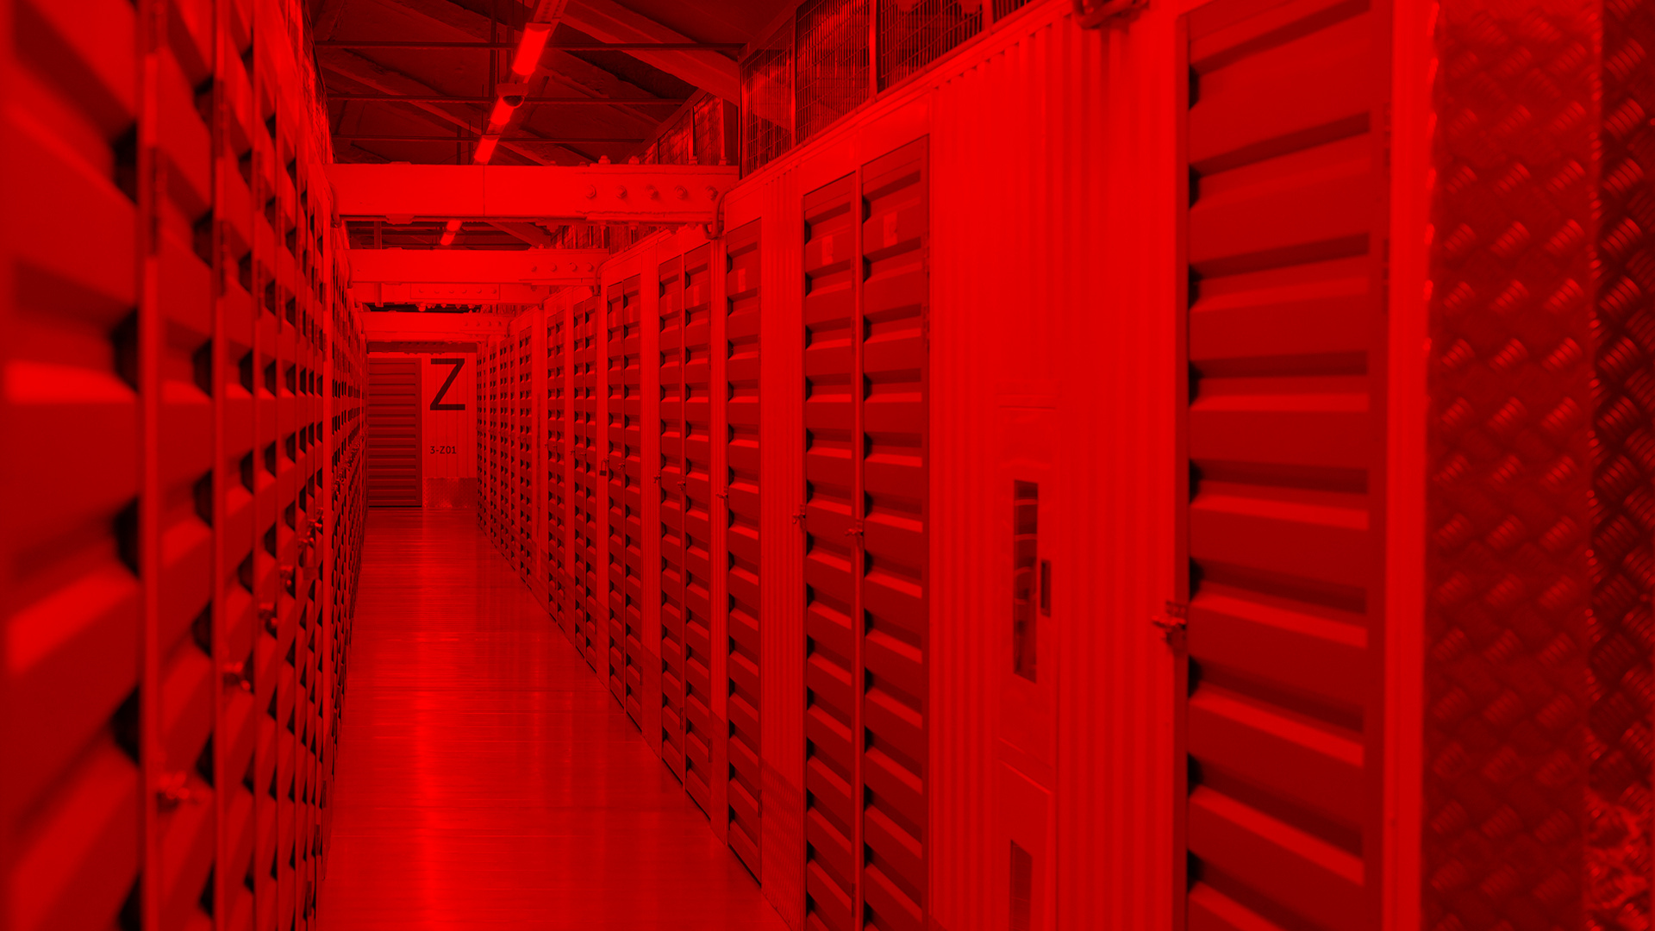
THANK YOU
Register, List and Sell in minutes.
www.ibidonstorage.eu

